Slide 1
Tomorrow’s Internet must sleep more and grow old
Romain Jacob
Laurent Vanbever
nsg.ee.ethz.ch @
ETH Zürich
RIPE 87
Nov. 27, 2023

Slide 2
What do you think consumes more energy?
Data Centers
Telco Networks

Slide 3
What do you think consumes more energy?
Point this way
Data Centers
Telco Networks
Point that way
or

Slide 4
What do you think consumes more energy?
Data Centers
Telco Networks
or
In 2022
240-340
TWh
260-360
TWh
https://www.iea.org/energy-system/buildings/data-centres-and-data-transmission-networks

Slide 5
What do you think consumes more energy?
Data Centers
Telco Networks
or
In 2022
240-340
TWh
260-360
TWh
In 2015
200
TWh
220
TWh
Change of
+20-70%
in energy
+18-64%
in energy
https://www.iea.org/energy-system/buildings/data-centres-and-data-transmission-networks

Slide 6
What do you think consumes more energy?
Data Centers
Telco Networks
or
In 2022
240-340
TWh
260-360
TWh
In 2015
200
TWh
220
TWh
Change of
+20-70%
in energy
+18-64%
in energy
+340%
in workload
+600%
in traffic
https://www.iea.org/energy-system/buildings/data-centres-and-data-transmission-networks

Slide 7
Energy efficiency improved a lot
Data Centers
Telco Networks
Change in energy
than in work done.
+20-70%
in energy
+18-64%
in energy
is much smaller
+340%
in workload
+600%
in traffic

Slide 8
Energy efficiency improved a lot but not enough!
Data Centers
Telco Networks
Change in energy
is positive!
+20-70%
in energy
+18-64%
in energy

Slide 9
With great power comes great responsibility”
“
It is easy to keep
increasing network capacity
It is much harder to keep
increasing energy efficiency

Slide 10
With great power comes great responsibility”
“
It is easy to keep
increasing network capacity
It is much harder to keep
increasing energy efficiency
Total energy usage is
likely to keep increasing.

Slide 11
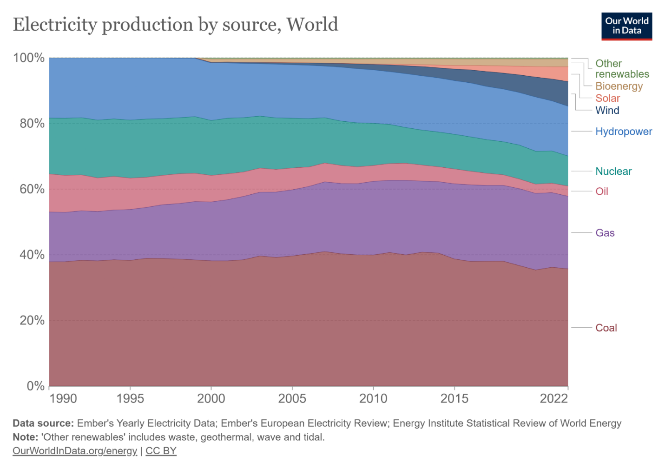
With great power comes great responsibility” and carbon footprint.
“
It is easy to keep
increasing network capacity
It is much harder to keep
increasing energy efficiency
60% of the world’s energy comes from
carbon-intensive sources
Total energy usage is
likely to keep increasing.
Producing energy
emits carbon.
https://ourworldindata.org/grapher/electricity-prod-source-stacked

Slide 12
Tomorrow’s Internet must sleep more and grow old
to reduce its carbon footprint.
1
Reduce operational footprint
with better proportionality
2
Reduce embodied footprint
with sustainable procurement

Slide 13
Tomorrow’s Internet must sleep more and grow old
to reduce its carbon footprint.
1
Reduce operational footprint
with better proportionality
Reduce embodied footprint
with sustainable procurement

Slide 14
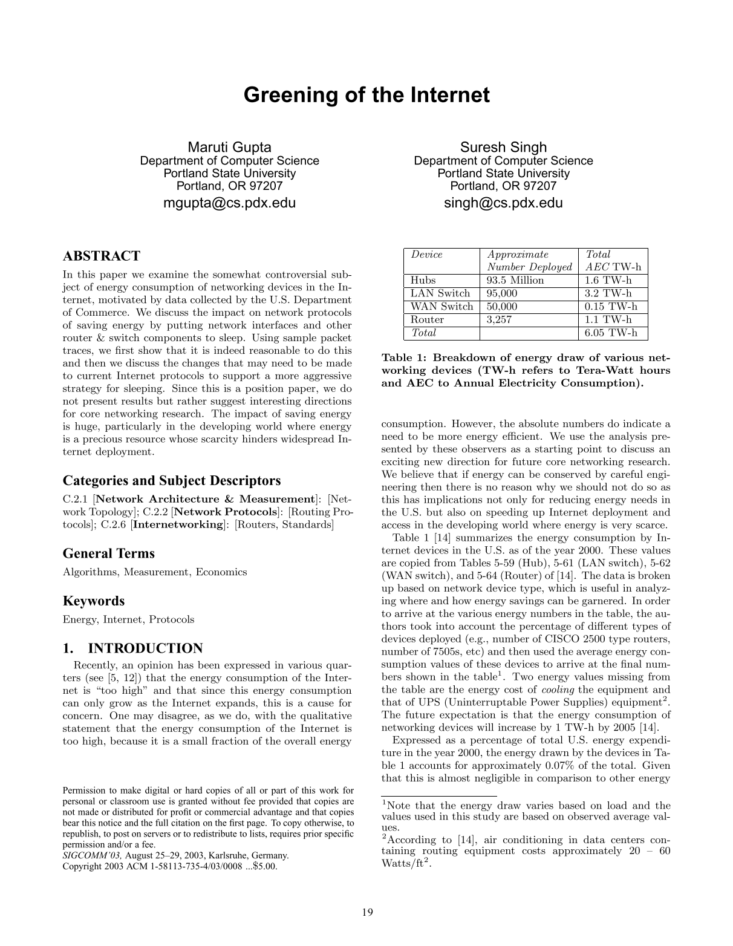
SIGCOMM 2003
The Internet core consumes
more Joules per Bytes
than wireless LANs.

Slide 15
SIGCOMM 2003
The Internet core consumes
more Joules per Bytes
than wireless LANs.
2x and 24x more...
depending on your hypotheses

Slide 16
1
Network devices
are always “on.”

Slide 17
1
Network devices
are always “on.”
2
Network devices’ energy consumption
is mainly independent of traffic load.

Slide 18
1
Network devices
are always “on.”
2
Network devices’ energy consumption
is mainly independent of traffic load.
3
Network devices
are under-utilized.
ISP overprovision
networks to support
Peak traffic
Fault tolerance

Slide 19
1
Network devices
are always “on.”
2
Network devices’ energy consumption
is mainly independent of traffic load.
3
Network devices
are under-utilized.
ISP overprovision
networks to support
Peak traffic
Fault tolerance

Slide 20
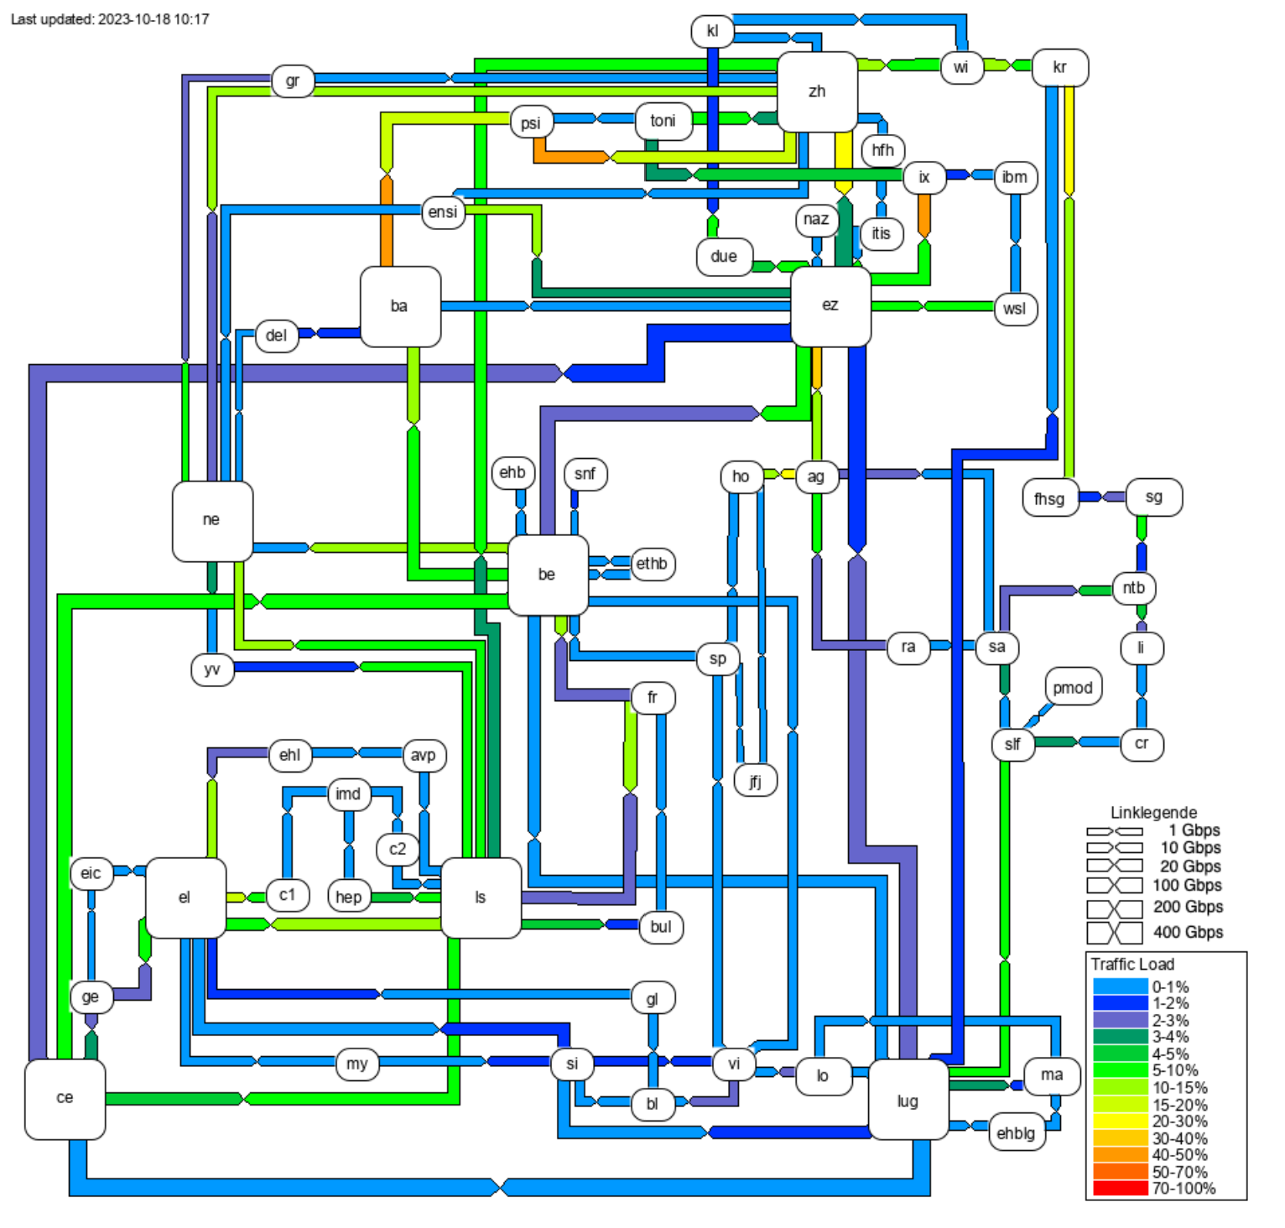
ISP overprovision
networks to support
Peak traffic
Fault tolerance
[ Weathermap data from SWITCH ]

Slide 21
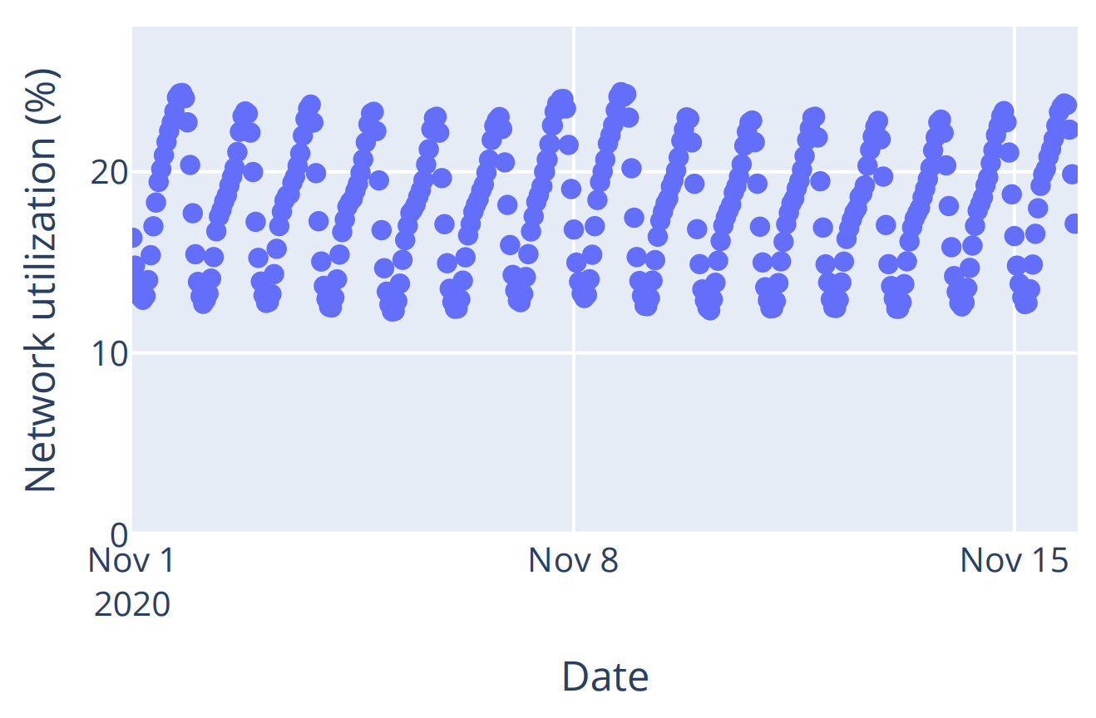
ISP overprovision
networks to support
Peak traffic
Fault tolerance
[ OVH Weathermap dataset ]

Slide 22
what you get
what you want
1
Network devices
are always “on.”
2
Network devices’ energy consumption
is mainly independent of traffic load.
3
Network devices
are under-utilized.
ISP overprovision
networks to support
Peak traffic
Fault tolerance

Slide 23
There two ways to improve energy efficiency
what you get
what you want
Run more often at high utilization
“
Buffer-and-Burst”
Time-shifting

Slide 24
There two ways to improve energy efficiency
what you get
what you want
Run more often at high utilization
“
Buffer-and-Burst”
Time-shifting
Take low-utilization power down
Ideally, do both.

Slide 25
The basic idea is to turn off
“stuff” whenever possible.
What can we possibly turn off?
Ports
Line cards
Entire device...

Slide 26
The basic idea is to turn off
“stuff” whenever possible.
What can we possibly turn off?
Ports
Line cards
Entire device...
Memory banks
Power supplies
LEDs
... etc.

Slide 27
The basic idea is to turn off
“stuff” whenever possible.
What can we possibly turn off?
It can be more subtle than on/off.
Ports
Change a port rate
from 100G to 10G
Line cards
Down-clock the ASIC
Entire device...
Cache frequently
used FIB entries
Memory banks
Power supplies
LEDs
... etc.

Slide 28
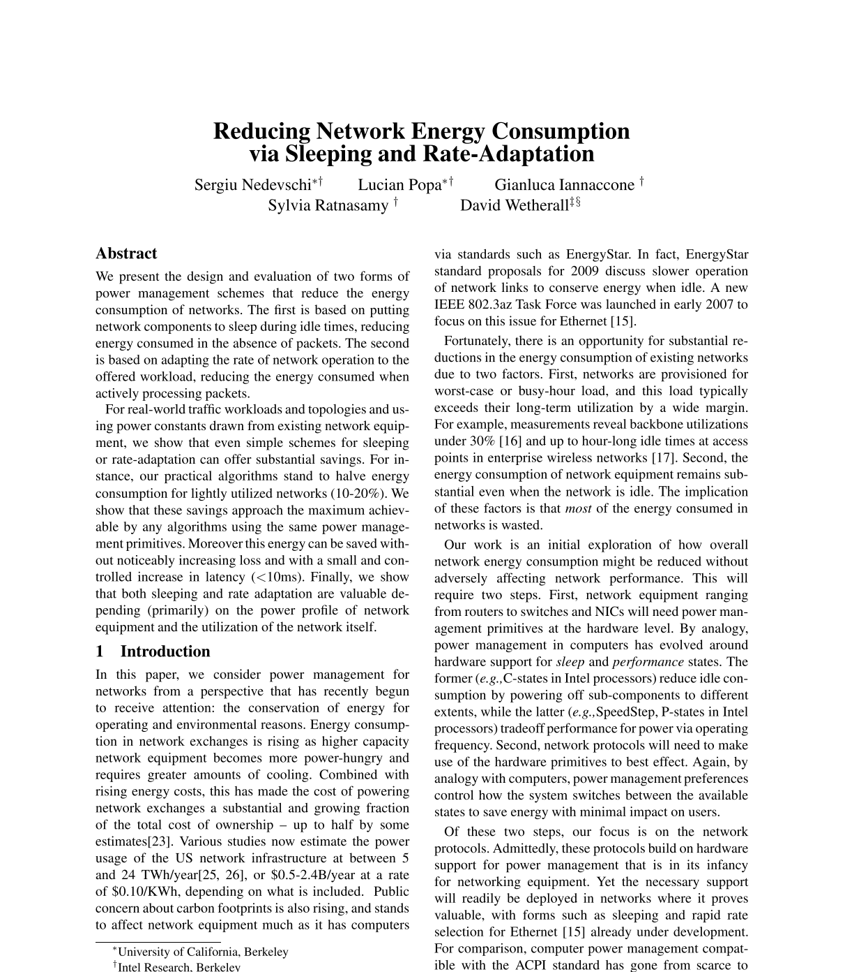
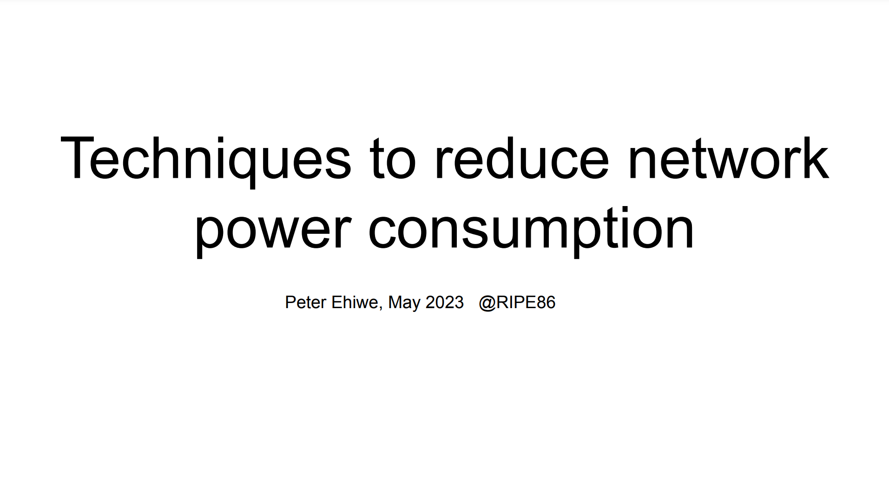
The basic idea is to turn off
“stuff” whenever possible. That’s nothing new.
Academia
NSDI 2008
RIPE
86

Slide 29
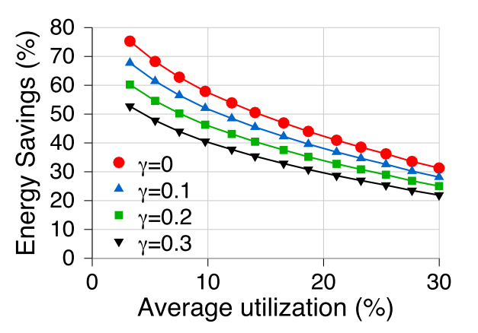
The theory says we can save tens of energy % in ISP networks.
Academia
Energy Savings (%)

Slide 30
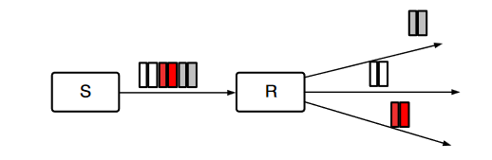


The theory says we can save tens of energy % in ISP networks.
Academia
How?
Buffer-and-Burst
Assuming
Wake-up delay $1ms$
Buffering time $10ms$

Slide 31
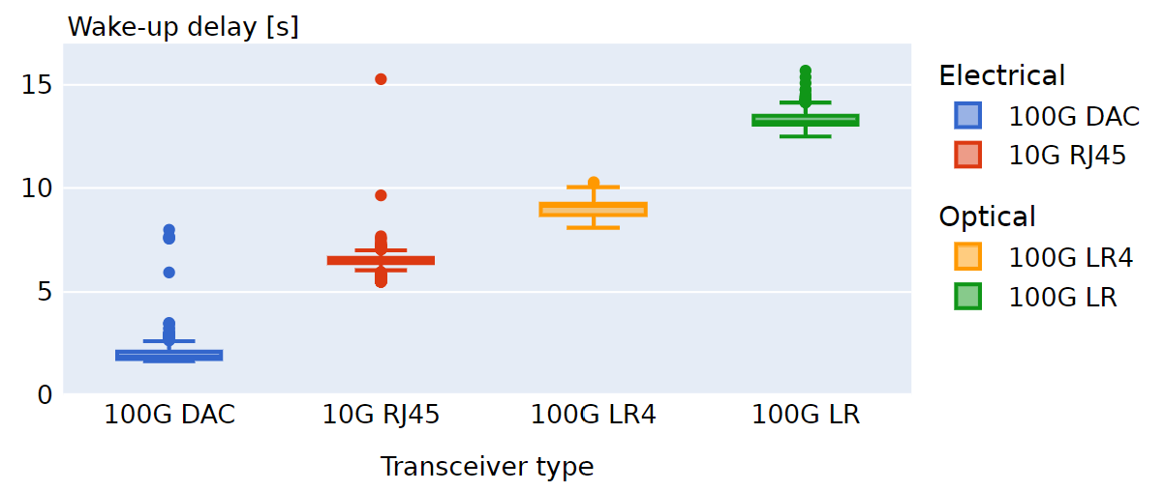
Practice
Theory
Wake-up delay
(s)
Measured on
Cisco Nexus 9300
How?
Buffer-and-Burst
Assuming
Wake-up delay $1ms$
Buffering time $10ms$

Slide 32
In practice, transcievers are 1000x slower to start than required for savings via buffering.
Wake-up delay
(s)
Measured on
Cisco Nexus 9300
How?
Buffer-and-Burst
Assuming
Wake-up delay $1ms$
Buffering time $10ms$

Slide 33
We can still “sleep” at longer timescales.

Slide 34
We can still “sleep” at longer timescales.
How to play nice with routing?
Which signal to use for
sleeping and wake-up control?
How much sleeping affects traffic?
And in case of bursts?

Slide 35
We can still “sleep” at longer timescales.
How to play nice with routing?
Easy, because wake-up is slow!
Which signal to use for
sleeping and wake-up control?
How much sleeping affects traffic?
And in case of bursts?

Slide 36
We can still “sleep” at longer timescales.
How to play nice with routing?
Easy, because wake-up is slow!
Which signal to use for
sleeping and wake-up control?
Link utilization works
Easy to collect with OSPF-TE
How much sleeping affects traffic?
And in case of bursts?

Slide 37
We can still “sleep” at longer timescales.
How to play nice with routing?
Easy, because wake-up is slow!
Which signal to use for
sleeping and wake-up control?
Link utilization works
Easy to collect with OSPF-TE
How much sleeping affects traffic?
And in case of bursts?
Very little, actually.

Slide 38
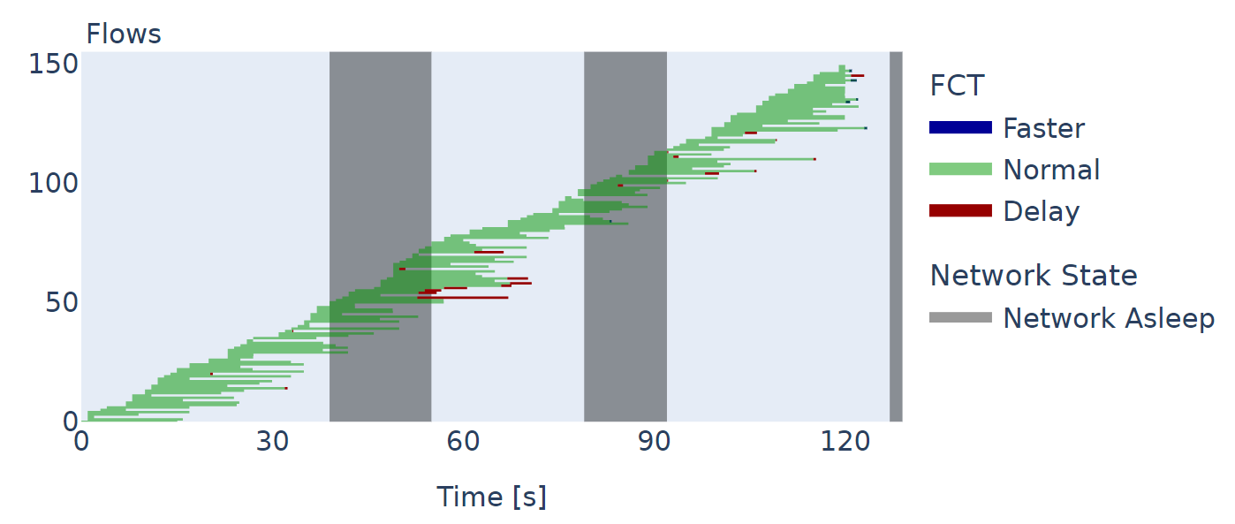
Network Wake-up

Slide 39
Only the flows that would finish
when the network wakes up
may suffer some FCT increase
Network Wake-up

Slide 40
We see no extra loss and little FCT increase because TCP is doing its job decently well.
Only the flows that would finish
when the network wakes up
may suffer some FCT increase
We had to work “hard”
to even see an effect...
Network Wake-up

Slide 41
We can still “sleep” at longer timescales
Ultimately, it is very similar
to a traditional TE problem.

Slide 42
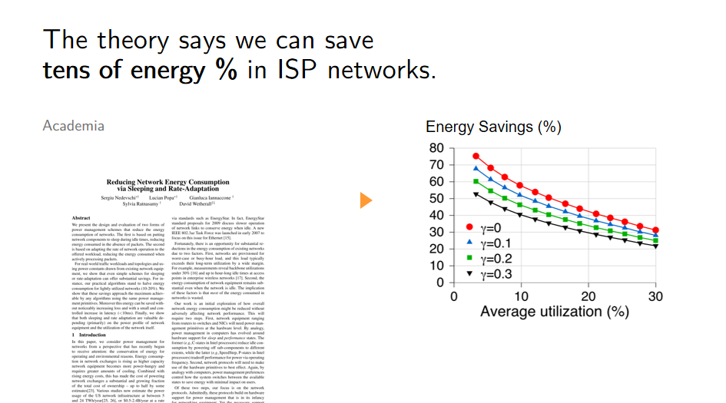
How much energy can we really save?

Slide 43
How much energy can we really save?
Hard to say because we lack
1
Measurements
2
Test cases

Slide 44
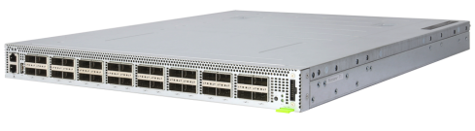
Energy savings are hard to estimate because we lack good power models.
Datasheets only talk
about the max power
Devices are never
under full load

Slide 45
Energy savings are hard to estimate because we lack good power models.
Datasheets only talk
about the max power
Devices are never
under full load

How much power is drawn
under “typical” load?

Slide 46
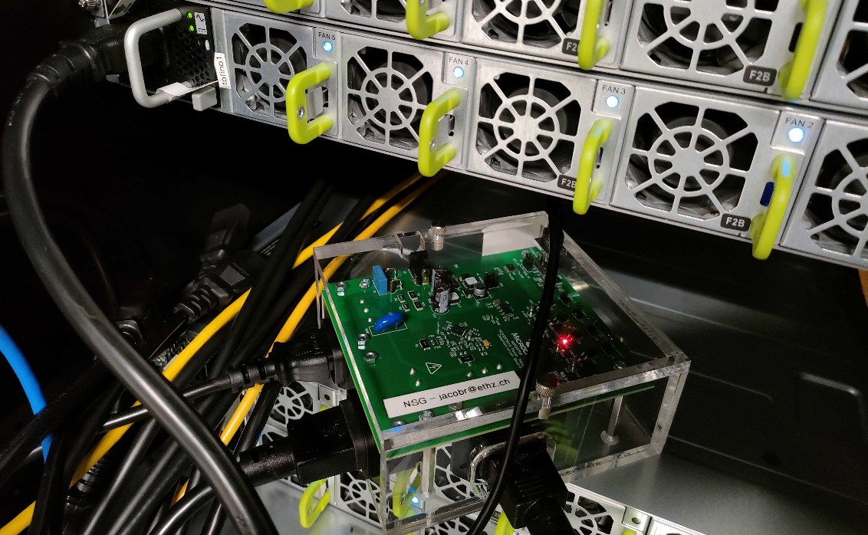
Energy savings are hard to estimate because we lack good power models.
... so we are building our own ...
Profiling a Tofino switch
WEDGE 100BF-32X
Wedge switch
Power meter

Slide 47
Energy savings are hard to estimate because we lack good power models.
... so we are building our own ...
Device power =
+ Static power
f(device config)
+ Energy per bit * bit rate
+ Energy per packet * packet rate
+ Fan power
~
f(temperature)
+ Power conversion losses
f(power demand)

Slide 48
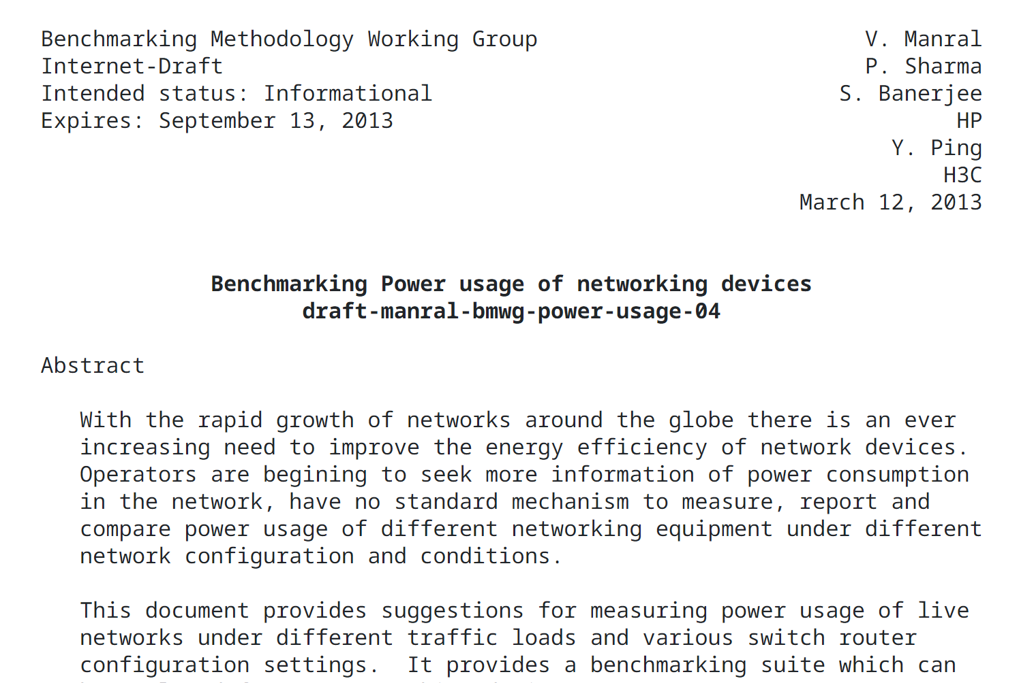
We discuss with the IETF to establish a benchmark for instantiating such models.
Reviving this expired draft
with inputs from
Carlos Pignataro
<add-your-name-here>

Slide 49
We have a modelling approach.
You have devices that need modeling.
Academics have limited access
to devices used in the field.

Can we measure yours?

Slide 50

We have a modelling approach.
You have devices that need modeling.
Academics have limited access
to devices used in the field.

Can we measure yours?
We sent you hardware
You plug it in
<your address>
Everyone gets
data!


Slide 51
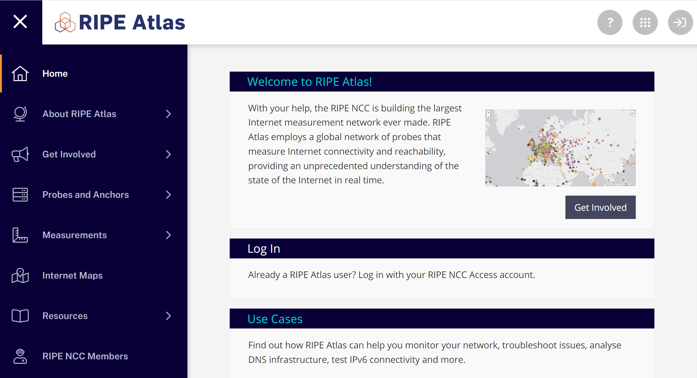
Academics have limited access
Vision
to devices used in the field.
RIPE Atlas for Power Data

Can we measure yours?
We sent you hardware
You plug it in
<your address>
Everyone gets
data!


Slide 52
How much energy can we really save?
Hard to say because we lack
1
Measurements
2
Test cases

Slide 53
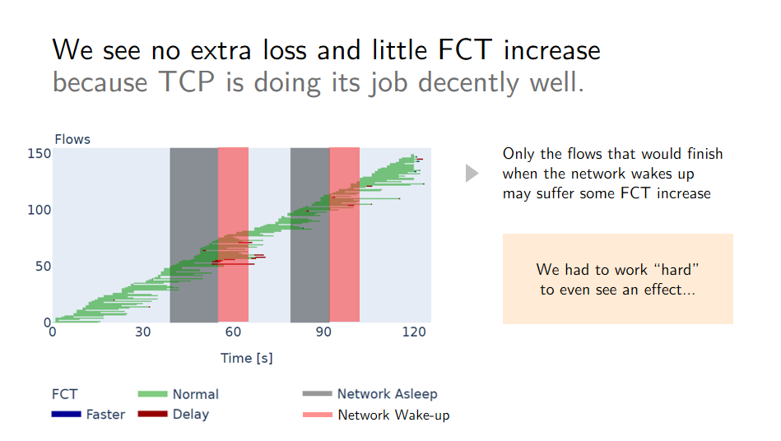
Energy savings are hard to estimate because they depend on the network.
Anything can happen
in simulation.
We need real traffic dynamics
to accuratly assess
the impact of sleeping.

Can we get yours?

Slide 54
Tomorrow’s Internet must sleep more and grow old
to reduce its carbon footprint.
1
Reduce operational footprint
with better proportionality
We can “sleep” at daily timescales
one in many ideas for better proportionality
We need your help
to know if it is worth it

Slide 55
Tomorrow’s Internet must sleep more and grow old
to reduce its carbon footprint.
Reduce operational footprint
with better proportionality
2
Reduce embodied footprint
with sustainable procurement

Slide 56
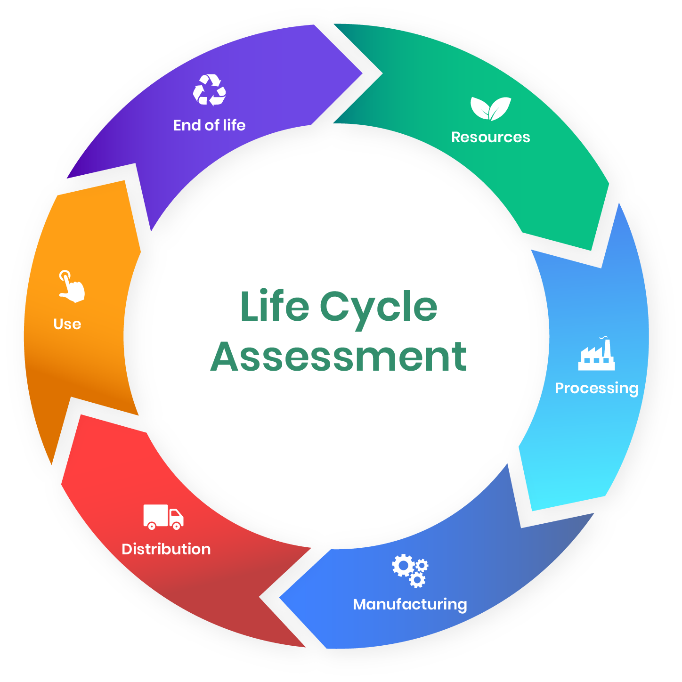
Embodied carbon refers to the footprint of producing and recycling a product.
embodied
operational
https://www.oneclicklca.com/life-cycle-assessment-explained/

Slide 57
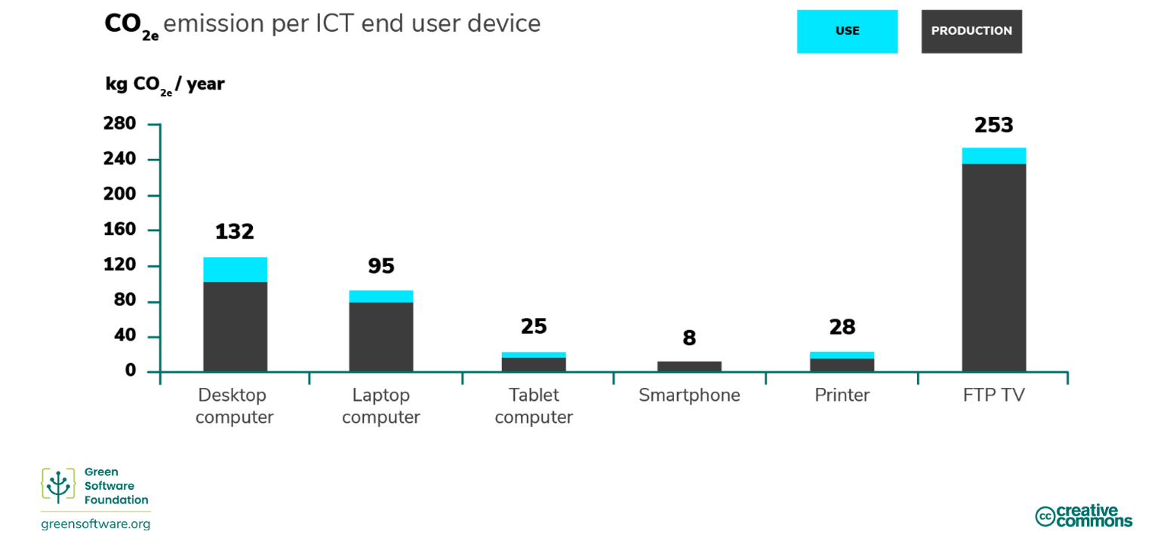
For consumer devices, the embodied footprint dominates.
https://learn.greensoftware.foundation/

Slide 58
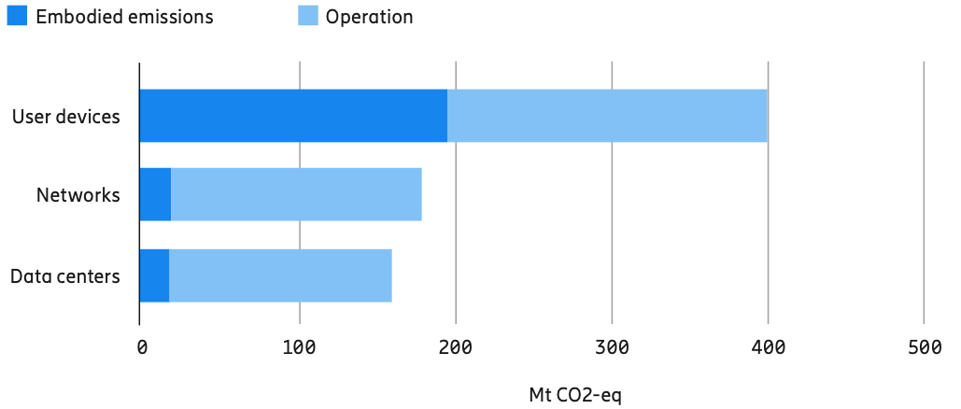
For networked devices, it tends to be the opposite
Embodied emissions
Operational emissions
Data from 2015
User devices
Networks
Data centers
https://www.ericsson.com/en/reports-and-papers/industrylab/reports/a-quick-guide-to-your-digital-carbon-footprint

Slide 59
For networked devices, it tends to be the opposite because the operational footprint is huge!
Embodied emissions
Operational emissions
Data from 2015
User devices
Networks
Not because better built or recycled
Because “use” phase consumes
a lot more in proportion
Data centers
https://www.ericsson.com/en/reports-and-papers/industrylab/reports/a-quick-guide-to-your-digital-carbon-footprint

Slide 60
Reducing the embodied footprint is simple:
Use hardware longer.
Today
Refresh rates are
around 3-5 years
only.
Easy to extend
Useful Life of IT Network Equipment: Assets & Perspective
icorps Technologies, 02/2015, Online.

Slide 61
Reducing the embodied footprint is simple:
Use hardware longer.
Today
Refresh rates are were
around 3-5 years
Recently
only.
Easy to extend
Useful Life of IT Network Equipment: Assets & Perspective
icorps Technologies, 02/2015, Online.

Slide 62
Okay, but
Today
Refresh rates are were
around 3-5 years
Wouldn’t this make networks
Recently
only.
Less reliable
Less secure
Easy to extend
Harder to manage
?

Slide 63
Okay, but
Today
Refresh rates are were
around 3-5 years
Wouldn’t this make networks
Recently
only.
Less reliable
Less secure
Easy to extend
Harder to manage
?
Not necessarily.

Slide 64
“Older” networks are not necessarily less reliable.
The vast majority of network
hardware failures take place within
the first 30 days of installing brand new, out-of-the-box network hardware.
CXTEC
Surprising truth about network hardware failures.
CXTEC, 03/2022, Online.

Slide 65
“Older” networks are not necessarily less reliable.
The vast majority of network
hardware failures take place within
the first 30 days of installing brand new, out-of-the-box network hardware.
CXTEC
Surprising truth about network hardware failures.
CXTEC, 03/2022, Online.
Manufactured products typically fail
following a “bathtub” profile.

Slide 66
Devices that never failed in 3 years are unlikely to fail anytime soon after.
Two hints in that direction
Main vendors
usually provide
5 year support
after end-of-sale.

Slide 67
Devices that never failed in 3 years are unlikely to fail anytime soon after.
Two hints in that direction
Main vendors
usually provide
5 year support
after end-of-sale.
Specilized companies
even provide
unlimited warranties
for refurbished network hardware.

Slide 68
We must understand better the aging of networking devices.
What are the practical consequences
of operating older devices?
When do aging effects appear?

Slide 69
We must understand better the aging of networking devices.
When does it really make sense
to renew networking hardware?
What are the practical consequences
of operating older devices?
When do aging effects appear?
3
years
5
15
more
?

Slide 70
To answer that question, we need data.
When does it really make sense
to renew networking hardware?

When do you renew
your hardware?

Why do you renew?
What failures do you see in practice?

3
years
5
15

When and where
do they occur?
more
?

Slide 71
Okay, but
Wouldn’t this make networks
Less reliable
Less secure
Let’s talk
offline.
Harder to manage
Not necessarily.

Slide 72
Tomorrow’s Internet must sleep more and grow old
to reduce its carbon footprint.
2
Reduce embodied footprint
with sustainable procurement
You should renew when really needed
which saves both carbon and money
We can help you assess when that is

Slide 73
We need your help to help your network.

Slide 74
We need your help to help your network.
We need data.
Testing
Measurement
Procurement
Dev. data
Ops. data
CapEx data

Slide 75
We need your help to help your network.
We need data.
Academics
have
ideas
sometimes even good ones!
Operators
have
power

Slide 76
We need your help to help your network.
We need data.
Academics
have
ideas
sometimes even good ones!
Operators
have
power
to pay for every month.

Slide 77
We need your help to help your network.
We need data.
Academics
have
ideas
sometimes even good ones!
Operators
have
power
to pay for every month.
to change things in their network.

Let’s work together
Yes, we know what NDAs are.

Slide 78
Tomorrow’s Internet must sleep more and grow old
See you @ the BoF
Today, 18h, Side room
to reduce its carbon footprint.
1850
2018
Romain Jacob
Laurent Vanbever
jacobr@ethz.ch
lvanbever@ethz.ch
RIPE 87
Nov. 27, 2023
Climate stripes.
Ed Hawkins, 2018
portrays the increase of average global temperature

