Slide 1
RIPE 87 – Euro-IX Update
Bijal Sanghani

Slide 2
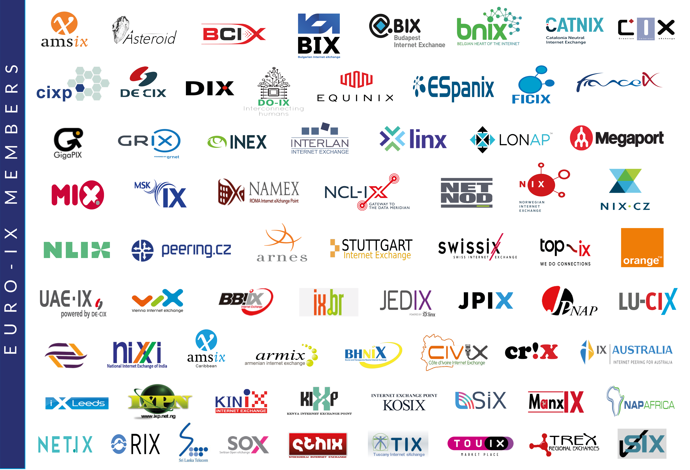

Slide 4
Membership Association of IXPs
Events
Services
Tools & Community Projects
Internet eXchange Point Database – IXPDB
Peering Toolbox
Fellowship & Mentor-IX
Working Groups
A new IXP Film
Two Membership events per year hosted by our Members
Workshops & hackathons
Online/ virtual workshops
Reports
Newsletters
Mailing list
IXP Benchmarking
Working groups

Slide 5
DE-CIX Update
Launch DE-CIX Nordics with locations in Copenhagen, Esbjerg, Helsinki, Kristiansand, Oslo, Stockholm (2024)
Launch DE-CIX Mexico with locations in Querétaro, Mexico City New traffic peaks a DE-CIX DFW, NYC, LIC and FRA.
Opening of DE-CIX Cloud Exchanges in key cloud hub locations offering cloud connectivity solutions that enable seamless, on-demand, direct access to cloud service providers. (Seattle RFS 12 Oct 2023; Amsterdam RFS 8 Nov 2023 (planned); Tokio/Osaka RFS 20 Dez 2023 (planned) )
The new Self-Service Portal is available for all customers, which allows on-demand ordering and provisioning of Interconnection services (e.g. Peering, Cloud Connectivity)
DE-CIX announced 5th location in the US: DE-CIX Phoenix
DE-CIX Dallas topped 300Gbps
DE-CIX Frankfurt topped at 10,7Tbps
IX-API: The work on Version 3 covering Monitoring and Statistics just started. Input on features and the specification is highly appreciated!
Slido.com: #1159050

Slide 6
DE-CIX Update
Traffic peaks in Dallas (880 Gbit/s), NYC (1,61 Tbit/s), Lisbon (78.3 Gbit/s), Madrid (1,29 Tbit/s), Marseille (350 Gbit/s), Munich (197 Gbit/s), FRA (16,62 Tbits), Dubai (598 Gbit/s)
The new Self-Service Portal is available for all customers, which allows on-demand ordering and provisioning of Interconnection services (e.g. Peering, Cloud Connectivity)
DE-CIX announced 5th location in the US: DE-CIX Phoenix
DE-CIX Dallas topped 300Gbps
DE-CIX Frankfurt topped at 10,7Tbps
IX-API: The work on Version 3 covering Monitoring and Statistics just started. Input on features and the specification is highly appreciated!
Slido.com: #1159050

Slide 7
BCIX Update
Finished our VXLAN/EVPN migration and enabled (ARP/)ND proxy
Turned up our first 400G customer ports
Refreshed our brand and logo to express simplicity, diversity and modernity
The new Self-Service Portal is available for all customers, which allows on-demand ordering and provisioning of Interconnection services (e.g. Peering, Cloud Connectivity)
DE-CIX announced 5th location in the US: DE-CIX Phoenix
DE-CIX Dallas topped 300Gbps
DE-CIX Frankfurt topped at 10,7Tbps
IX-API: The work on Version 3 covering Monitoring and Statistics just started. Input on features and the specification is highly appreciated!
Slido.com: #1159050

Slide 8
InterLAN Update
38th Euro-IX Forum hosted in Cluj-Napoca, Romania, 23-25 April 2023
Daily peak traffic over 500 Gbps 100 Gbps ports available in Bucharest and Frankfurt
Work in progress to implement Nokia routers in core and convert to EVPN
Adding support for 400Gbps ports
The new Self-Service Portal is available for all customers, which allows on-demand ordering and provisioning of Interconnection services (e.g. Peering, Cloud Connectivity)
DE-CIX announced 5th location in the US: DE-CIX Phoenix
DE-CIX Dallas topped 300Gbps
DE-CIX Frankfurt topped at 10,7Tbps
IX-API: The work on Version 3 covering Monitoring and Statistics just started. Input on features and the specification is highly appreciated!
Slido.com: #1159050

Slide 9
AMS-IX Update
AMS-IX had one of its biggest outages in history on 22/23 Nov
Problem was well understood and mitigated. Following up with vendors for permanent fixes
Will be a short lighting talk tomorrow at the plenary about this topic.
The new Self-Service Portal is available for all customers, which allows on-demand ordering and provisioning of Interconnection services (e.g. Peering, Cloud Connectivity)
DE-CIX announced 5th location in the US: DE-CIX Phoenix
DE-CIX Dallas topped 300Gbps
DE-CIX Frankfurt topped at 10,7Tbps
IX-API: The work on Version 3 covering Monitoring and Statistics just started. Input on features and the specification is highly appreciated!
Slido.com: #1159050

Slide 10
Peering Toolbox
Community Focused Learning Tool
10

Slide 11
Peering Toolbox
Website focused on learning:
Short sections with clear explanations of each topic
Easy for new entrants to discover what they need to make the best decisions for their network
Easy for organisations already peering to learn about current best practices, keep up to date with technology, and help with troubleshooting connectivity and reachability issues
Advice from experienced peers sharing tips and tricks
Use of the IXPDB and the PeeringDB

Slide 12
RFC8950
Working Group
12

Slide 13
RFC8950 Working Group
RFC8950 = IPv4 BGP route with IPv6 next-hop
Formerly known as RFC5549 (many implementors refer to this)
Allows for IPv6-only peering LANs
Working group
led by Aleksi and André
founded at 38th forum
monthly Zoom meetings (3 so far)
Mailing list + Mattermost + GitHub
Slido.com: #1159050

Slide 14
RFC8950 Working Group
Setup a ContainerLabs environment for testing
Aim to test different vendors' BGP implementations and interoperability
Tested so far:
Arista EOS
Juniper JunOS
Bird 2.x as Route server
(ARouteServer)
Slido.com: #1159050

Slide 15
RFC8950 Working Group
Forwarding requires special configuration
No IXP peering LAN IP visible in traceroute
Can RFC8950 peers and traditional peers be safely mixed on the same route server?
If you’re interested to learn more about this work get in touch!
Slido.com: #1159050

Slide 16
Thank You!

