Slide 1
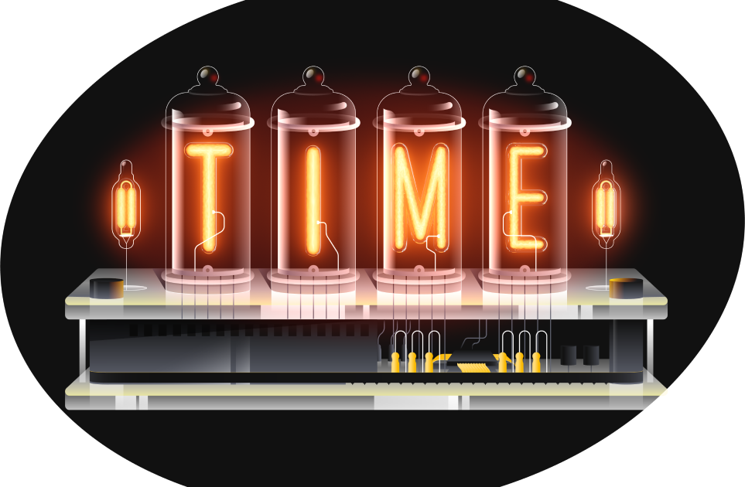
Roughtime:
Securing time for IoT devices
Christer Weinigel, Netnod

Slide 2
Accurate time is important
Many security critical protocols need accurate time
DNSSEC and TLS
The application itself might need time

Slide 3
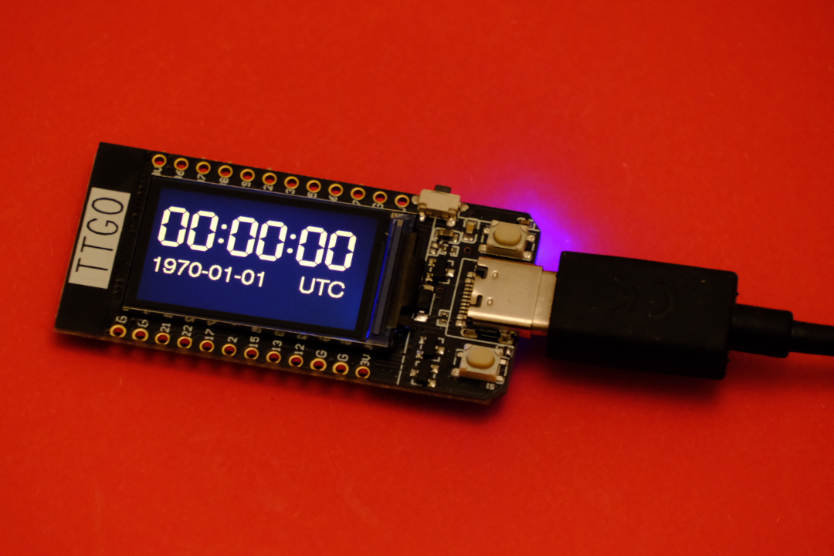
Keeping time
All devices can keep time
When powered on
But not when powered off
IoT devices may not have a Real Time Clock (RTC)
Raspberry Pi - has RTC hardware, but no battery backup by default
"Shipping mode"
Even with a battery the clock will not run before first power on because the battery is not connected

Slide 4
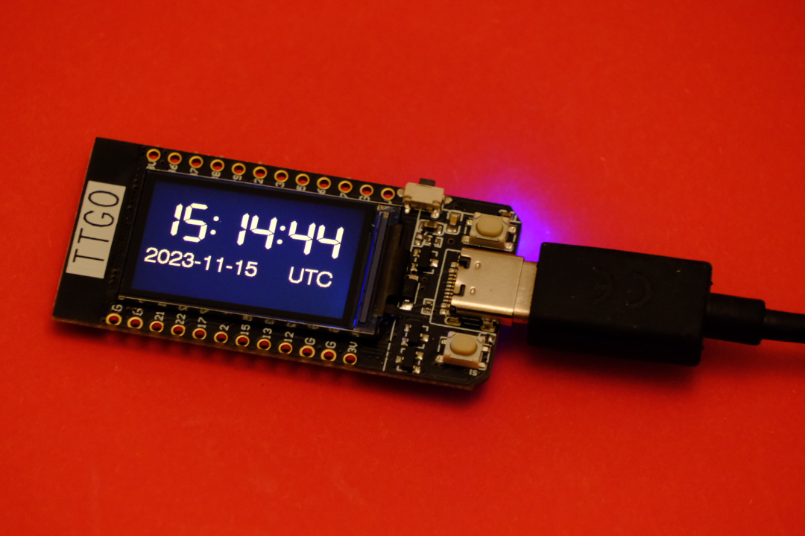
Getting time over the network
NTP (Network Time Protocol)
Lacks security
NTS (Network Time Security)
Adds security
Bootstrapping problem
NTS depends on TLS
Which depend on having accurate time
Heavyweight, not suited for resource constrained devices

Slide 5
Possible solution: Roughtime
Protocol is an IETF Draft
Started out as a way to solve the bootstrapping problem
Secure
Was not intended to replace NTP
Only 10 second accuracy
Fairly low CPU usage and small memory footprint

Slide 6
Roughtime: evolution
It is now a decent generic time protocol
With better accuracy than 10 seconds
Microsecond resolution
Which is secure
Which can run on resource constrained client
Which still solves the bootstrapping problem

Slide 7
Next steps
Roughtime development has stalled
RIPE community funded project to revive it!
Going forward
Kickstart work on protocol
Collect requirements
What do we need to secure time on IoT devices?
Getting community involvement and feedback.
Update draft based on requirements
Add missing features, maybe drop unnecessary features
Update implementations
Hackathon
Submit Roughtime to IETF RFC Editors

Slide 8
Resources
Roughtime Draft
https://datatracker.ietf.org/doc/html/draft-ietf-ntp-roughtime
Working client implementation of draft version 4, 5 and 7
https://vadarklockan.readthedocs.io
Roughtime servers
Netnod: sth1.roughtime.netnod.se, sth2.roughtime.netnod.se (v7)
Marcus Dansarie: roughtime.se (v7)
Mailing list: "proto-roughtime"
Blog posts with background about Roughtime
https://blog.cloudflare.com/roughtime/
Longer talk in the IoT WG later
Contact me: wingel@netnod.se

