Slide 1
Measuring Internet Censorship with OONI
The OONI Measurement Aggregation Toolkit (MAT) meets the Measurement, Analysis and Tools (MAT) Working Group
28th Nov 2023, Rome, Italy

Slide 2
Internet censorship
is the intentional control or suppression
of what can be accessed, published,
or viewed on the internet.

Slide 3
Provide evidence to support advocacy efforts fighting internet censorship worldwide
ISPs or governments cannot claim plausible deniability of blocking events
Provide a public archive with longitudinal open data on internet censorship worldwide
Oversight and transparency into what is blocked and how it’s blocked around the world
Support researchers that study internet censorship with technical data
Support developers that need technical data to improve their tools
Why measure Internet censorship?

Slide 4
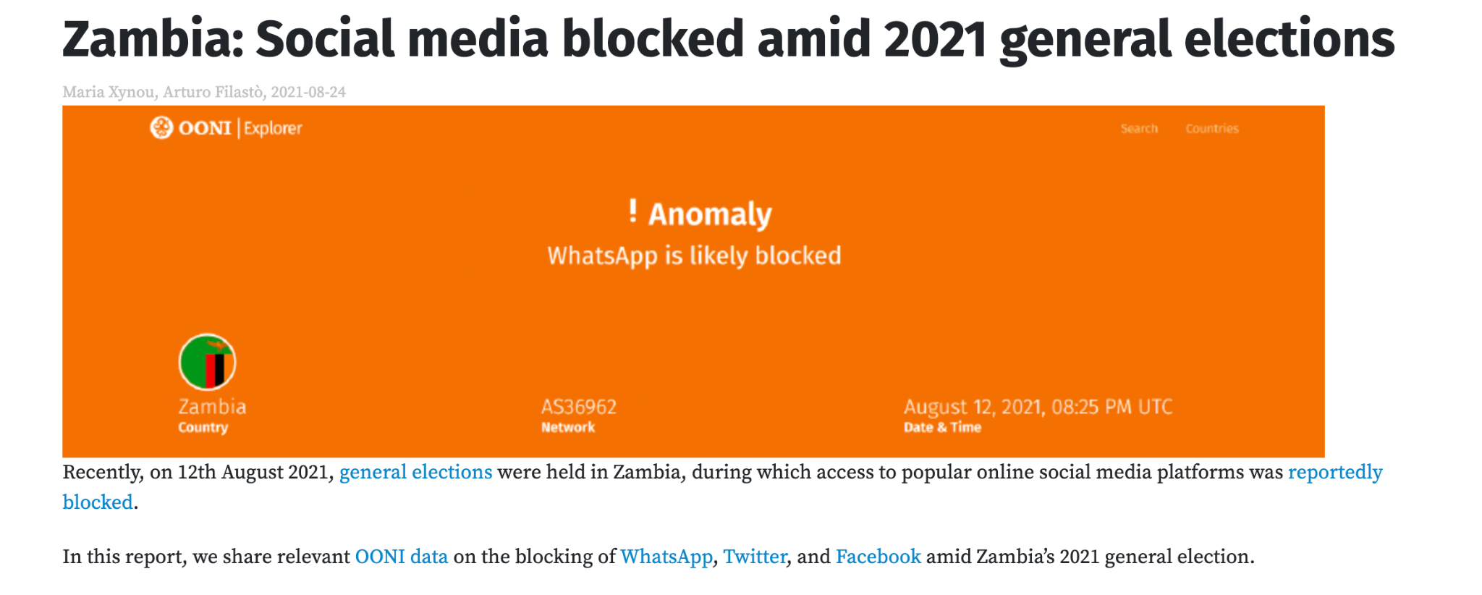
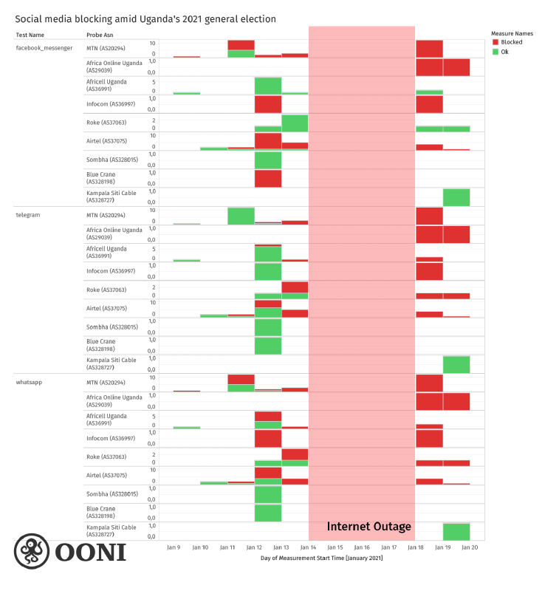
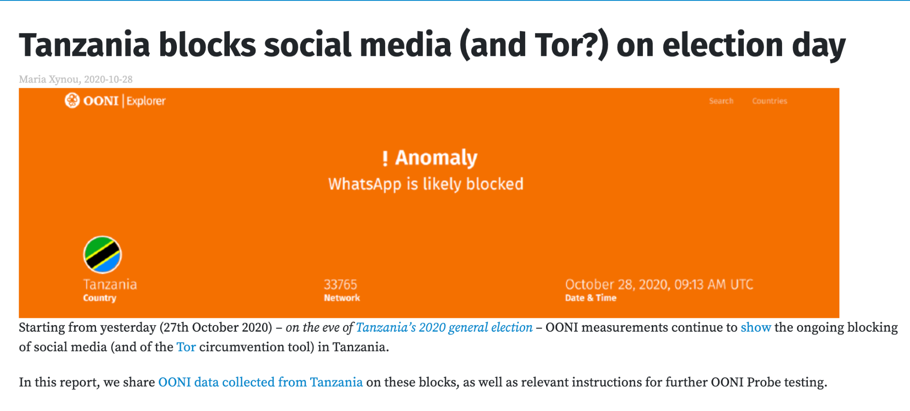
Censorship during elections

Slide 5
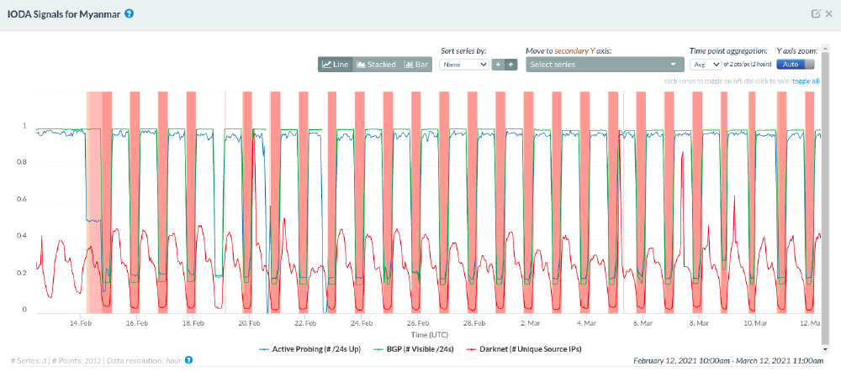
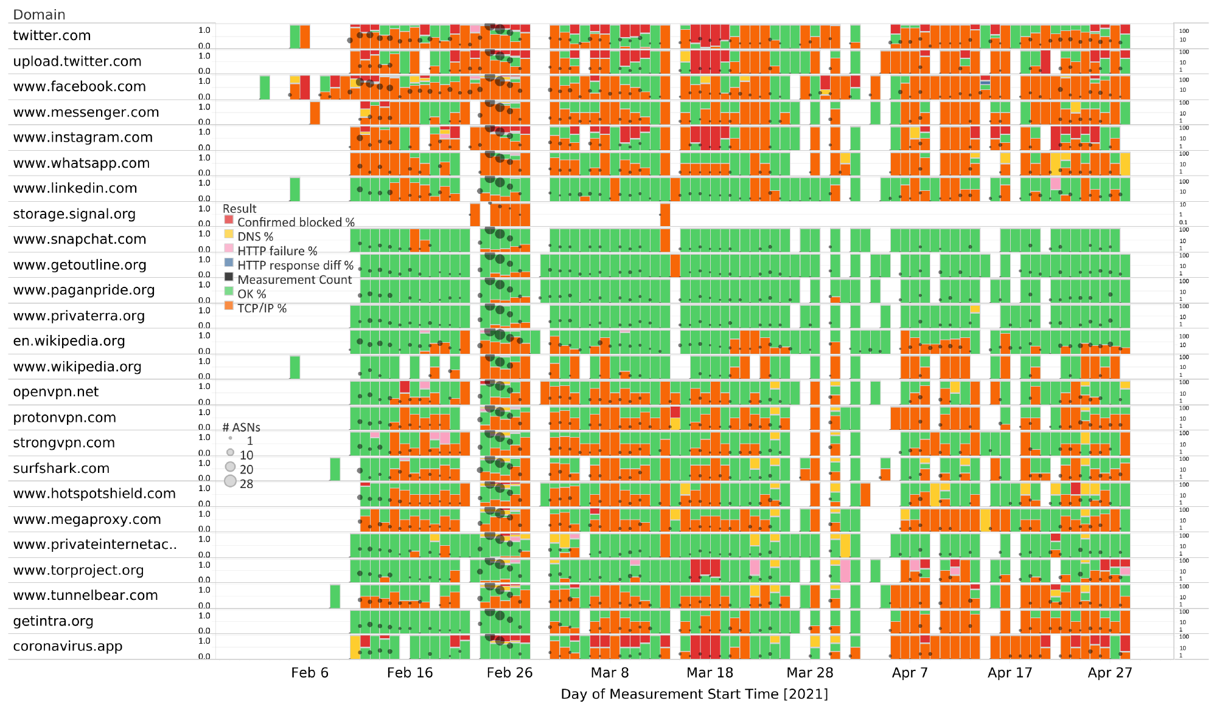
Censorship during political transitions

Slide 6
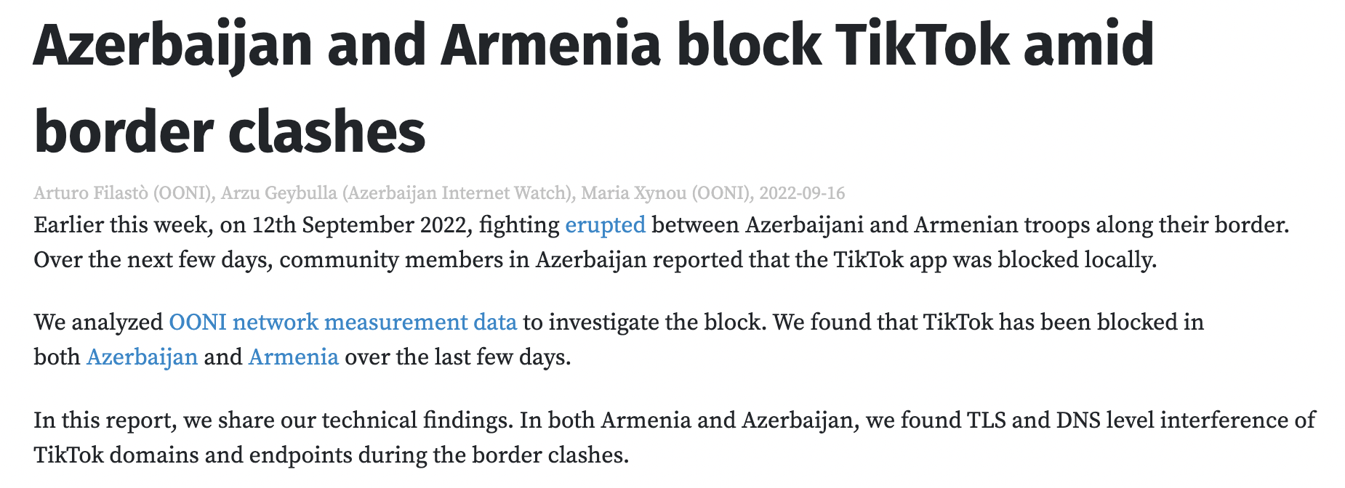
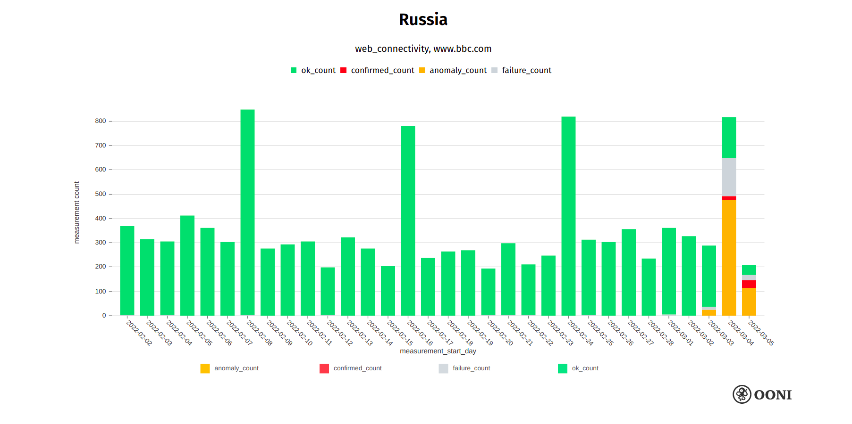
Censorship during conflicts

Slide 7
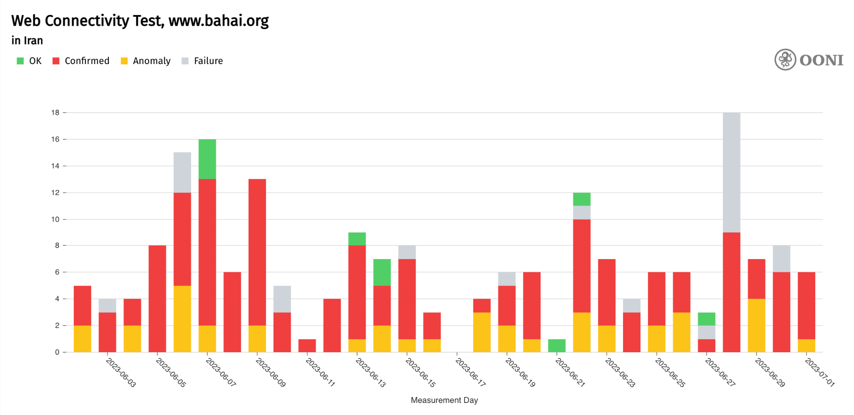
Censorship impacting marginalized communities

Slide 8
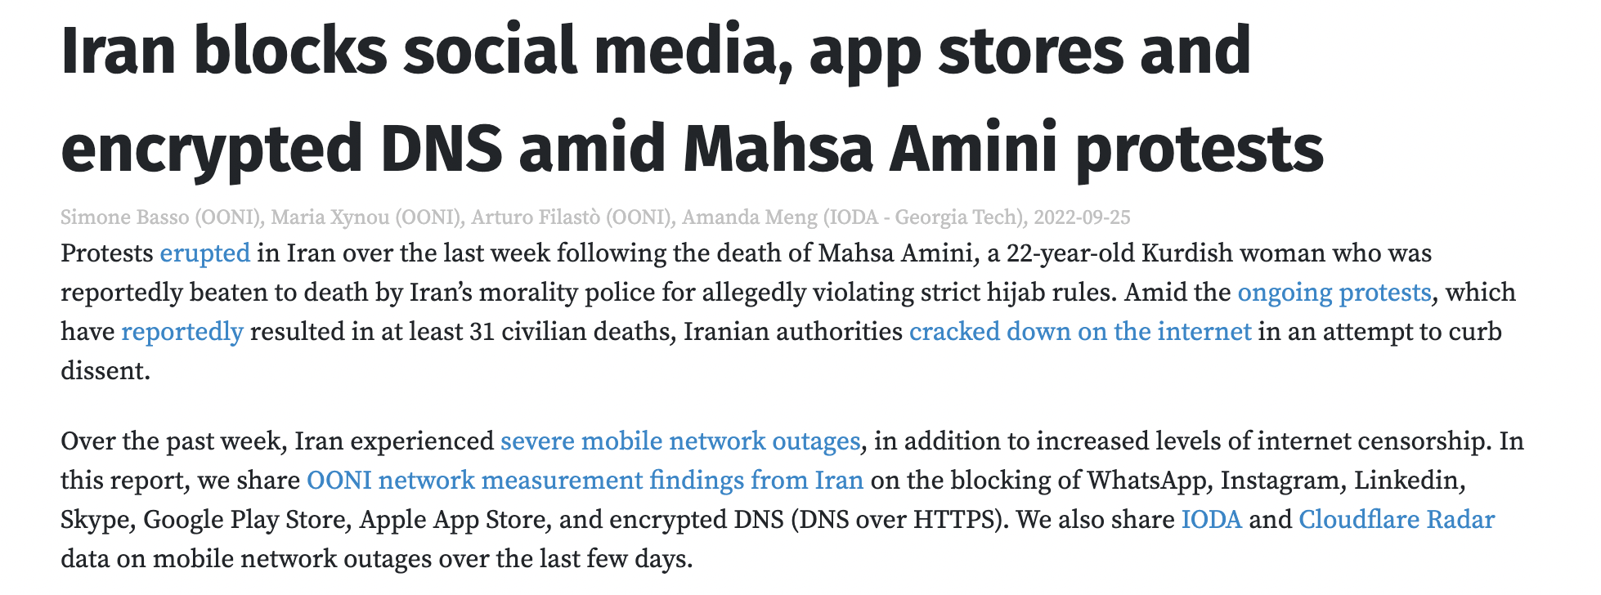
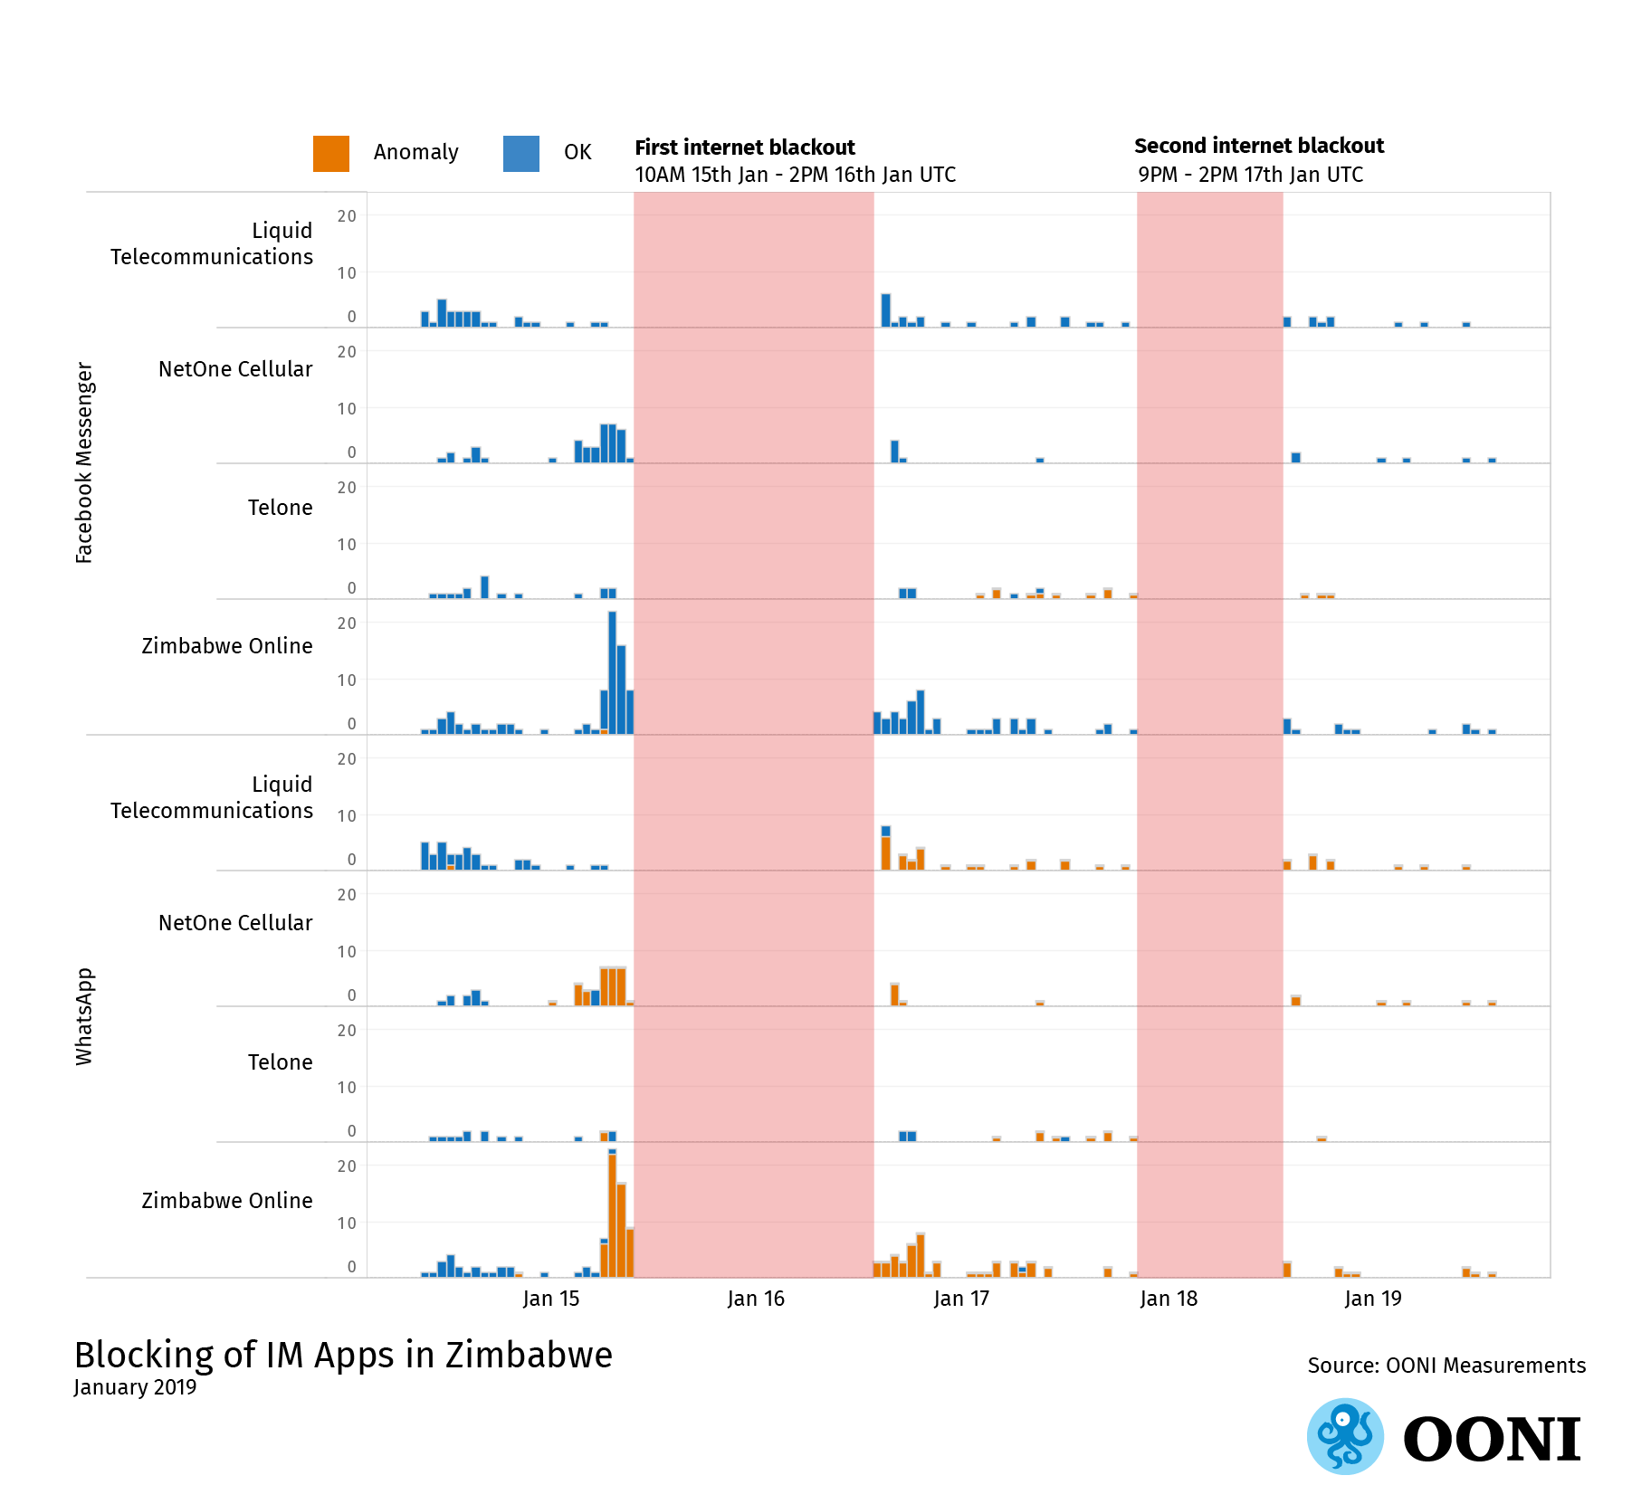
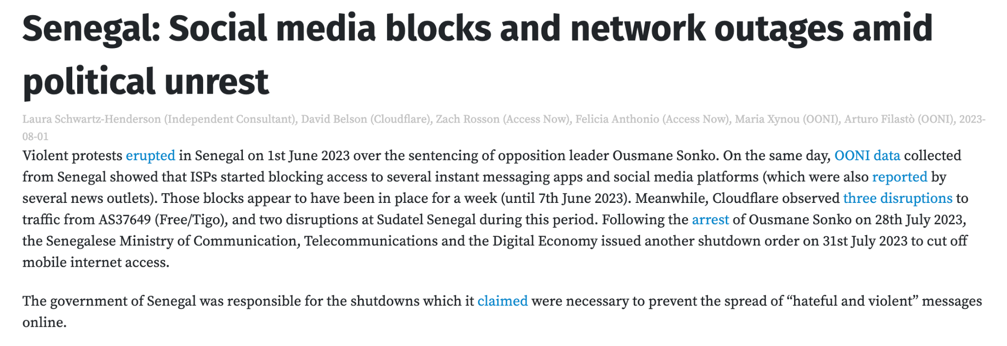
Censorship during protests

Slide 9
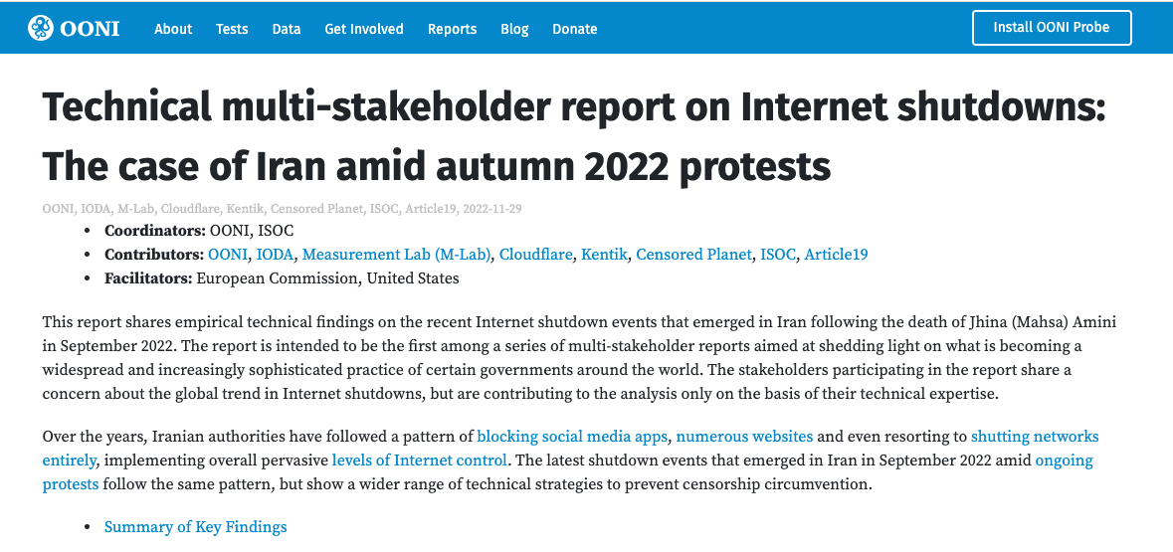
https://ooni.org/post/2022-iran-technical-multistakeholder-report

Slide 10
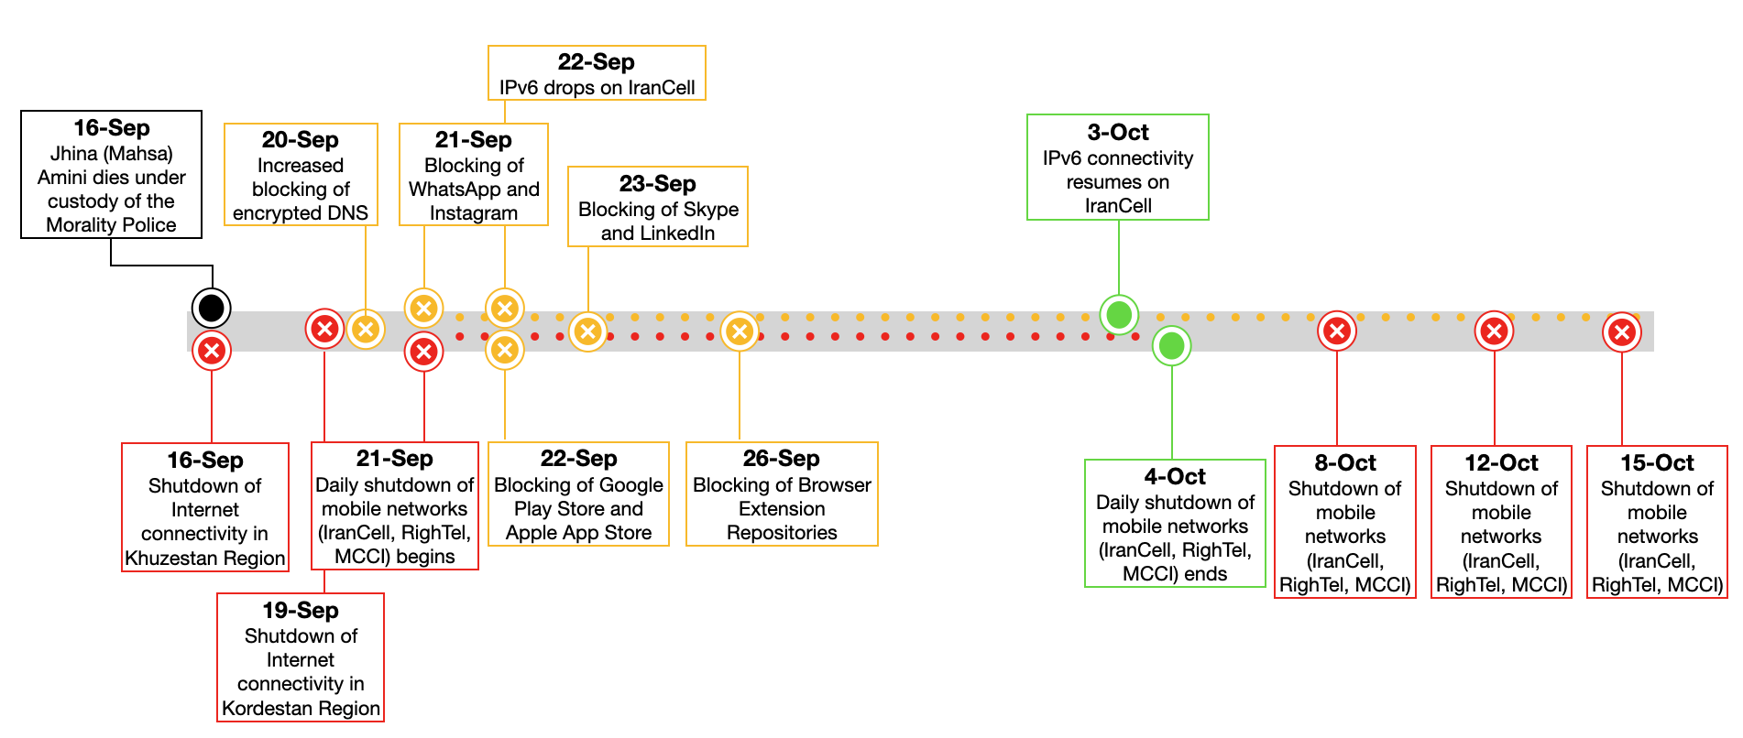
Iran Censorship Timeline of Events:
16 Sep - 16 Oct 2022
Notes:
During this presentation we will cover the range of censorship strategies exacted on Iranian people from September 16 – October 16 which included mobile Internet shutdowns at both national and regional levels and blocking of applications. By combining measurements from multiple organizations with disparate but complementary views of digital censorship, we were able to reconstruct a detailed timeline. We will now review the elements in this timeline beginning with the National shutdowns of mobile networks.

Slide 11
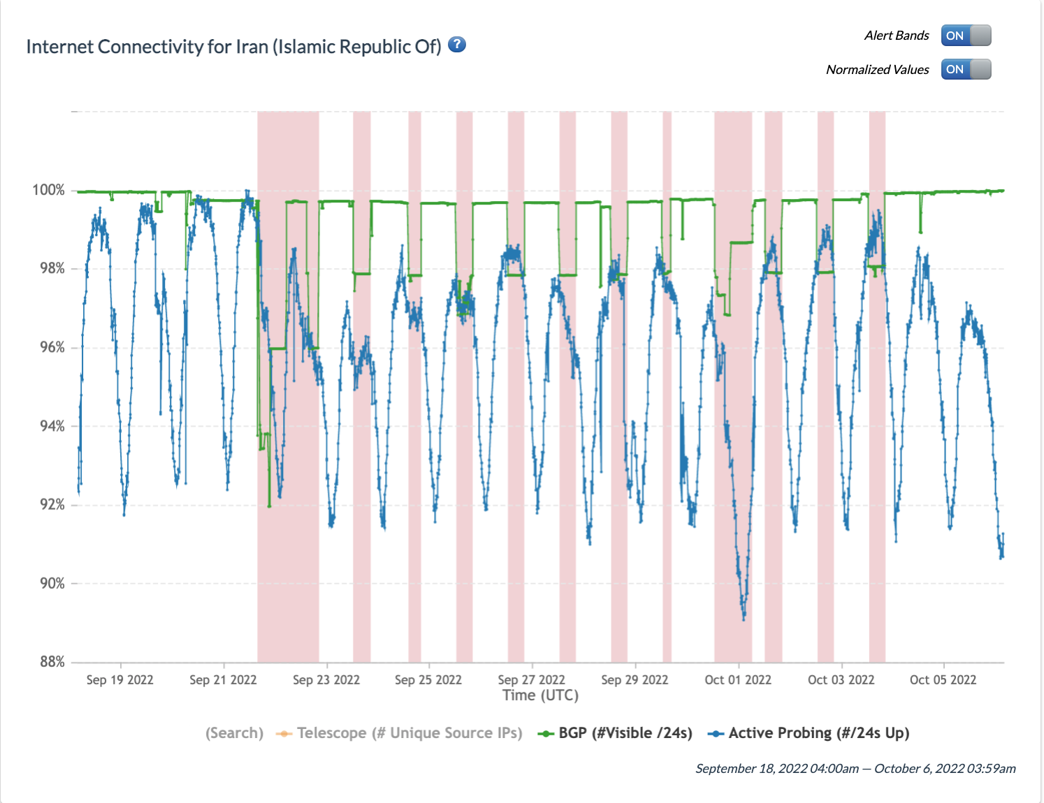
Internet Outage Detection and Analysis (IODA) is an open-source project at Georgia Tech that provides measurements of the connectivity of Internet infrastructure at the country, subnational and Internet operator level that is available via a public, online dashboard (https://ioda.live).
A digital “curfew” blocked all mobile Internet use for 13 consecutive evenings.
Notes:
Internet Outage Detection and Analysis (IODA) is an open-source project at Georgia Tech that provides measurements of the connectivity of Internet infrastructure at the country, subnational and Internet operator levels, available via a public online dashboard. The view you see here is from IODA’s view of Iran’s Internet connectivity from September 18 to October 6th.
Less than a week after Jihna (Mahsa) Amini’s death and in the midst of protest, the Iranian government shutdown the top three mobile network providers for 13 consecutive days.
The daily shutdowns lasted from around 4:00 PM local time until around midnight.
The daily shutdowns are clearly represented by the vertical red bars. Each bar represents a disruption to Iran’s Internet infrastructure connectivity.
During these periods, mobile users would have been unable to do anything at all that relied on the Internet, including documenting or coordinating protests, unless they had a fixed-line or satellite connection.
These measurements are not always easy to interpret so in the next slide we will take a closer look at the characteristics of the signals demonstrate the outage

Slide 12
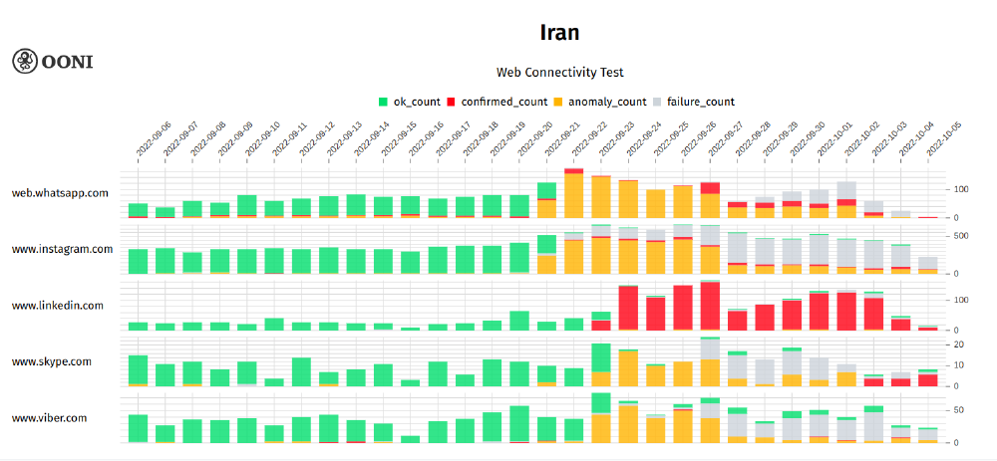
Several social media platforms were newly blocked
Notes:
WhatsApp, Instagram, Skype, Viber and Linkedin

Slide 13
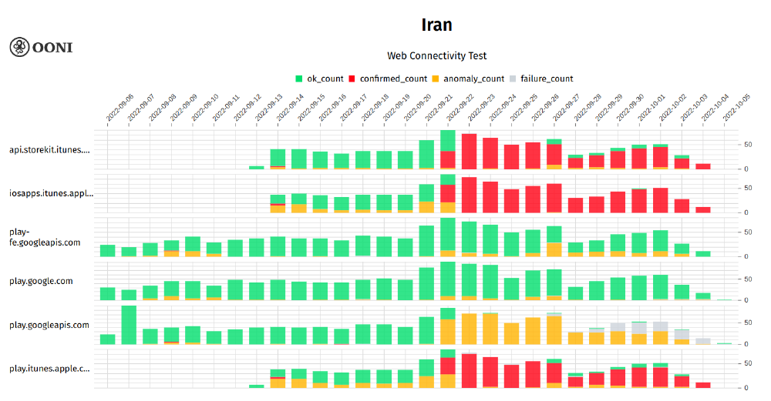
App stores were blocked
Notes:
[These might include tools like VPN or the hard-to-surveil Tor browser]

Slide 14
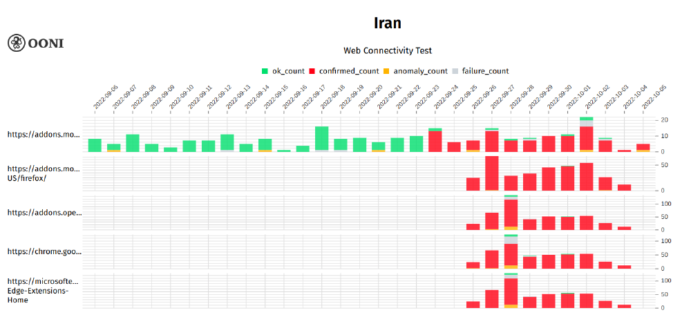
…and browser extension repositories

Slide 15
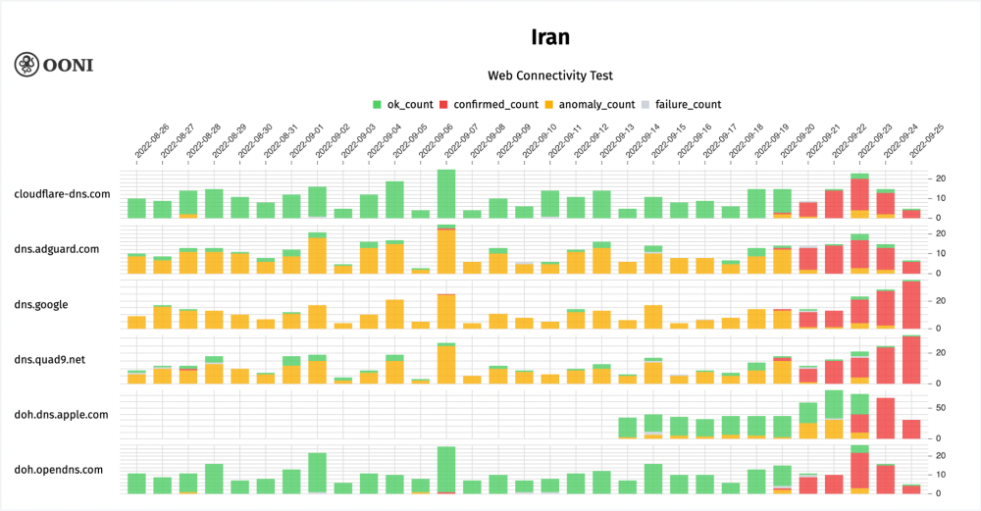
Encrypted DNS started to be blocked
Notes:
[Encrypted DNS prevents network administrators from seeing when a website or service they want to block is being accessed by name, so they don’t know to stop users from being directed to it.]

Slide 16
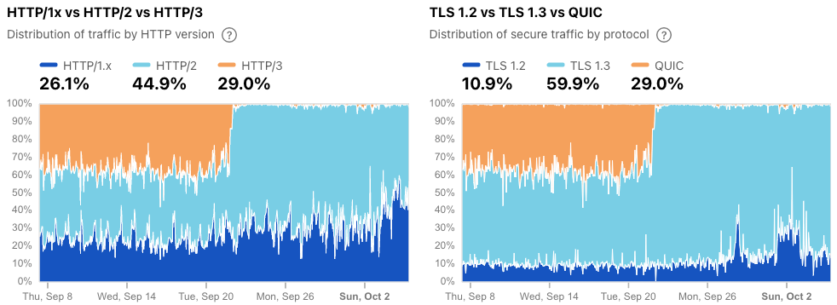
HTTP/3 and QUIC were blocked

Slide 17
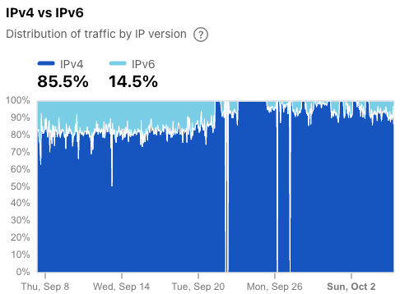
IPv6 was blocked on Irancell
Notes:
Describe what IPv6 is, how it is often used on mobile networks.
[Starting on September 21, Cloudflare observed that IPv6 connectivity on AS44244 (Irancell) was apparently being blocked.
Similar issues with IPv6 connectivity on Irancell during that time frame were also observed in measurements from Kentik, OONI, and RIPE Atlas.
It remains unclear what implications IPv6 blocking would have had for users]

Slide 18
How can you do this research on your own?

Slide 19
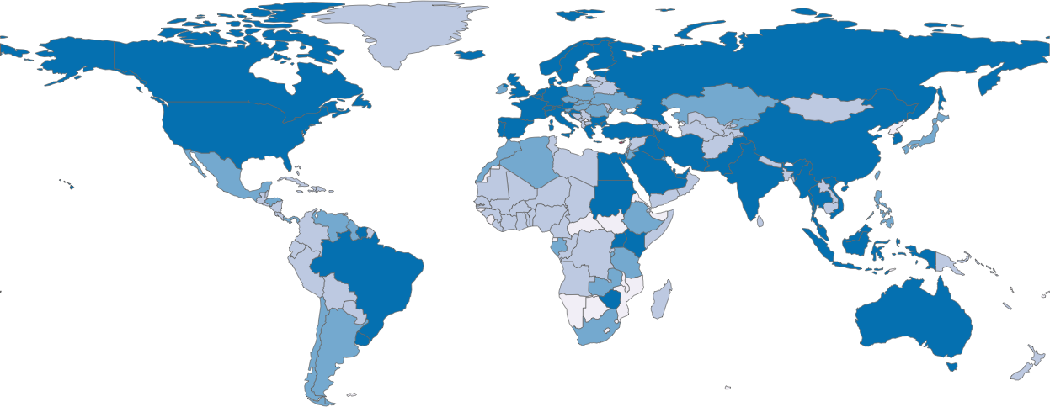
Since 2012, the OONI community has collected more than a billion network measurements
from 241 countries and territories, shedding light on internet censorship worldwide.
Free software project (born under The Tor Project) aimed at empowering decentralized efforts in increasing transparency of internet censorship around the world.

Slide 20
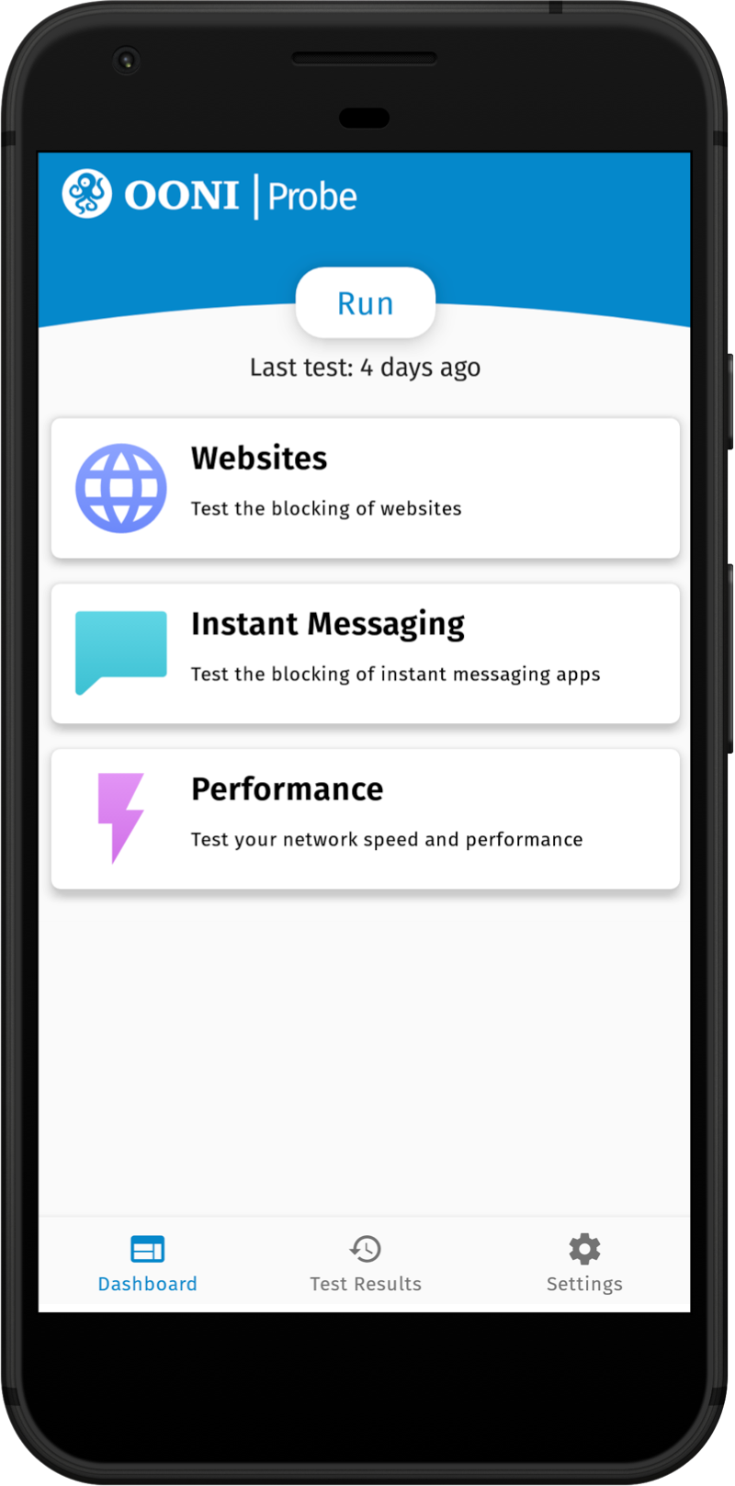
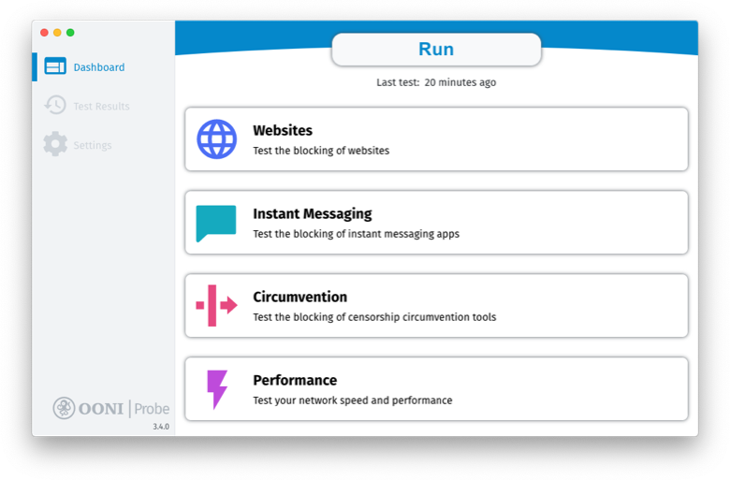
https://ooni.org/install/
OONI Probe

Slide 21
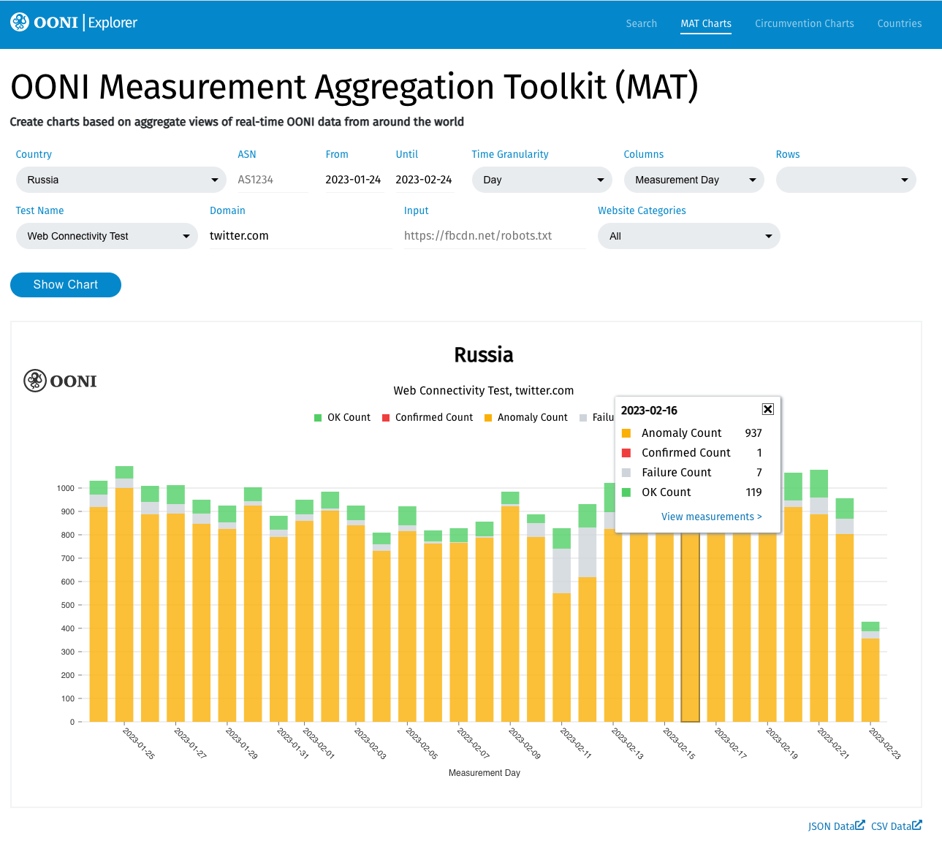
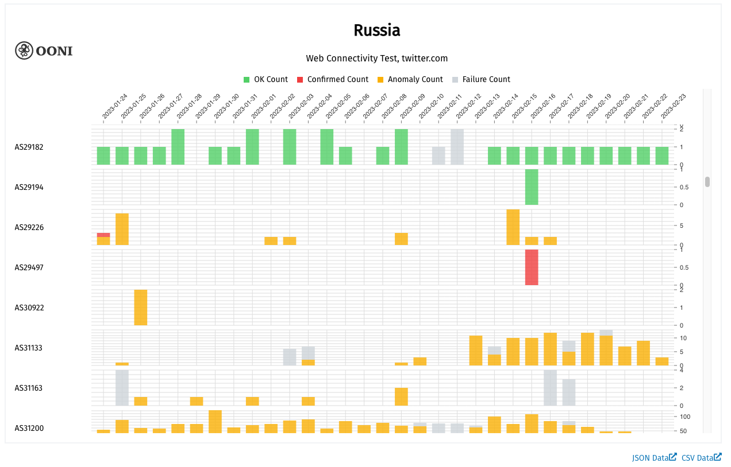
1.8 Billion measurements
241 countries and territories
26.6k networks
https://explorer.ooni.org/chart/mat
Measurement Aggregation Toolkit (MAT): Accessing OONI Data

Slide 22
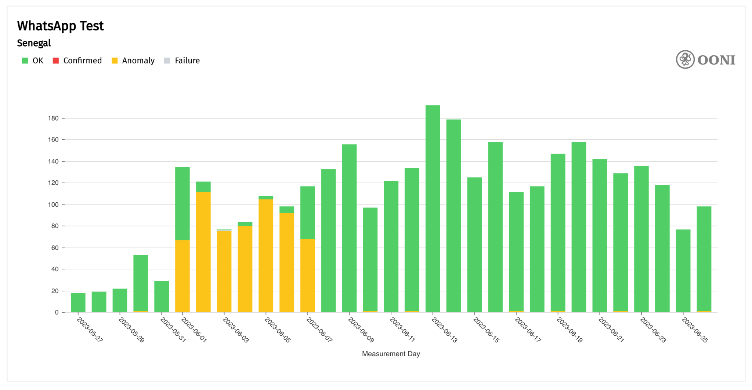
Sometimes the signal is clear…
Notes:
The MAT provides filters that enable you to select the parameters you care about in order to plot charts based on aggregate views of OONI data.
Specifically, the MAT includes the following filters:
* **Countries:** Select a country through the drop-down menu (the "All Countries" option will show global coverage)
* **Test Name:** Select an [OONI Probe test](https://ooni.org/nettest/) based on which you would like to get measurements (for example, select `Web Connectivity` to view the testing of websites)
* **Domain:** Type the domain for the website you would like to get measurements (e.g. `twitter.com`)
* **Website categories:** Select the [website category](https://github.com/citizenlab/test-lists/blob/master/lists/00-LEGEND-new_category_codes.csv) for which you would like to get measurements (e.g. `News Media` for news media websites)
* **ASN:** Type the [ASN](https://ooni.org/support/glossary/#asn) of the network for which you would like to get measurements (e.g. `AS30722` for Vodafone Italia)
* **Date range:** Select the date range of the measurements by adjusting the `Since` and `Until` filters
* **X axis:** Select the values that you would like to appear on the horizontal axis of your chart
* **Y axis:** Select the values that you would like to appear on the vertical axis of your chart

Slide 23
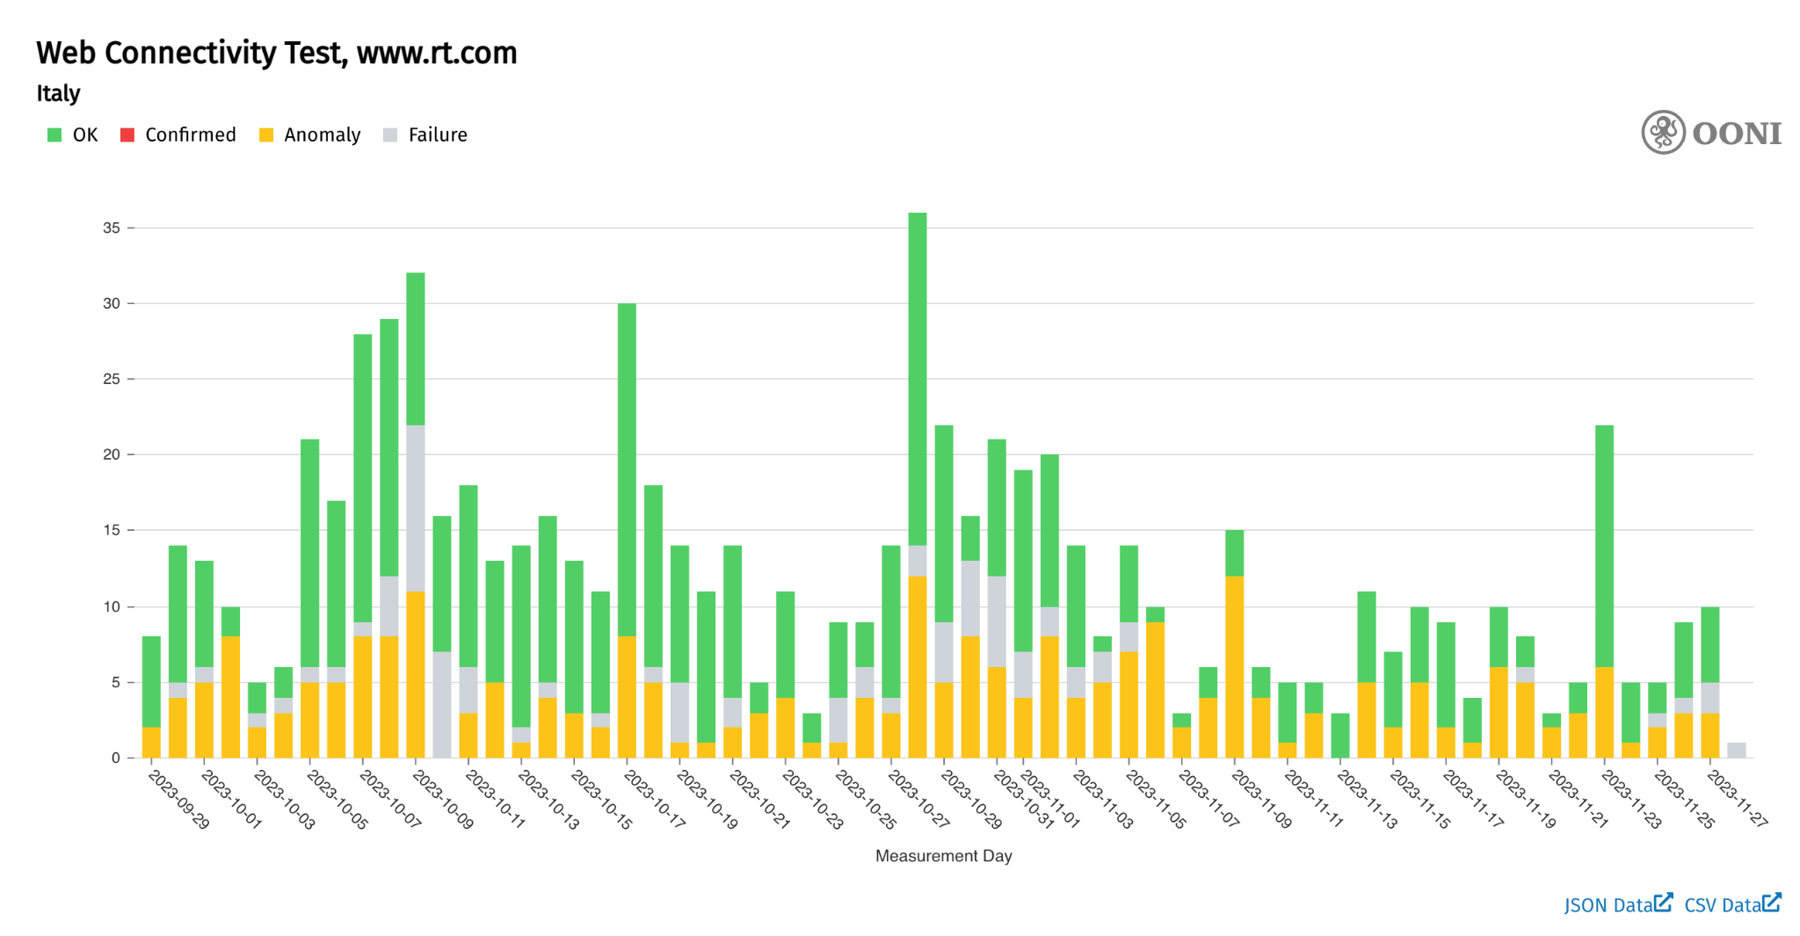
less clear, but still easy
Notes:
The MAT provides filters that enable you to select the parameters you care about in order to plot charts based on aggregate views of OONI data.
Specifically, the MAT includes the following filters:
* **Countries:** Select a country through the drop-down menu (the "All Countries" option will show global coverage)
* **Test Name:** Select an [OONI Probe test](https://ooni.org/nettest/) based on which you would like to get measurements (for example, select `Web Connectivity` to view the testing of websites)
* **Domain:** Type the domain for the website you would like to get measurements (e.g. `twitter.com`)
* **Website categories:** Select the [website category](https://github.com/citizenlab/test-lists/blob/master/lists/00-LEGEND-new_category_codes.csv) for which you would like to get measurements (e.g. `News Media` for news media websites)
* **ASN:** Type the [ASN](https://ooni.org/support/glossary/#asn) of the network for which you would like to get measurements (e.g. `AS30722` for Vodafone Italia)
* **Date range:** Select the date range of the measurements by adjusting the `Since` and `Until` filters
* **X axis:** Select the values that you would like to appear on the horizontal axis of your chart
* **Y axis:** Select the values that you would like to appear on the vertical axis of your chart

Slide 24
https://explorer.ooni.org/chart/mat
breaking down by network, helps
Notes:
The MAT provides filters that enable you to select the parameters you care about in order to plot charts based on aggregate views of OONI data.
Specifically, the MAT includes the following filters:
* **Countries:** Select a country through the drop-down menu (the "All Countries" option will show global coverage)
* **Test Name:** Select an [OONI Probe test](https://ooni.org/nettest/) based on which you would like to get measurements (for example, select `Web Connectivity` to view the testing of websites)
* **Domain:** Type the domain for the website you would like to get measurements (e.g. `twitter.com`)
* **Website categories:** Select the [website category](https://github.com/citizenlab/test-lists/blob/master/lists/00-LEGEND-new_category_codes.csv) for which you would like to get measurements (e.g. `News Media` for news media websites)
* **ASN:** Type the [ASN](https://ooni.org/support/glossary/#asn) of the network for which you would like to get measurements (e.g. `AS30722` for Vodafone Italia)
* **Date range:** Select the date range of the measurements by adjusting the `Since` and `Until` filters
* **X axis:** Select the values that you would like to appear on the horizontal axis of your chart
* **Y axis:** Select the values that you would like to appear on the vertical axis of your chart

Slide 25
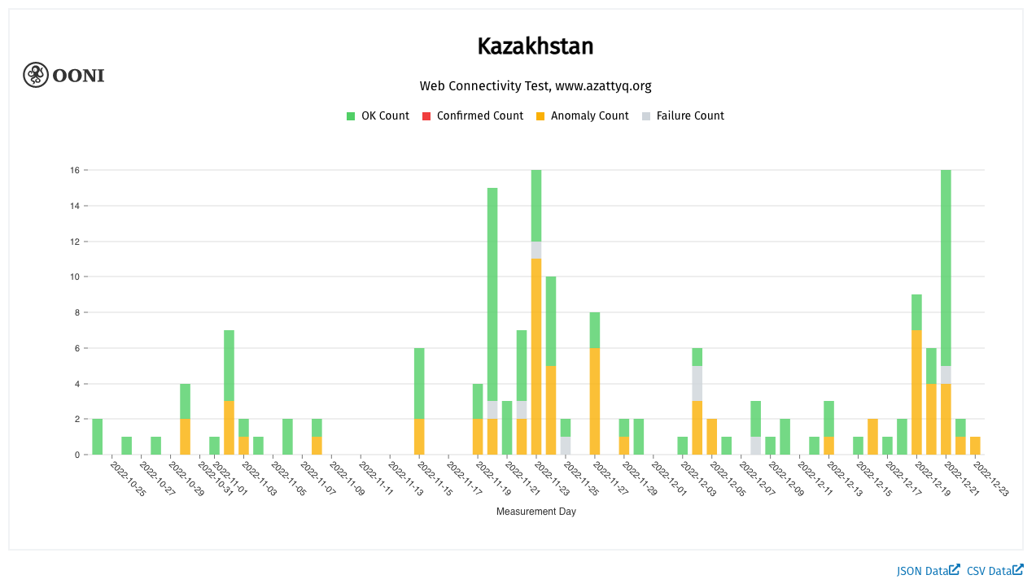
Blocking of RFERL sites during KZ elections?

Slide 26
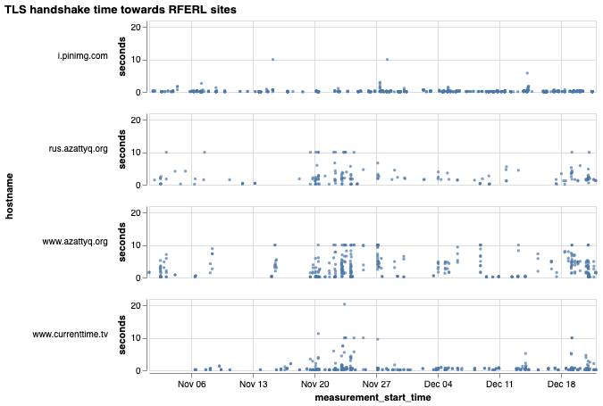
Throttling of RFERL sites

Slide 27
Throttling of RFERL sites

Slide 28
Join community discussions: https://slack.ooni.org
Run OONI Probe: https://ooni.org/install/
Analyze OONI data: https://ooni.org/data/
Get Involved

Slide 29
contact@ooni.org
github.com/ooni
@OpenObservatory
https://slack.ooni.org/
Questions?

