Slide 1
Numbered Work Items Update

Slide 2
What is an NWI?
Numbered work item
Relatively similar to a ticket

Slide 3
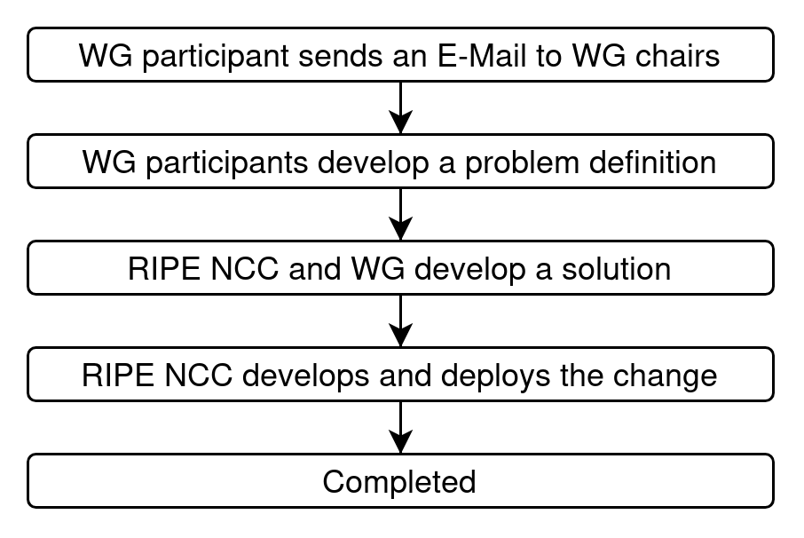
What is an NWI?

Slide 4
NWI-2
Displaying history of deleted objects
NCC legal team presented a legal analysis at RIPE 84
Any volunteers to draft this?

Slide 5
NWI-4
Role of status: field in multivalued status context
NCC published an impact analysis of {prefix, status} tuple as inetnum primary key
Edward will go into detail

Slide 6
NWI-10
Adding the “country” attribute to organization objects
Completed

Slide 7
NWI-12
NRTMv4
NCC implementation is practically done
Can we consider this NWI finished?

Slide 8
NWI-13
Adding geolocation attributes
Implemented
168th executive board meeting minues

Slide 9
NWI-13
inet6num: 2001:db8:1::/48
netname: Example-Net1
descr: Example network
country: IT
geofeed: https://geofeed.example.com/geofeed.csv
geoloc: 41.8156606 12.4084386
[…]
https://geofeed.example.com/geofeed.csv:
2001:db8:1::/48,IT,IT-RM,Rome,
2001:db8:2::/48,NL,NL-ZH,Rotterdam,
2001:db8:3::/48,RS,,,

Slide 10
NWI-14
Protecting references to objects in the RIPE Database
Completed

Slide 11
Working with NWIs
Do we need to change something?
Do we want interim sessions?
What does the working group need?

