Slide 1
Automatisation for global BGP tunnel
How to use tools that are not made for the job
support@freetransit.ch
02 480 933 93
Pystyy vetää oy

Slide 2
Who
Also known as juustoperse
Migrated to finland in 2020
Online since 2014 with 58299, then 41666, 41051
Pystyy vetää oy

Slide 3
What is this talk about
Research and Education Network
Our Tunnel Network
Pystyy vetää oy

Slide 4
Freetransit
Webplatform for sponsoring of
IP Transit (via Tunnels or IXPs)
IPv6 Blocks
ASN Sponsoring is not meant to be cost free, but at cost. Sponsoring ORG is a LIR that “”subresells”” the RIR Resources
Pystyy vetää oy

Slide 5
Tunnel Setup
Ticket Request
Check Authority (Spoofing)
Check best Tunnel node
Check prefixes to be announced + are they legit?
Setup BGP Session
Documentation
Support
Fix mistakes
Pystyy vetää oy

Slide 6
Issues
We are growing
VYOS as basis system (config generation from one source for different targes, daemons and interfaces)
Somtimes needs a reboot
Recently upgraded to 1.3.2 before rebooting (well, why not)
Broke. Route Leaks
Pystyy vetää oy

Slide 7
New Platform
Thinned Debian. No SystemD. Boots in 5 seconds
Script to pull config from ixpmanager
Setup tunnels by hand, rest by ixpmanager
Filter updates (new prefixes/NLRI) get accepted automatically from proper sources
Pystyy vetää oy

Slide 8
What’s IXPmanager
Orchestration for IXPs
Standard tool
Opensource
Can be templated
Pystyy vetää oy

Slide 9
IXPmanager
Change Template: Instead of RR peer, be regular eBGP Peer.
Add some local Routings
Filtering: Mark learned routes towards upstream
IXP Peerings: No Manual work on routers
Pystyy vetää oy

Slide 10
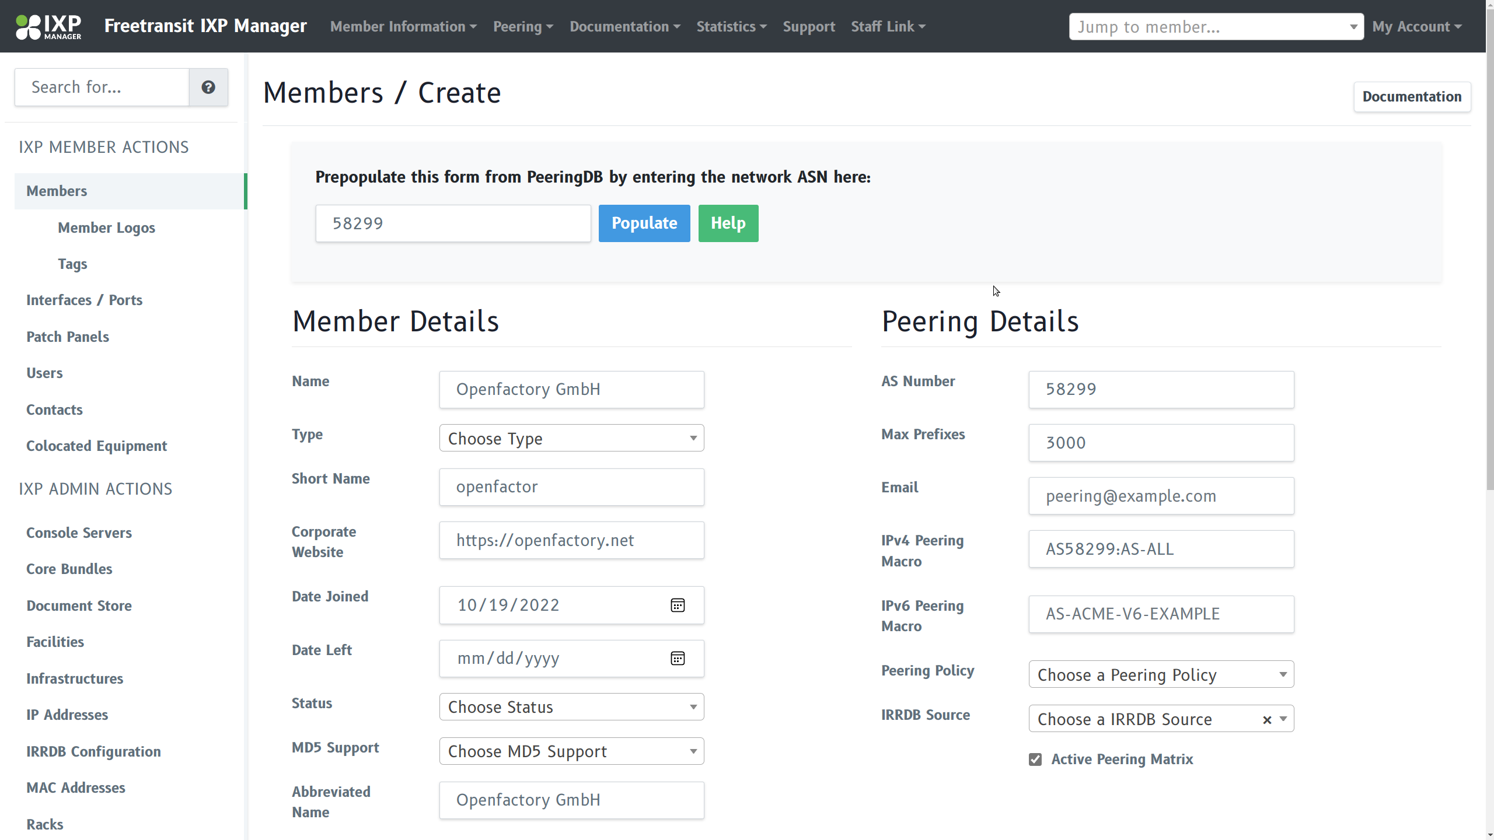
IXPmanager
Pystyy vetää oy

Slide 11
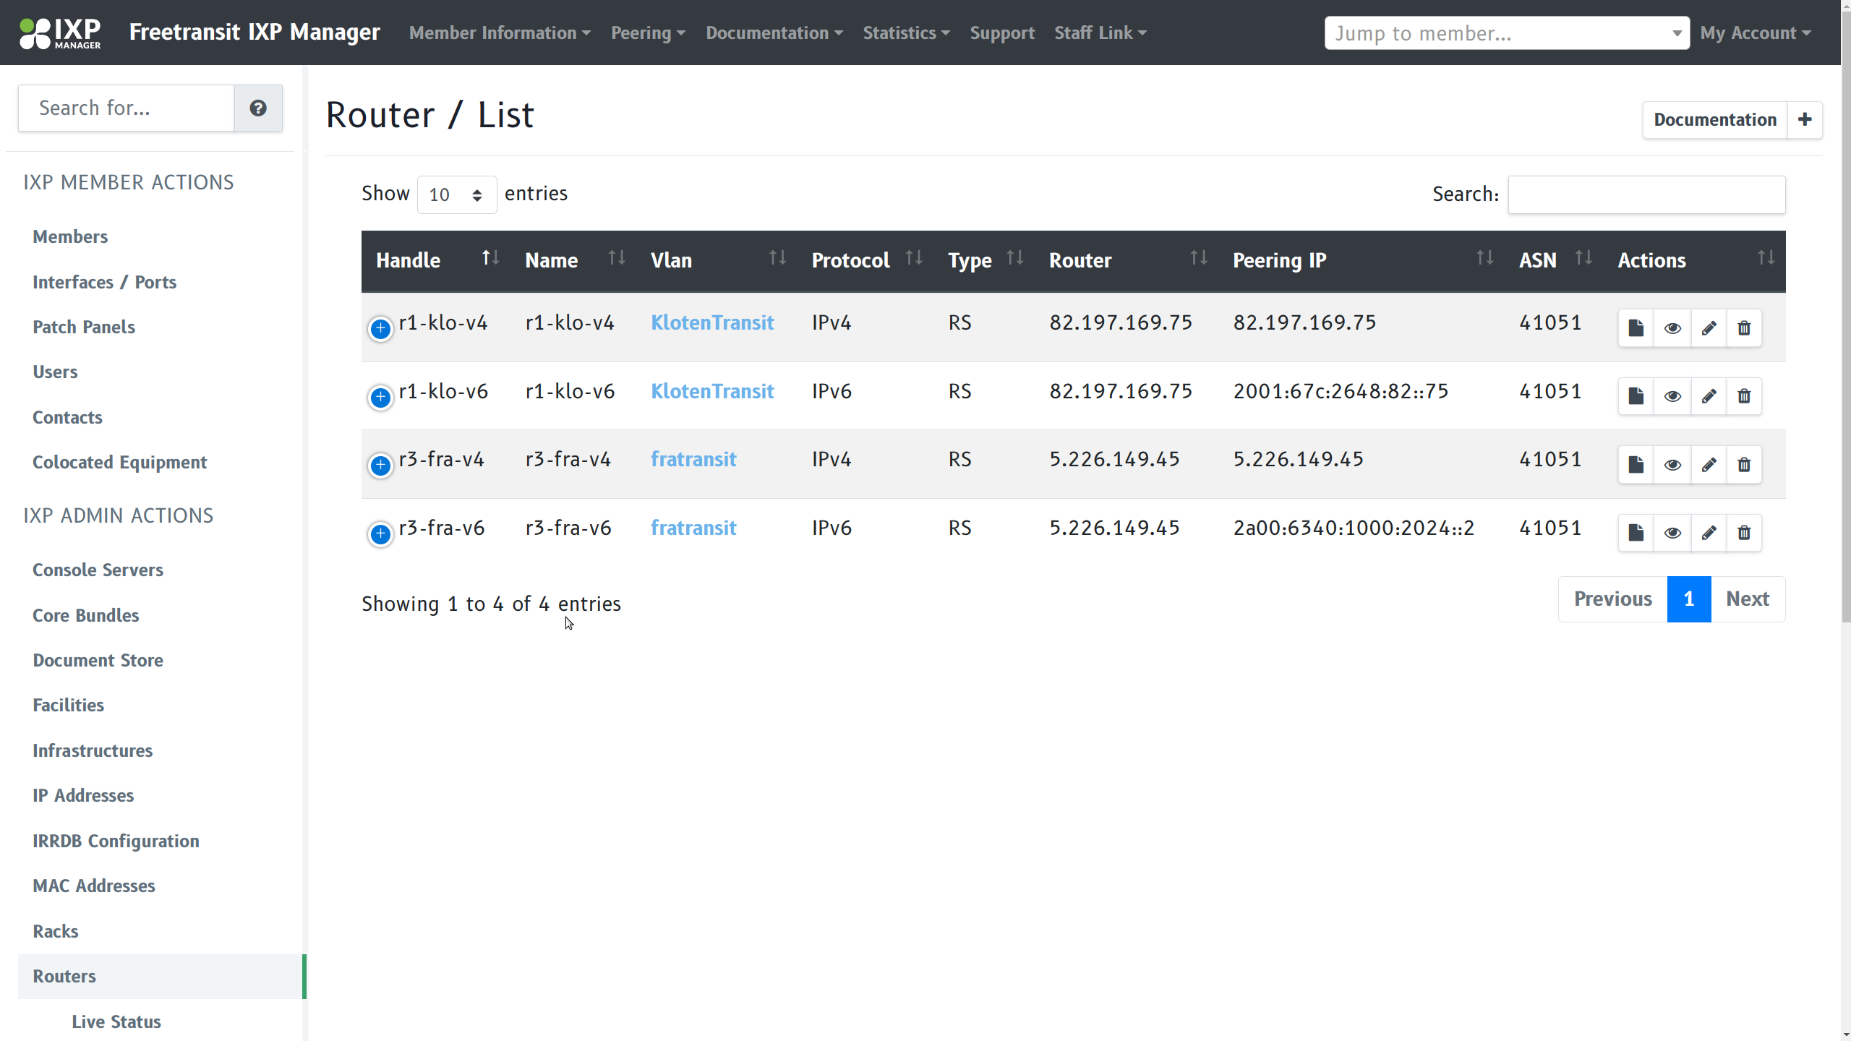
IXPmanager
Pystyy vetää oy

Slide 12
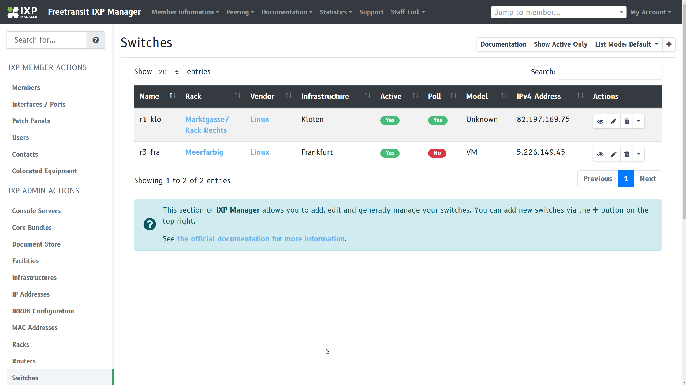
IXPmanager
Pystyy vetää oy

Slide 13
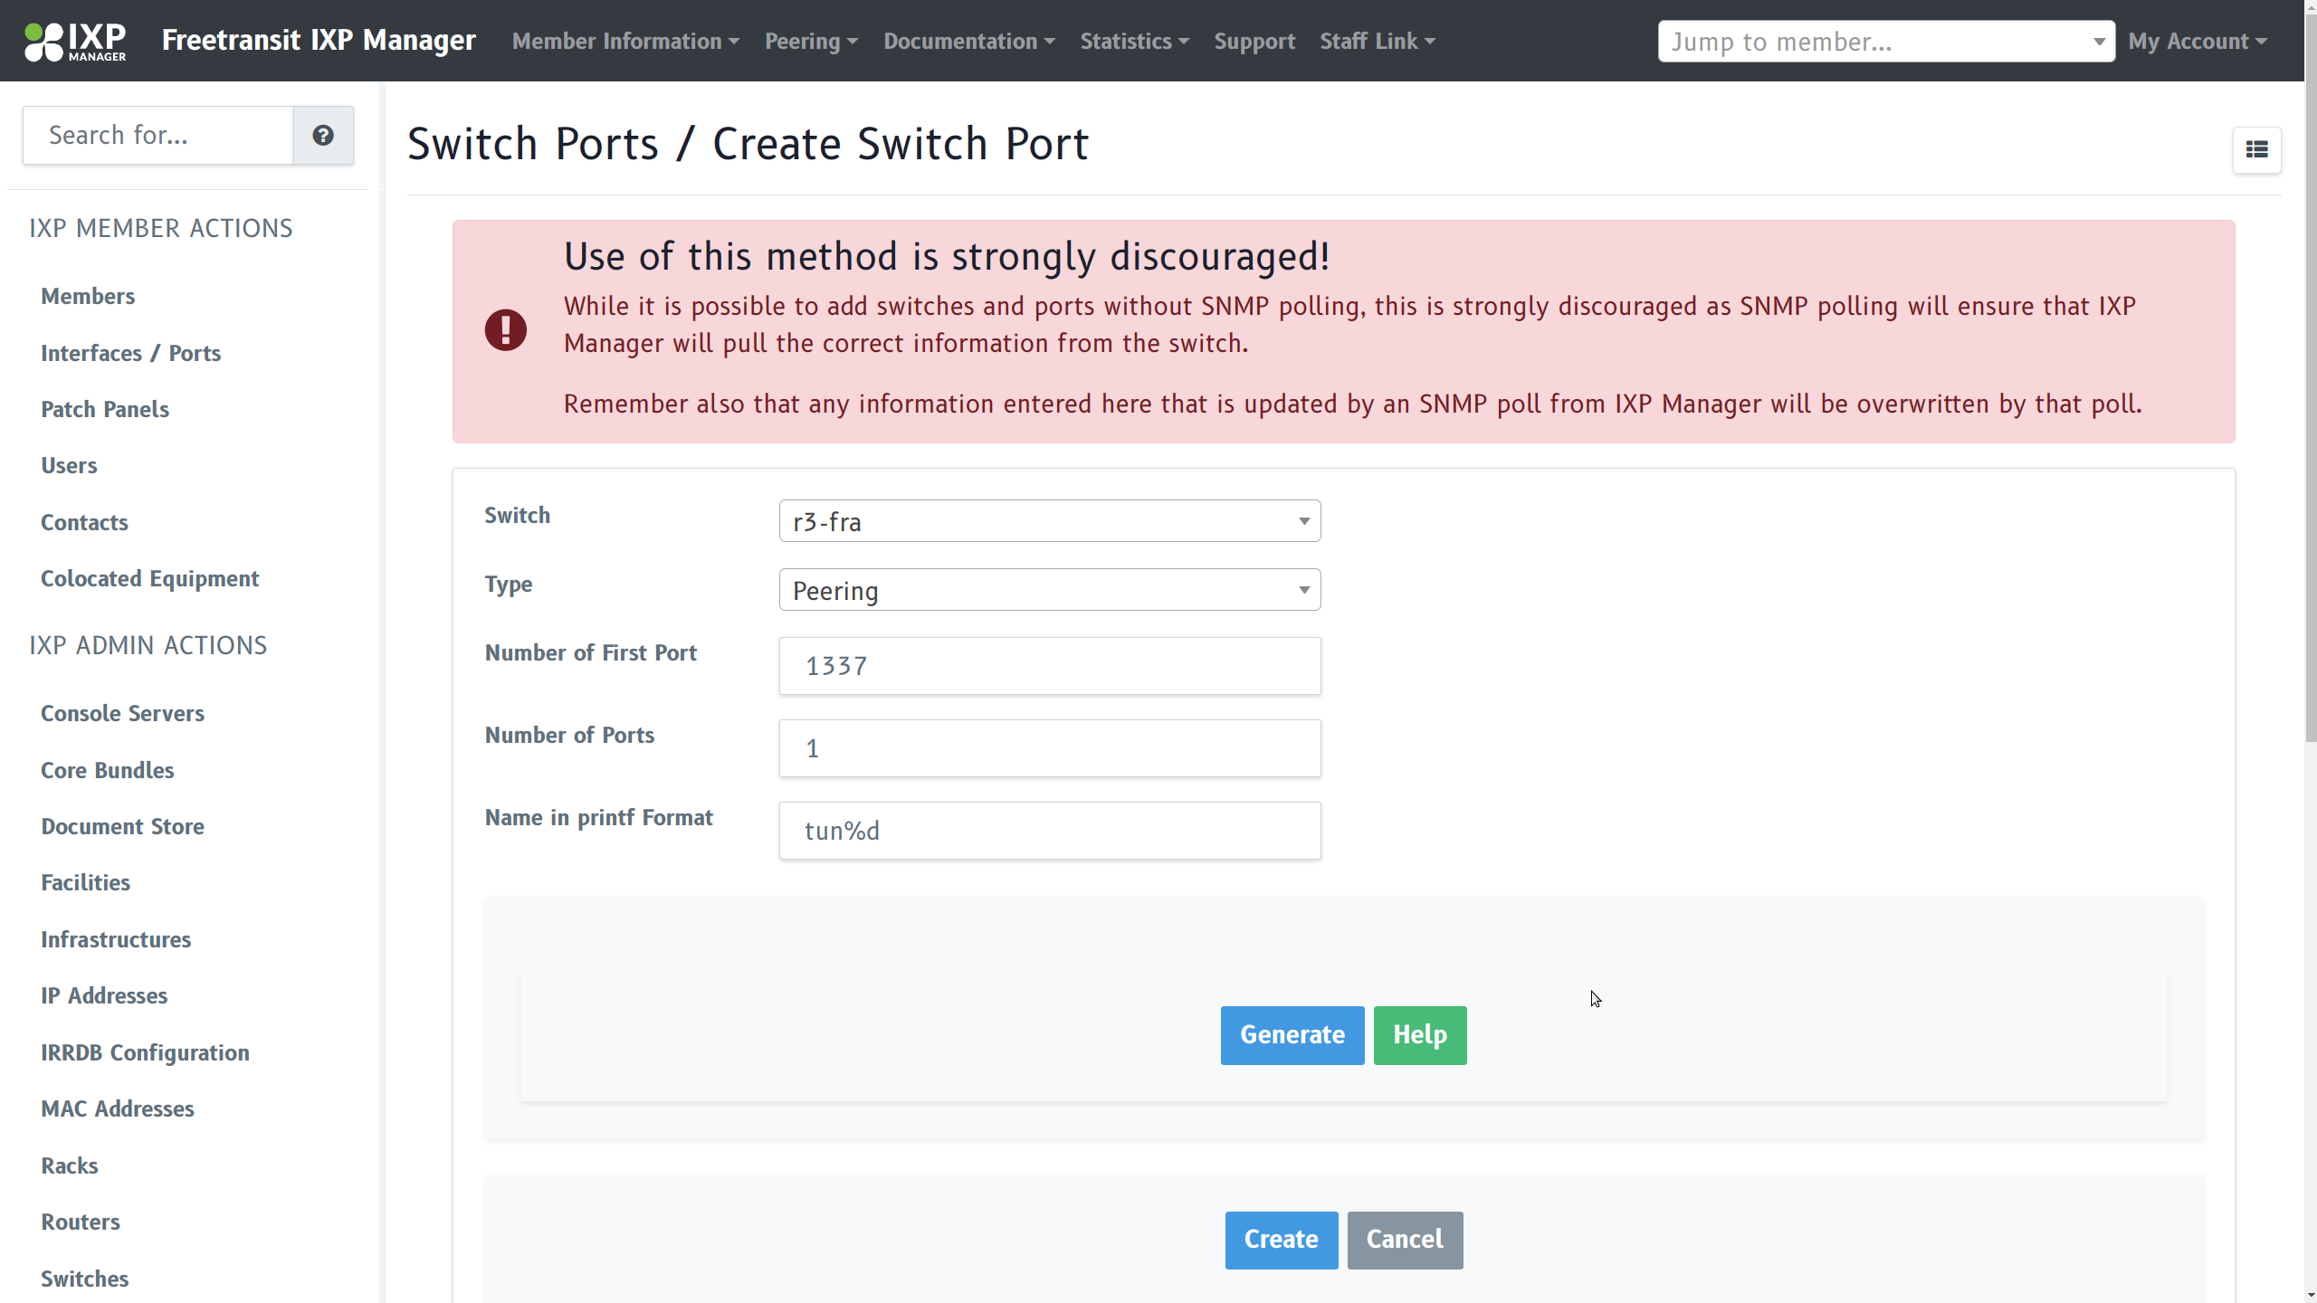
IXPmanager
Pystyy vetää oy

Slide 14
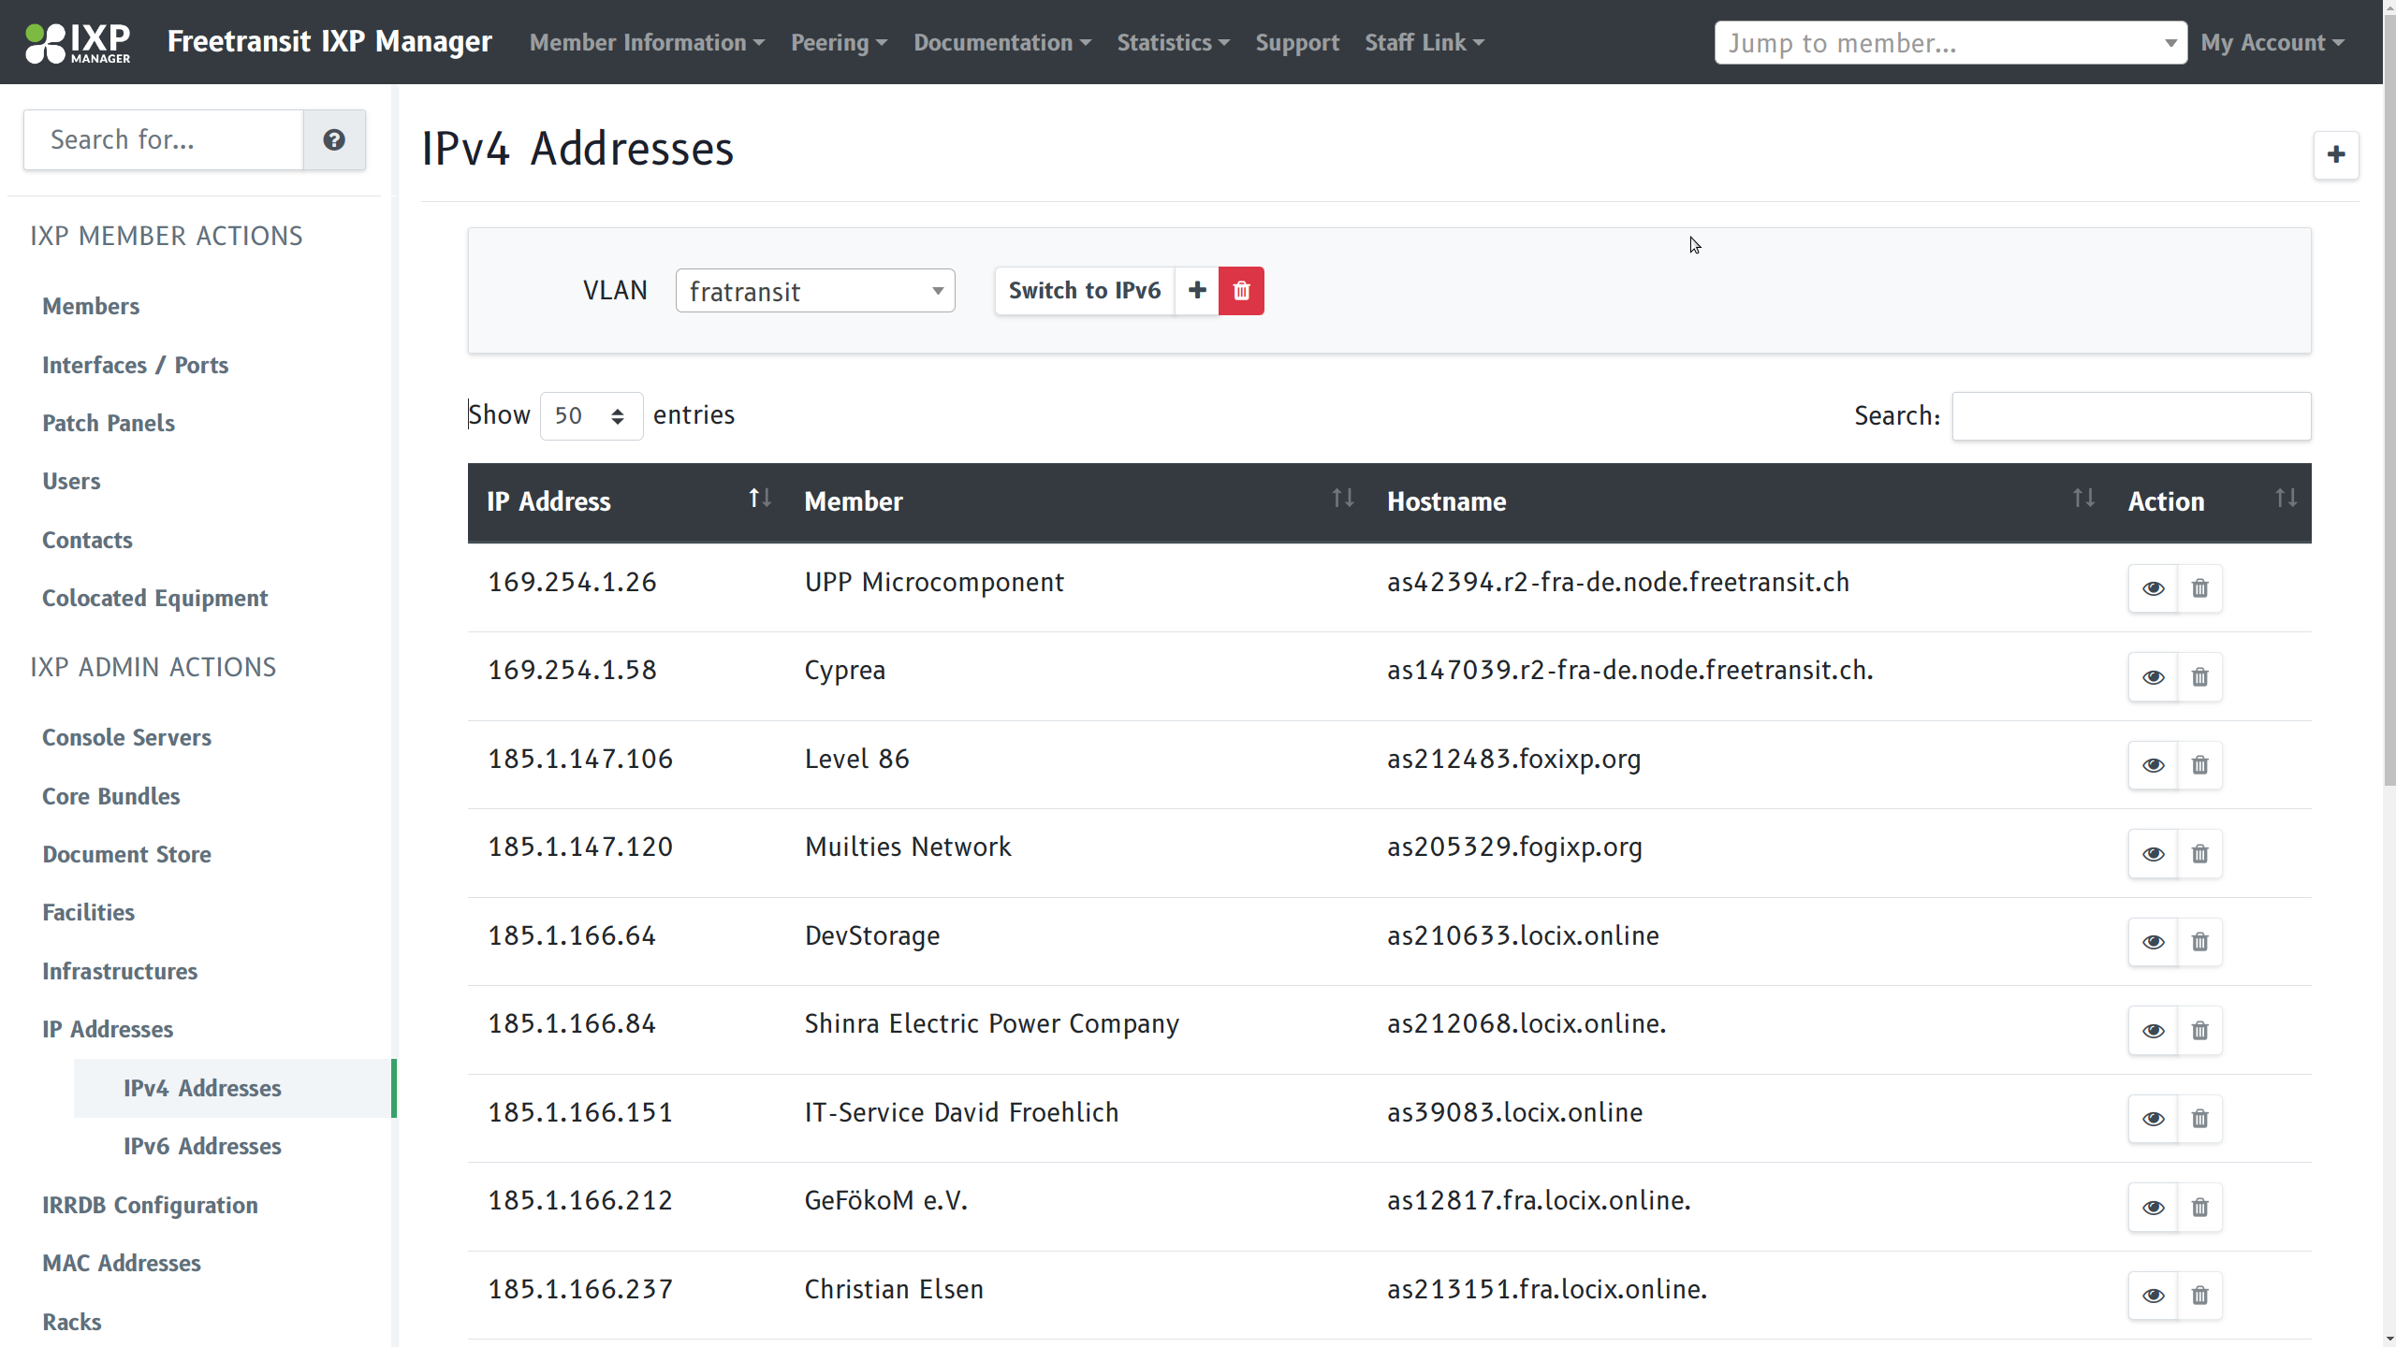
IXPmanager
Pystyy vetää oy

Slide 15
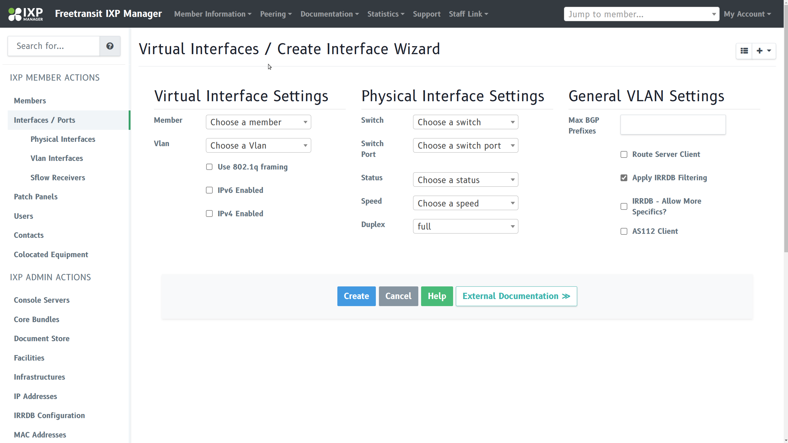
IXPmanager
Pystyy vetää oy

Slide 16
AS-SET
Definition of your “cone”
Your upstream and RS should generate filters
They can be stacked (included)
Pystyy vetää oy

Slide 17
BROKEN AS-SET
Recursions
Misuse: Include upstreams, include large ASN
Overflow on Hardware resources (ACL)
Pystyy vetää oy

Slide 18
Incident
We screwed up an ACL and had no more “on exit discard” (default deny) – we lost the last rule on copy paste
A downstream included their Upstreams
They leaked that prefix
We leaked Cloudflare towards Salesforce – and self inflicted DOS
Pystyy vetää oy

Slide 19
Countermeasures
Filter more intelligent, detect mistakes
Machinelearning
AI
Static Filters
Other system (none in use)
Stop using it
Pystyy vetää oy

Slide 20
No more acceptance of AS-SET
Lot more tunnel requests
Helpful for latency, as resharing tunnels is garbage
MTU
Scenic Routing
Hard debugging
More support cases, tho other are the problem
Pystyy vetää oy

Slide 21
Impact with IXPmanager
Shorter TimeToDeployment
Automated & Better filter updates
Documentation built in
Config Centralized
Pystyy vetää oy

Slide 22
Numbers
~ >>> whois AS41051:AS-PARTICIPANTS|grep members|grep AS|wc -l
320
~ >>>
ca 0.5% of the Global IPv6 Table
Sloppy/Lazyness of Endusers
Reworking of AMS node
Pystyy vetää oy

Slide 23
Technical
Neighbor-template.foil.php: - rs-client - source address routeserveraddress; (due to tunnel interfaces)
Header-foil.php: + protocol direct + protocol device + protocol kernel (we do want to write the routes to the operating system, we are actually a router!)
Footer.foil.php: + if/else bird/bird6 + include "/etc/bird/bird(6).d/*.conf.static";
Pystyy vetää oy

Slide 24
Technical
#### CONFIG BLOCK PER TUNNEL
auto tun9
iface tun9 inet static
address 169.254.1.25/30
#netmask 255.255.255.252
pre-up ip route add 192.0.2.1/32 via 5.226.149.44; ip tunnel add tun9 mode gre local 5.226.149.45 remote 193.33.84.8 ttl 255
post-down ip route del 192.0.2.1/32; ip tunnel del tun9
iface tun9 inet6 static
address 2a01:20e:1001:13c::1/64
#### END CONFIG BLOCK PER TUNNEL
Pystyy vetää oy

Slide 25
Contact
https://bgp.he.net/AS41051
www.freetransit.ch
@freetransit_ch
support@freetransit.ch
Pystyy vetää oy

