Slide 1
Amassing Country-Code Top-Level Domains from Public Data
Raffaele Sommese, Roland van Rijswijk-Deij, Mattijs Jonker
University of Twente
RIPE87 – Rome – 27 Nov – 1 Dec

Slide 2
Before starting
A special thanks to the
RIPE Academic Cooperation Initiative!

Slide 3
Introduction
The Web, as a vast and intricate network, has been the subject of extensive academic study from diverse technical, economical, and policy aspects.
These studies often start with lists of domain names, which serve as a fundamental building block of the Web's addressing system.
Domain lists can include top-ranked domain names or names extracted from zone files of top-level domains (TLDs).

Slide 4
Our (OpenINTEL) journey to domain names
OpenINTEL: A research-oriented, large-scale DNS measurement platform scanning ~65% of all registered domain names every day.
252 million domains daily, 9.1 trillion data point collected since 2015, more than 60 papers made possible by our data.
Goal: be the long-term memory of the DNS.
We rely on domain name lists (or zones) to seed our (forward DNS) measurements!

Slide 5
Source 1: Public Top Lists
Alexa top 1-Million (RIP)
Cisco Umbrella top 1-Million
Tranco top 1-Million
Cloudflare Radar top 1-Million
Only popular domain names : Biased, but public!

Slide 6
Source 2: The open ccTLDs
Switzerland (.ch), Estonia (.ee), Lichtenstein (.li), Niue (.nu) and Sweden (.se) via Zone Transfer (intentional AXFR!)
France (.fr) and Slovakia (.sk) via OpenDATA.
Fully representative : Public!
Source: Super Straho - Unsplash

Slide 7
Hic sunt dracones
The boundaries of our public data sharing!
https://data.openintel.nl/
Source: Wikipedia

Slide 8
Source 3: ICANN CZDS
With the expansion of new generic TLDs (gTLDs), ICANN mandated zone files to be accessible through a simplified and centralized process: ICANN's Centralized Zone Data Service.
Most of the gTLDs approved by ICANN!
Easy and quick process, only for gTLDs : Not re-shareable publicly (sort of)!

Slide 9
Source 4: The 'NDA' ccTLDs
Obtaining domain lists for 'non-open' ccTLDs is a complex and often arduous process, involving negotiations and restrictive contracts with ccTLD governing bodies.
And sometimes beers :)
We managed to get access to 13 ccTLDs.
Under NDAs : Not re-shareable
Source: Teo Do Rio - Unsplash

Slide 10
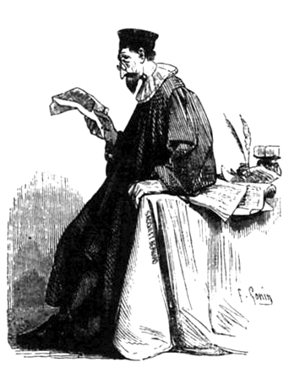
Source 5: The 'no way' ccTLDs
Germany (.de): Nein, Nein, Nein! Privacy!
Italy (.it): "We should ask to all the Italian domains owners if they agree to share the data with you"
Source: Wikipedia

Slide 11
Source 6: The 'we should share' ccTLDs
REGULATION (EU) 2020/857
"The Registry shall cooperate with competent authorities involved in the fight against cybercrime. It shall also cooperate with competent authorities and public and private bodies involved in the fight against speculative and abusive registrations, in cybersecurity and information security, in consumer protection, and in the protection of fundamental rights. It shall provide access to data to competent authorities and public bodies in line with Union or national law that complies with Union law, including with orders by courts or competent authorities vested with relevant powers."
Guess who is not sharing with public bodies (Universities) who operate in the cyber and information security spectrum?
Yes, looking at .eu!

Slide 12
To recap: The Problem
Barriers to data-sharing hurts the research community!
The Web extends beyond gTLDs: country-code top-level domains (ccTLDs) represent a significant portion of the local online landscape.
This lack of transparency leads to an underrepresentation of ccTLDs in research, limiting our understanding of the global and regional Web ecosystems.

Slide 13
ccTLDs concerns
Contrary to gTLDs, ccTLD governance is not under ICANN’s purview, but instead a matter of local policy.
Local policies often severely limit the data sharing possibility due to privacy and liability concerns.
GDPR complicated the matter -- some entities consider domain names personally identifiable information (PII).

Slide 14
Source: Star wars Movie

Slide 15
Another hope?
We turn to alternative sources and rely on public data sources containing substantial numbers of domain names
We explore two: Certificate Transparency (CT) logs and Common Crawl data.
But how representative are these public sources of the ccTLDs landscape?

Slide 16
Our Dataset
We collect data from two sizeable and sustained sources: Certificate Transparency (CT) logs and Common Crawl data.
CT logs track (as required by popular browsers) issuance of TLS certificates.
Common Crawl provides a vast repository of Web crawl data (~bi-monthly).
We amass domain names into a consolidated dataset for analysis.
Our methodology involves cross-referencing this dataset with a ground-truth of ccTLD zones to study coverage and timeliness.

Slide 17
Ground Truth
Our ground truth data is derived from the OpenINTEL project, which measures 19 ccTLDs (out of ~300 in existence).
12 ccTLDs zone files were obtained through NDA agreements; 7 are public.
Our dataset spans from 2018 to 2023.

Slide 18
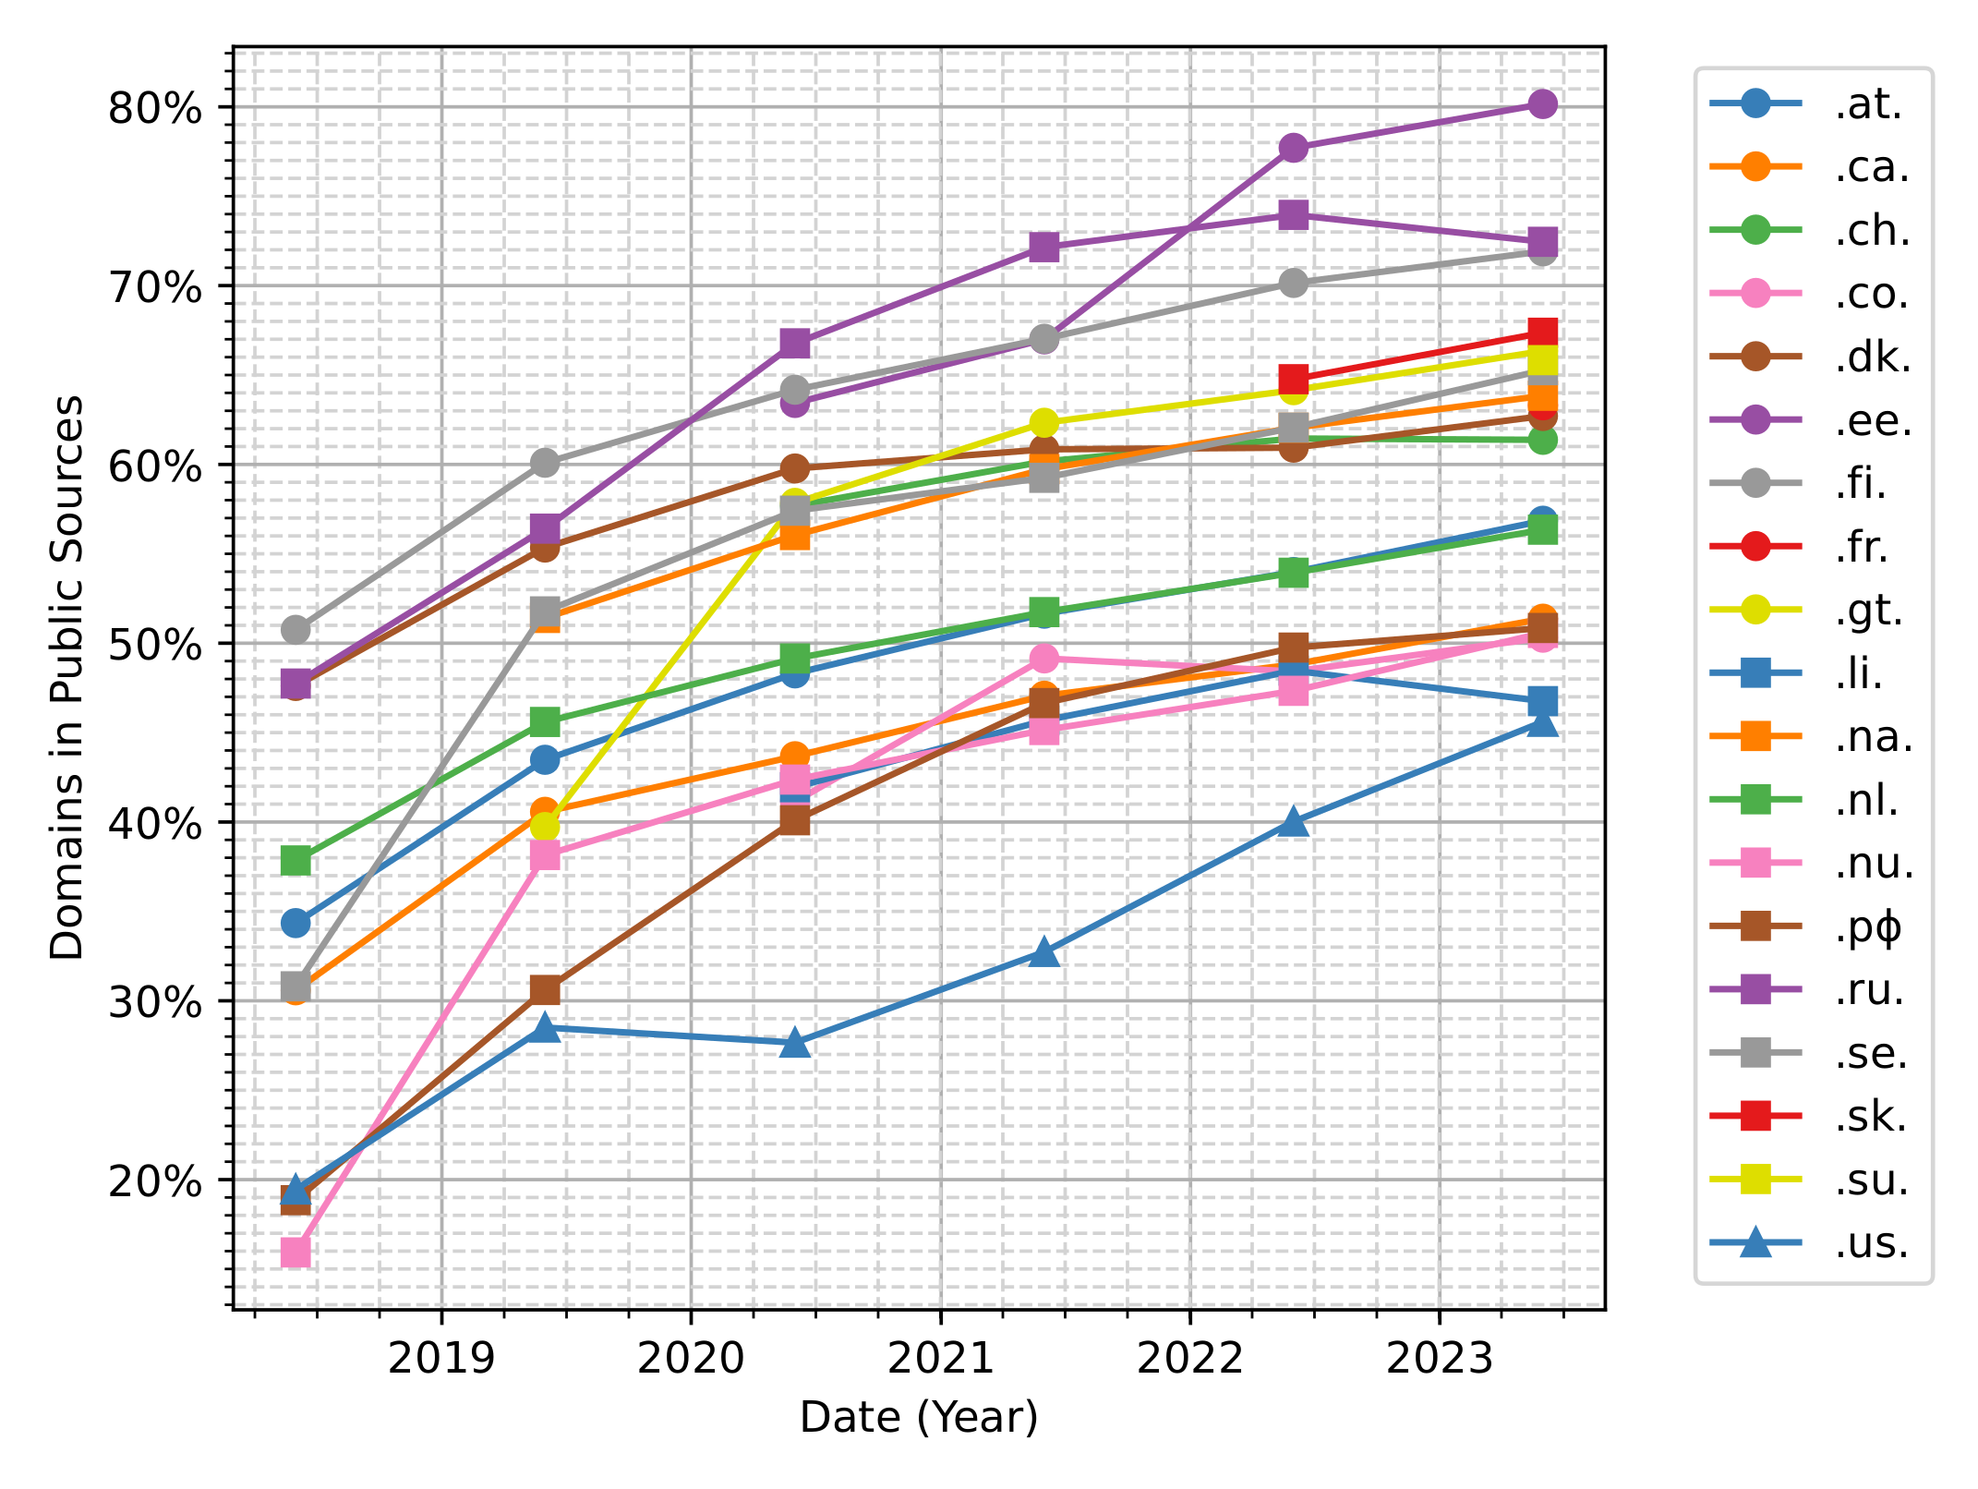
Half of the zones are already public!
Varying coverage for 19 ccTLDs, ranging from 43% to 80% in 2023.
Coverage has steadily increased over the years, from avg 37% in 2018 to 59% in 2023.
This already negates the privacy concerns of ccTLDs!

Slide 19
Half of the zones are already public!
Varying coverage for 19 ccTLDs, ranging from 43% to 80% in 2023.
Coverage has steadily increased over the years, from avg 37% in 2018 to 59% in 2023.
This already negates the privacy concerns of ccTLDs!

Slide 20
Coverage Contributions
In 2023, CT logs and Common Crawl together contribute to a coverage of 59% for ccTLDs.
CT logs account for most of this coverage, with 24% due to co-appearing names, 28% solely thanks to CT, and 7% exclusively from Common Crawl.
Common Crawl adds value by capturing additional domain names.
The supplemental coverage provided by Common Crawl is decreasing over time, possibly due to the increased adoption of TLS.

Slide 21
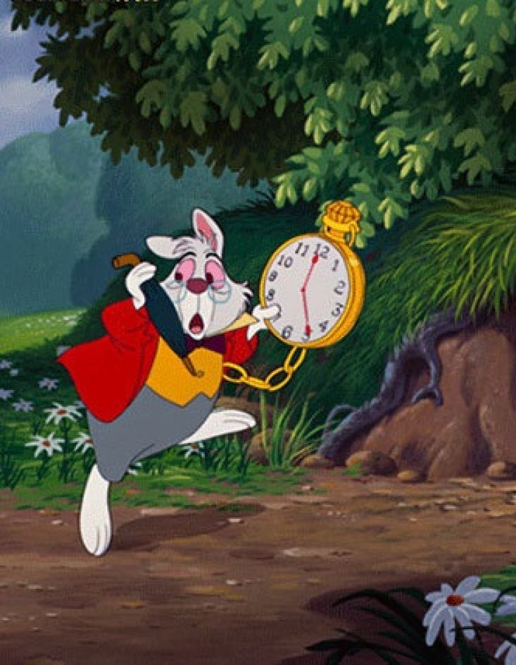
Delay in Publication
How long does it take for a ccTLD domain to appear in public sources after registration?
Nearly 60% of newly registered domains appeared in CT logs on the same day they were added to the zone, and 80% within five days.
CT logs can provide timely data about newly registered domains!
Source: Alice in wonderland Movie

Slide 22
Can we generalize our results?
Our sample of ccTLD covers only 19 of ~300 ccTLDs in existence.
To generalize our results, we assessed coverage in 2023 for 1153 gTLDs!
Coverage across gTLDs varies, but generally falls within the range of 38% to 80%.
Larger gTLDs tend to have higher coverage rates.
Our findings suggest that public sources can provide substantial coverage across different TLDs.

Slide 23
What do we not see?
We examined the presence of IPv4 address and open web ports.
Of the names in both CT logs and Common Crawl, 91.5% had open Web ports.
Domains not found in either source: 70.5% had open Web ports.
Domains in both CT logs and Common Crawl showed the highest rates of HTTPS deployment (87.7%).

Slide 24
Our Appeal to Registries
Registries with closed zones should consider opening their zones with minimal delay to address security concerns and benefit the community.
Legal framework should be rediscussed, even at the European Level.
NIS2 ?!

Slide 25
Conclusion
CT Logs and Common Crawl provide visibility on more than 50% of closed ccTLDs domains (on average).
OpenINTEL data sharing efforts have been curbed in the past due to contractual agreements. We will make more measurement data public soon.
We hope these results can spark a discussion with ccTLD operators for more transparency and data sharing efforts.

Slide 26
Questions?
r.sommese@utwente.nl
Let's discuss data sharing!

Slide 27
Amassing Country-Code Top-Level Domains from Public Data
Raffaele Sommese, Roland van Rijswijk-Deij, Mattijs Jonker
University of Twente
RIPE87 – Rome – 27 Nov – 1 Dec

Slide 28
Backup Slides

Slide 29
Amassing Domain Names Challenges
Considering other public data sources:
There are alternative sources such as the HTTP Archive and TLS scans that could complement domain name amassment efforts.
Feasibility of amassing domain names:
Scraping CT logs and Common Crawl data at scale requires resources.
CT Logs are retired over time (especially temporally sharded logs).

