Slide 1
Indexing Europe’s Internet Resilience
November 2023
Robbie Mitchell
mitchell@isoc.org
Notes:
Good morning,
First, thank you to the organizers and selection committee for putting on and inviting us to this event and to all of you who have stayed until the end of the week to listen to our final presentations.
Today, I will talk about the Internet Society’s efforts to help decision-makers understand the global Internet's health, availability, and evolution and gain your feedback on how we can improve this as an industry.
What I hope you leave here today with is that it’s worth keeping abreast of the resilience of your and your neighboring country’s Internet ecosystems, as there is plenty to learn from the strengths and weaknesses and plenty of insight that you can offer to improve the overall health of the Internet.

Slide 2
What we'll cover
Why we are seeking to better inform decision-makers.
What can we learn from recent incidents?
Strengths and weaknesses within Europe
The industry and Internet community have a role to play in improving the Internet’s resilience.
Notes:
As an overview:
I’ll discuss three case studies of how Internet resilience in North America, Europe, and Australia has been compromised in the last 17 months.
I’ll then share a snapshot of Europe’s Internet resilience with you and highlight its strengths and weaknesses.
Finally, I’ll discuss the need to improve national and regional Internet ecosystem data resolution to allow decision-makers to make more informed decisions on improving the Internet’s health in their countries.

Slide 3
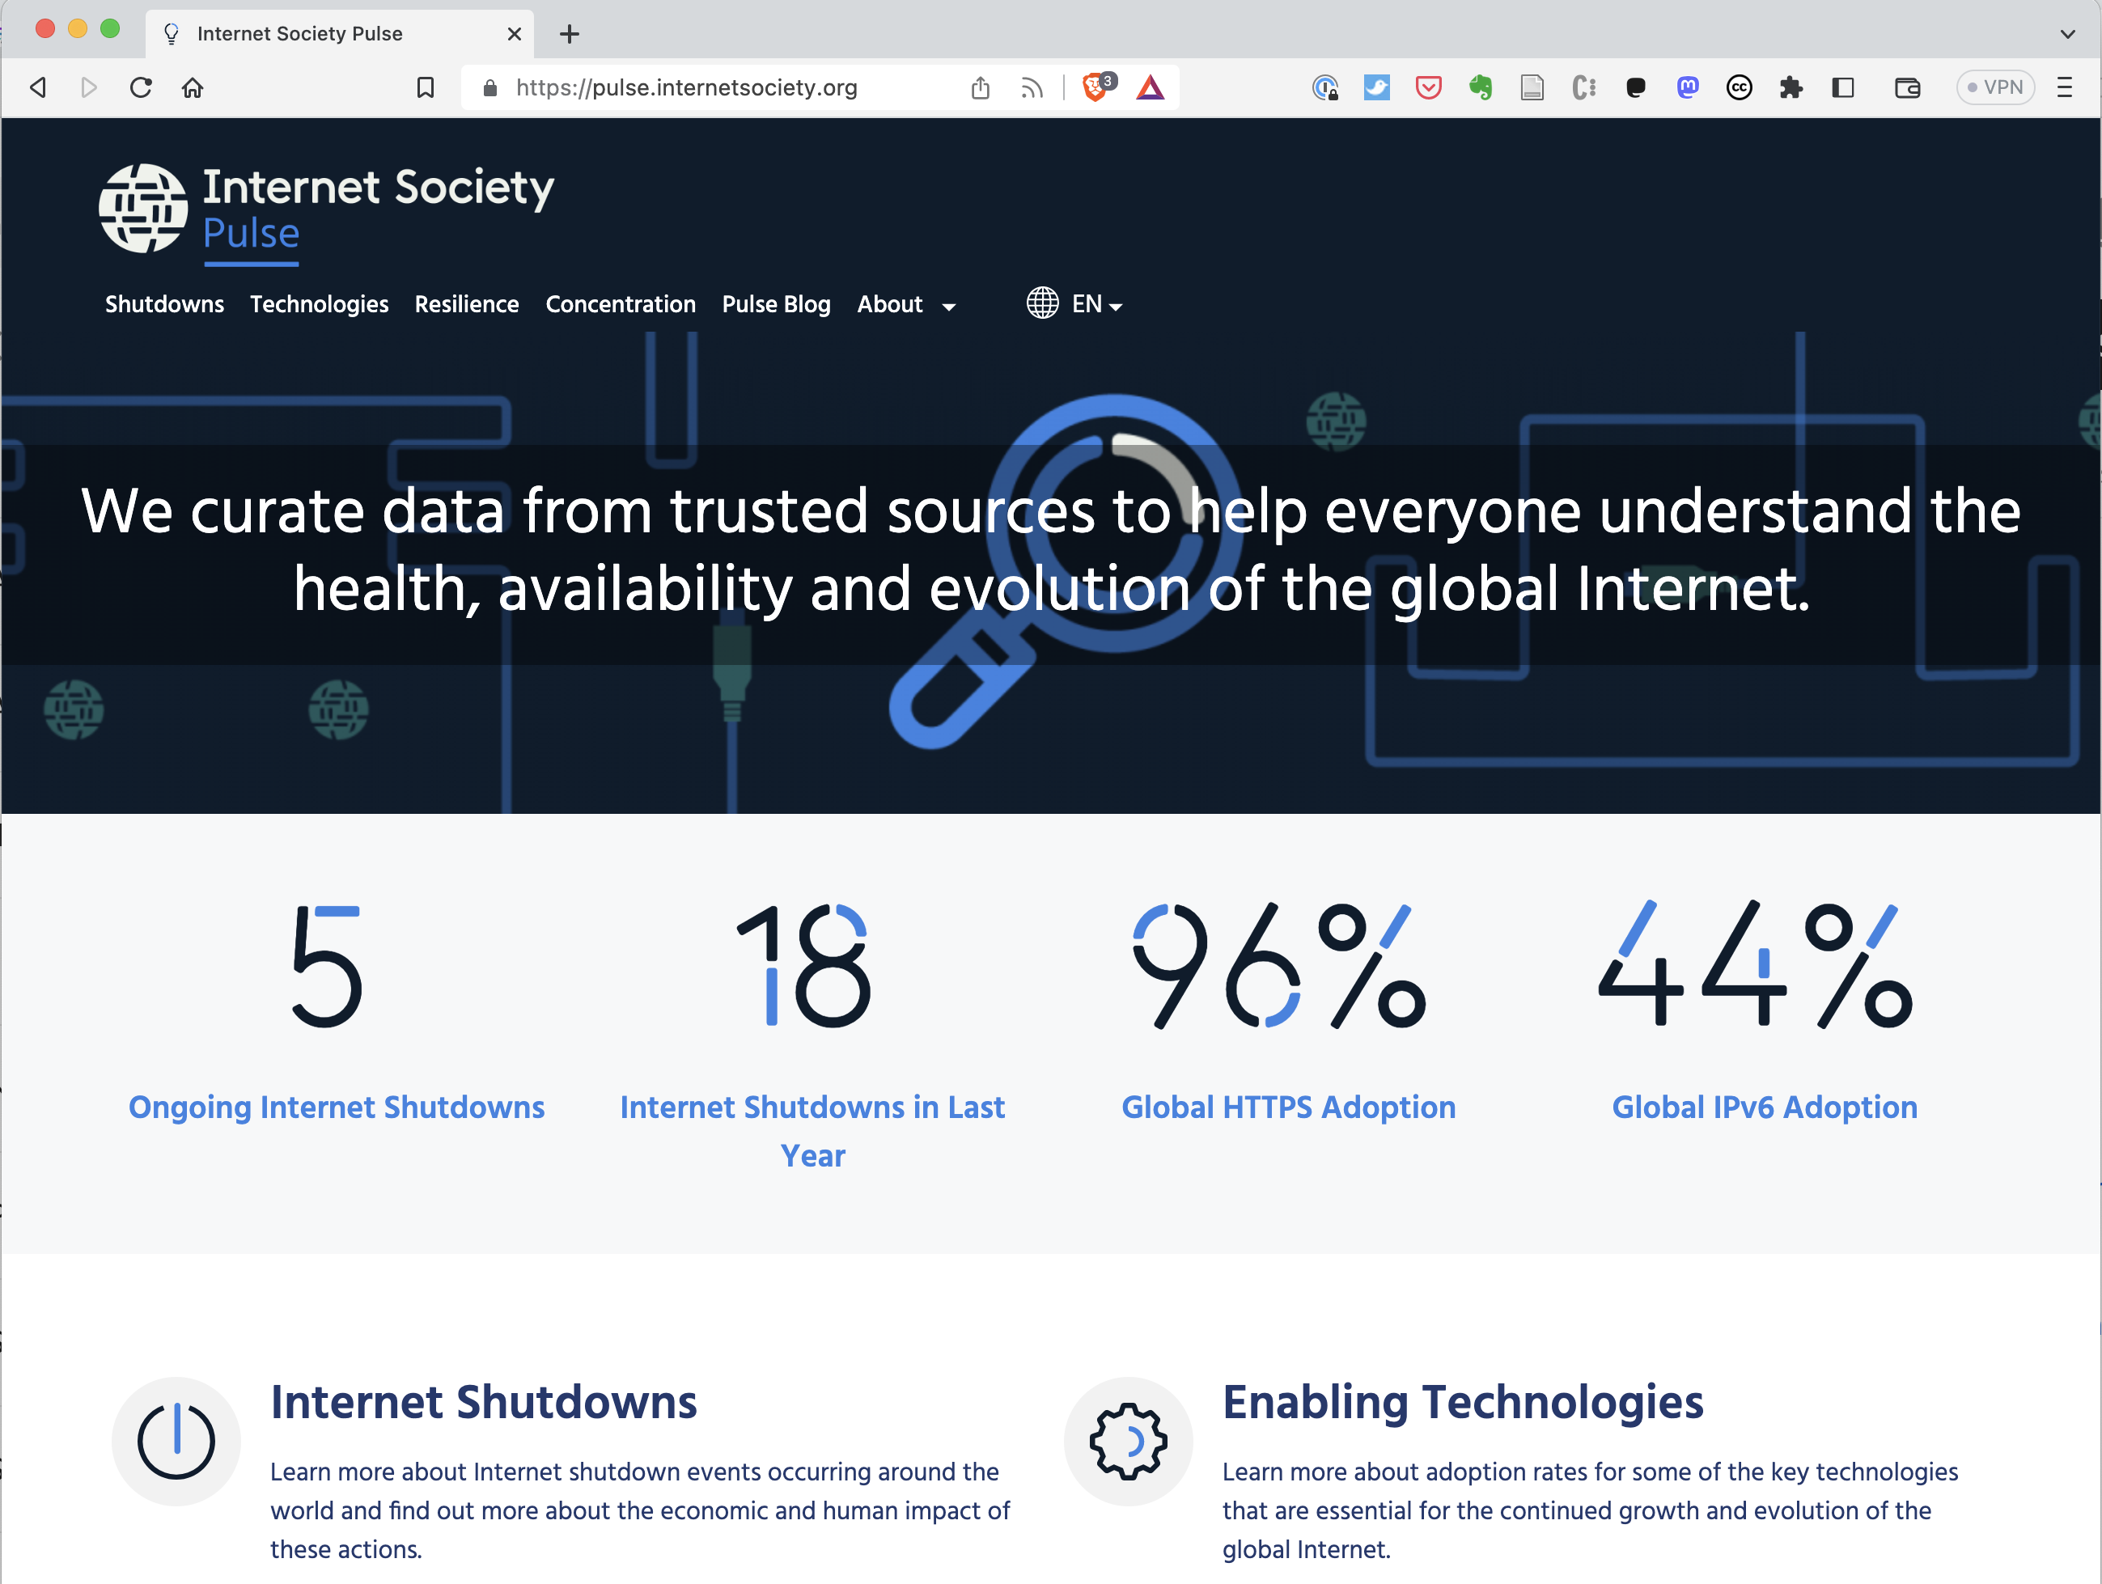
pulse.internetsociety.org
Your Data Dashboard
Notes:
ISOC has been running its Measuring the Internet project for around three years. The outward-facing product of this is the Pulse platform, which curates open-source data to examine Internet trends and tell data-driven stories so that decision-makers and others can better understand the Internet's health, availability, and evolution.

Slide 4
Pulse tracks
Shutdowns: Where do Internet Shutdowns take place?
Technologies: What is the state of deployment of technologies critical for the evolution of the Internet?
Concentration: How much are services concentrated in the hands of a few?
Resilience: How robust is the Internet ecosystem?
Notes:
Our current focus areas are tracking:
Internet shutdowns
The state of deployment of critical technologies such as IPv6, DNSSEC, TLS1.3, and HTTPS
The concentration of infrastructure, services, and markets
And, finally, the resilience of the Internet in more than 170 countries

Slide 5
Internet Society Pulse Internet Resilience Index (IRI)
Notes:
Regarding the last of these focus areas, we developed an Internet Resilience Index, which I’ll refer to during this presentation.
The IRI collates and tracks open-source Internet resiliency metrics to support policy-makers in their decisions related to improving the Internet’s resilience at a local, regional, and global level.

Slide 6
The Internet Resiliency Index (IRI)
pulse.internetsociety.org/resilience​
The framework collates around 30 sets of public metric data that relate to four pillars of a resilient Internet:
.
Infrastructure
The existence and availability of physical infrastructure that provides Internet connectivity.
Performance
The ability of the network to provide end-users with seamless and reliable access to Internet services.
Security
The ability of the network to resist intentional or unintentional disruptions through the adoption of security technologies and best practices.
Market Readiness
The ability of the market to self-regulate and provide affordable prices to end-users by maintaining a diverse and competitive market.
Methodology: https://pulse.internetsociety.org/wp-content/uploads/2023/07/Internet-Society-Pulse-IRI-Methodology-July-2023-v2.0-Final-EN.pdf
Notes:
The IRI draws upon more than 20 open data sources and uses best practice methodologies to calculate a snapshot of a country’s Internet resilience in terms of its:
Infrastructure
Performance
Security
Market Readiness
I’ll speak to these pillars and the metrics contributing to them as I go along. But before I do…

Slide 7
What can we learn from recent incidents?
Notes:
I want to place the importance of measuring and advocating for Internet resilience into context by noting three recent incidents that brought to the fore the weaknesses in the resilience of Australia's, Canada's, and Italy’s Internet ecosystems.

Slide 8
AS4804 outage
The outage lasted 10 hours
It affected the fixed broadband and mobile communications of over 10 million individuals and 400,000 businesses and services.
Issue believed to be related to BGP Maximum-Prefix filter.
Signs of lack of resilience were clear to see
Notes:
The most recent of these incidents happened last month in Australia, where a minor technical slip-up by the second largest operator, Optus, caused one-third of Australians to lose Internet and mobile connectivity and disrupted emergency services, hospitals, banks, and public transport services.
While there has been no Root Cause Analysis forthcoming yet, plenty of commentary is swirling around as to what happened. One of my colleagues, Aftab Siddiqui, noted on the Pulse Blog that the warning signs of Optus’ lack of resilience, compared to other carriers, were apparent, most notably their disengagement with local peering. While this was possibly a strategic business decision, it overlooks an opportunity to bolster network resilience through diverse connection points, a metric we consider part of the IRI.

Slide 9
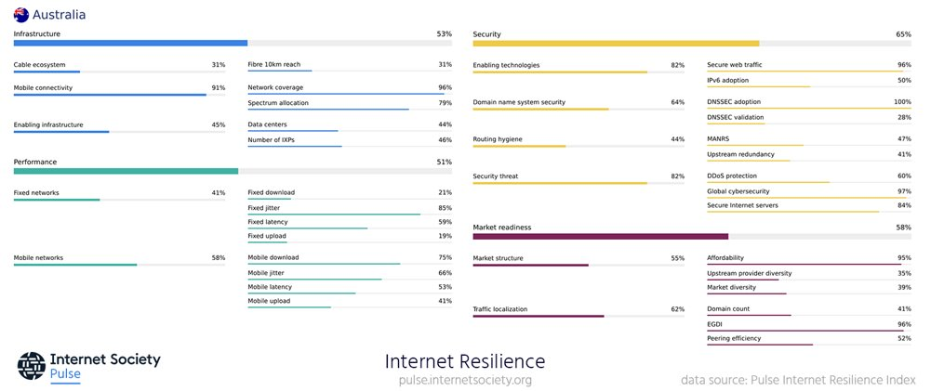
Australia – Internet Resilience Index​
Notes:
While the IRI does not offer insight at a network level, it shows how concentrated market share is, which, if you’re familiar with Australia’s telecommunications market, is pretty much a 2.5-horse race.
Given the wide-ranging severity of this outage, the Australian government quickly ordered an inquiry to examine roaming and emergency services impacts and whether rival telcos can offer access to their services during network shutdowns. It will also investigate the adequacy of Optus’s communications on the day of the outage.

Slide 10
AS812 outage
The outage lasted 19 hours.
It affected 12 million subscribers and indirectly affected millions of others.
Cost the economy nearly 142 million USD and Rogers 150M USD in customer credits.
Rogers has also never provided a Root Cause Analysis
Notes:
The second case study shares similar traits to the first, including a chief executive. The Rogers outage in July 2022 spread across Rogers’ cable, mobile, and fixed line services and directly affected all of its 12 million subscribers and indirectly:
Prevented all businesses nationwide from being able to accept debit card transactions,
Affected several government services, including the Canadian Border Service
Impacted on the timing of one-quarter of all traffic signals in Toronto
Denied access to 911 emergency services.
Overall, it was estimated to have cost the Canadian economy nearly 142 million USD and Rogers 150M USD in customer credits.
Like Optus, Rogers has never provided a postmortem on the outage except for noting that the outage resulted from a configuration change that deleted a route filter, flooding “certain network routing equipment” and resulting in a core network failure with broad impact.
Rogers has acknowledged the need to “plan and implement network separation of wireless and wireline core network functions.” it is currently spending USD 261 million on doing so.

Slide 11
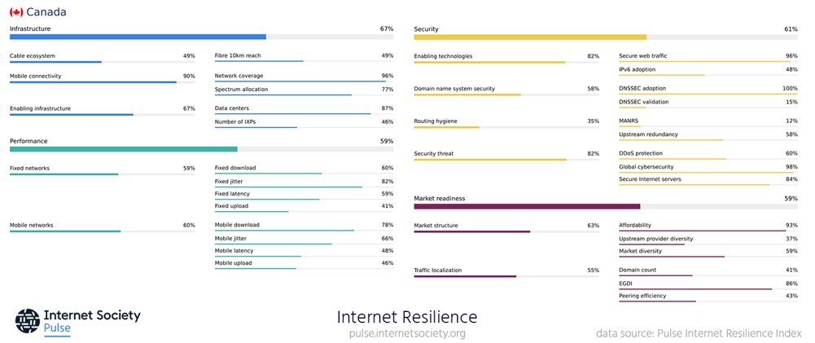
Canada – Internet Resilience Index​
Notes:
If we look at the IRI profile for Canada, we can see that upstream provider diversity is about the same as Australia's, but its market diversity is quite a bit higher. It will be interesting to see how this figure changes, given the recently approved merger between Rogers and Shaw Communication.
Like Australia, the incident bore government scrutiny. It spurred similar government policies that the Australian government is currently seeking to reduce the impact of future incidents, including greater clarity from providers.

Slide 12
AS3269 and AS16232 outage
Outage lasted 5 hours
It affected one-third of Italy’s Internet users.
Cost the economy nearly 142 million USD and Rogers 150M USD in customer credits.
Rogers has also never provided a Root Cause Analysis
Notes:
The final incident I wanted to highlight happened here in Italy earlier this year, when, again, nearly a third of Internet users in a country were left without Internet connectivity for five hours.
Like the other two incidents, the ISPs in question haven’t been forthcoming with a Root Cause Analysis. Still, thanks to analysis from the community, including my former colleague, Max Stucchi, it was apparent that the issue was related to a lack of redundancy on the side of TIM and its upstream provider, Sparkle, combined with a lack of local peering.

Slide 13
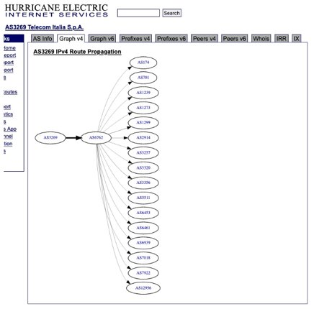
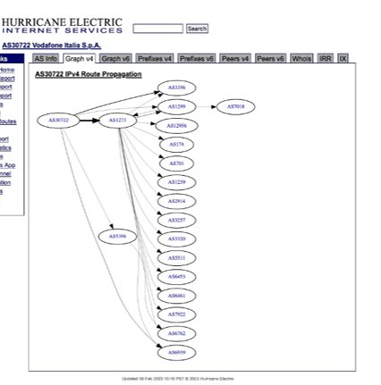
Italy – Compare the Pair
AS3269 TIM
AS30722 Vodafone Italia
Notes:
As seen on the Hurricane Electric BGP Toolkit, TIM relies only on Sparkle for international connectivity.
If we compare this to Vodafone Italy (AS30722), it has five upstream providers. This setup provides plenty of redundancy ’when’ one of these upstreams has an outage.

Slide 14
Italy – Internet Resilience Index​
Notes:
If we look at Italy’s IRI, it’s interesting to note how upstream diversity ranks highest of all three case study countries, which does point to a limitation of the index and metric. I’ll speak more about this shortly.

Slide 15
Internet Resilience in Europe: Strengths and Weaknesses
Notes:
Ok, with all this in mind, let’s take a look at the Internet Resilience of Europe.

Slide 16
Overall Internet Resilience — By Region
Notes:
So, Europe collectively has by far the most resilient ecosystem of the five regions in the world.

Slide 17
Notes:
Of the top ten countries, nine are European, with Switzerland and Iceland leading all.

Slide 18
Switzerland– Internet Resilience Index
Notes:
If we look at Switzerland’s IRI profile, we can see they don’t have many weaknesses, though we can note their market diversity is lower than that of our previous countries. This still needs to take into consideration Switzerland's smaller population, though. The one interesting outlier is their lack of DDoS protection.

Slide 19
Iceland– Internet Resilience Index
Notes:
Similarly, Iceland has plenty of strengths, with IPv6 adoption and, again, market diversity being among its weakest resilience metrics.
Of note, both countries have needed to overcome differing challenges to establish their Internet resilience, one being landlocked and mountainous, the other being an island.

Slide 20
Notes:
One country that I wanted to highlight was Bulgaria, which ranks 5th in Europe and 6th globally.

Slide 21
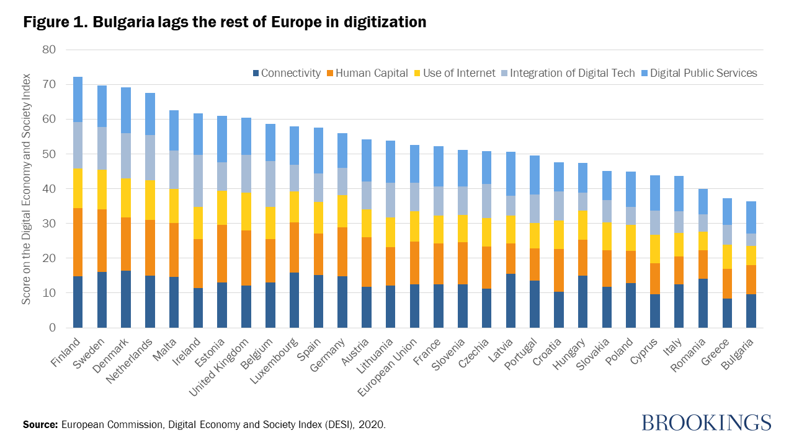
https://www.brookings.edu/articles/can-bulgaria-catch-the-digital-wave-defining-the-policy-priorities/
Notes:
This is interesting when considering that, as per a Brooking report from 2021, Bulgaria still lags behind the rest of Europe regarding adopting digital technologies. Poor digital literacy and skills, low levels of investment in research and development (R&D), and incomplete digitization of public services are perceived to be holding the country back even though it has one of the most resilient ecosystems, and the ICT sector has grown to become the country’s top export in services.

Slide 22
Bulgaria– Internet Resilience Index
Notes:
Incredibly, there is plenty of potential for the country to increase its resilience relatively easily through greater IPv6 and DDoS protection adoption and increasing peering with its 7 IXPs.

Slide 23
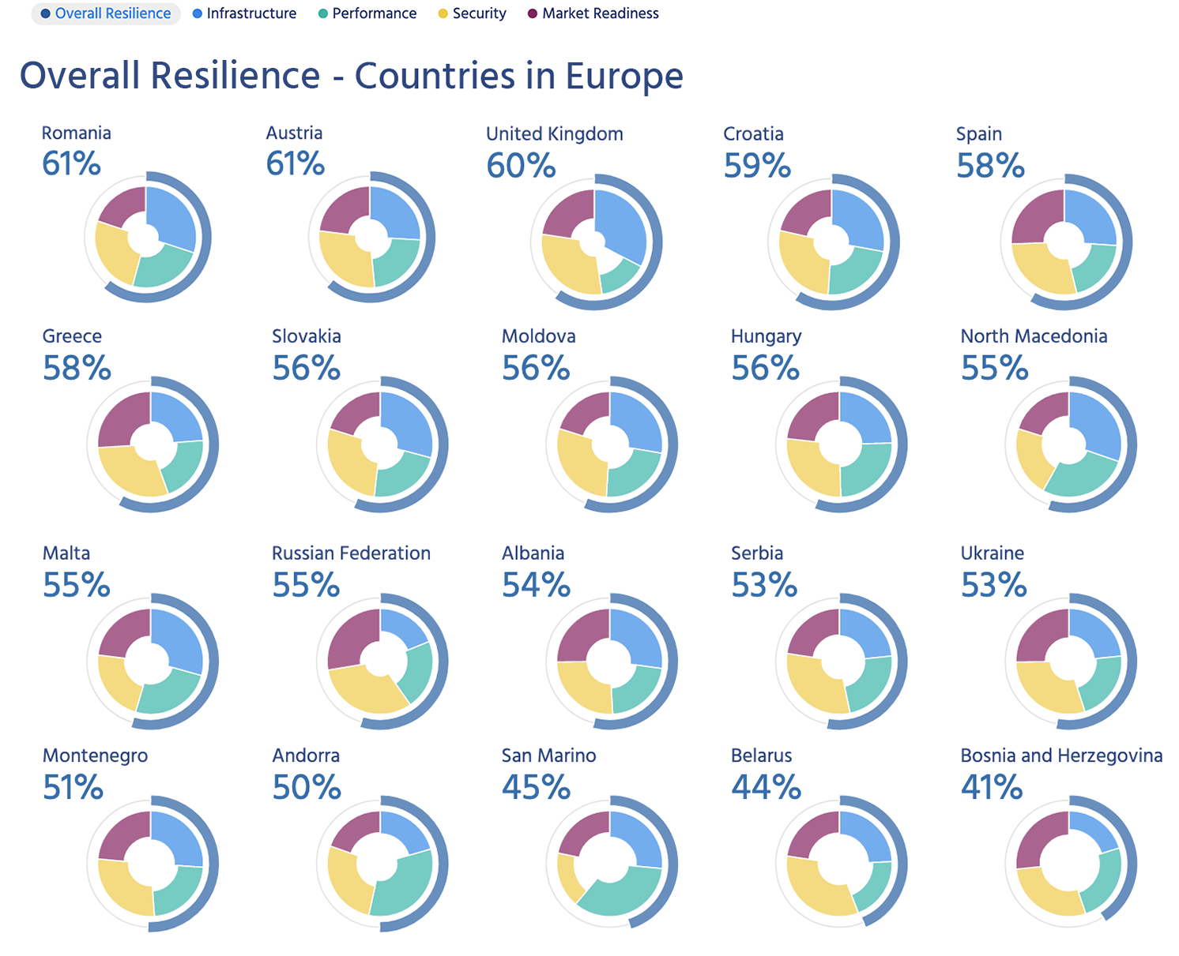
Notes:
If we turn our attention to the countries with the weakest resilient Internet ecosystems, we can see that there is plenty of opportunity for Europe to increase its overall resilience collectively.

Slide 24
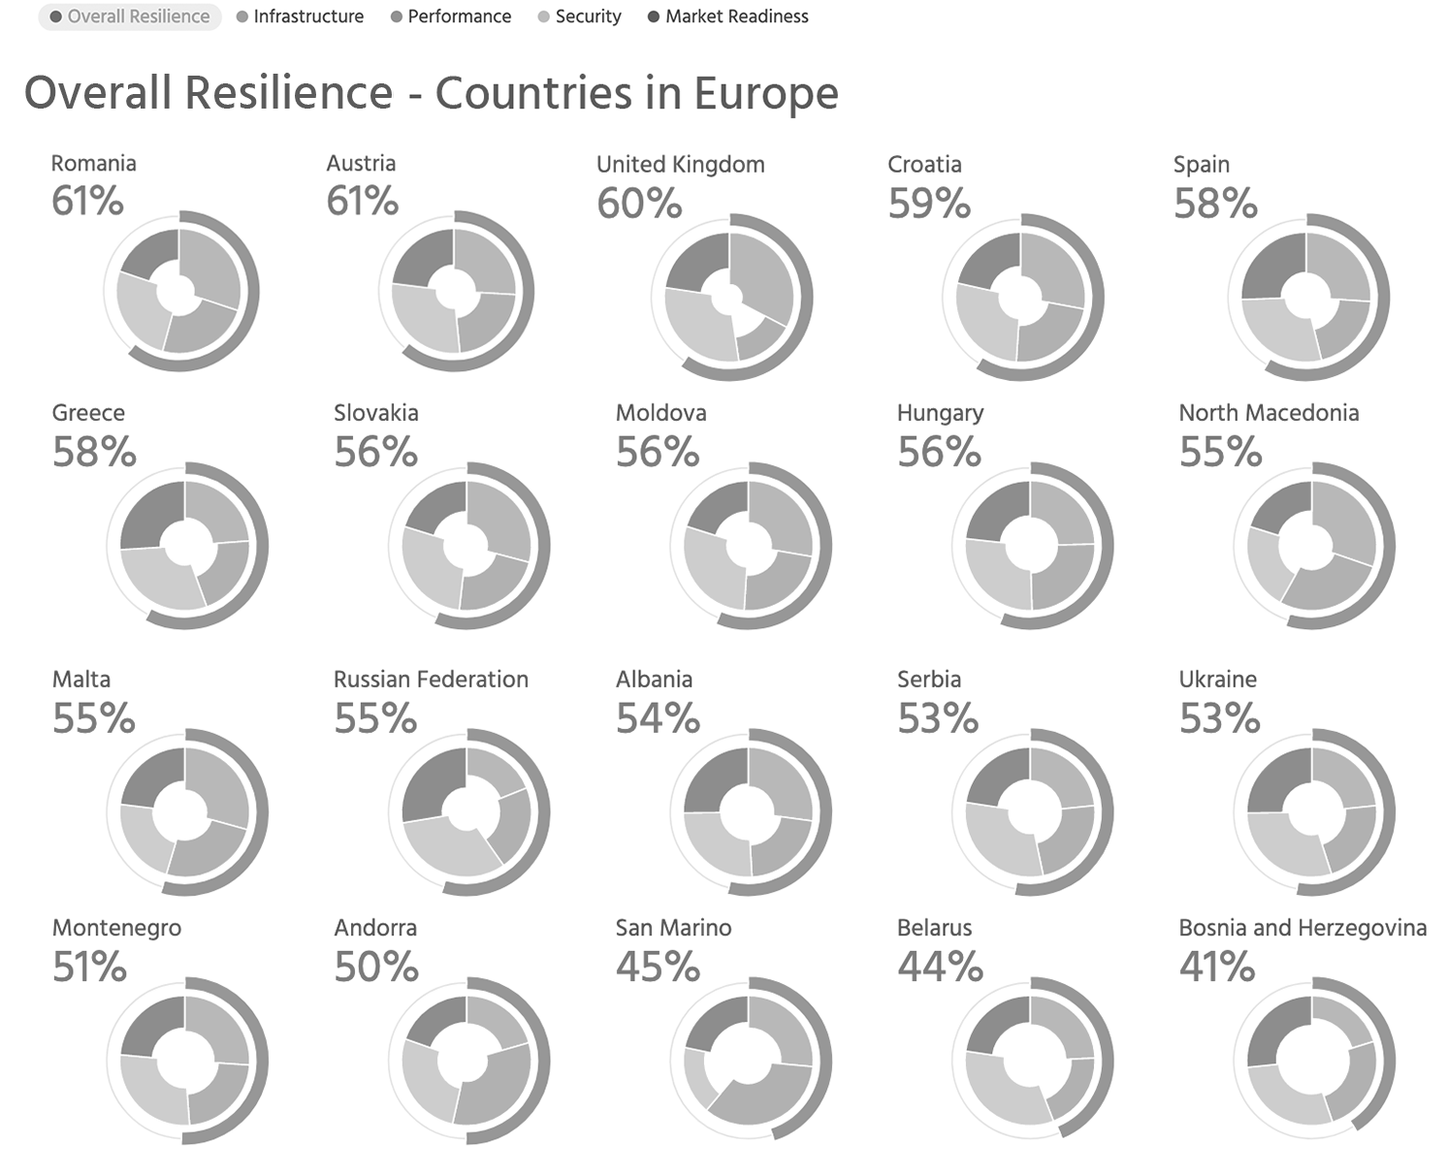
Notes:
More so, we can highlight the importance of resilience by looking at the country that has perhaps had its Internet ecosystem come under the most stress of any country in the 18 months.

Slide 25
Ukraine– Internet Resilience Index
Notes:
Ukraine has been a role model of Internet resilience in Eastern Europe for many years and has consistently scored relatively high on the four pillars of the IRI. Having this solid base, particularly for its infrastructure, security, and market readiness, has helped it maintain its Internet connectivity during the war.

Slide 26
Ukraine– Internet Resilience Index
Notes:
Four metrics that I wanted to draw your attention to specifically are:
Number of IXPs — it has 27 IXPs
MANRS score
Upstream redundancy and
Market diversity
All of these have helped insulate local connectivity in many ways from the targeted attacks that Russia has made on Ukraine’s infrastructure.

Slide 27
Ukraine – IPv4 and v6 Interconnection (APNIC REx)
https://rex.apnic.net/as-interconnections?allocationType=ipv4,ipv6&economy=UA
Notes:
As can be seen here, it has a strong local peering fabric. Importantly, this has changed little, even as nearly 100 ASNs have transferred out of the country, most to Russia.

Slide 28
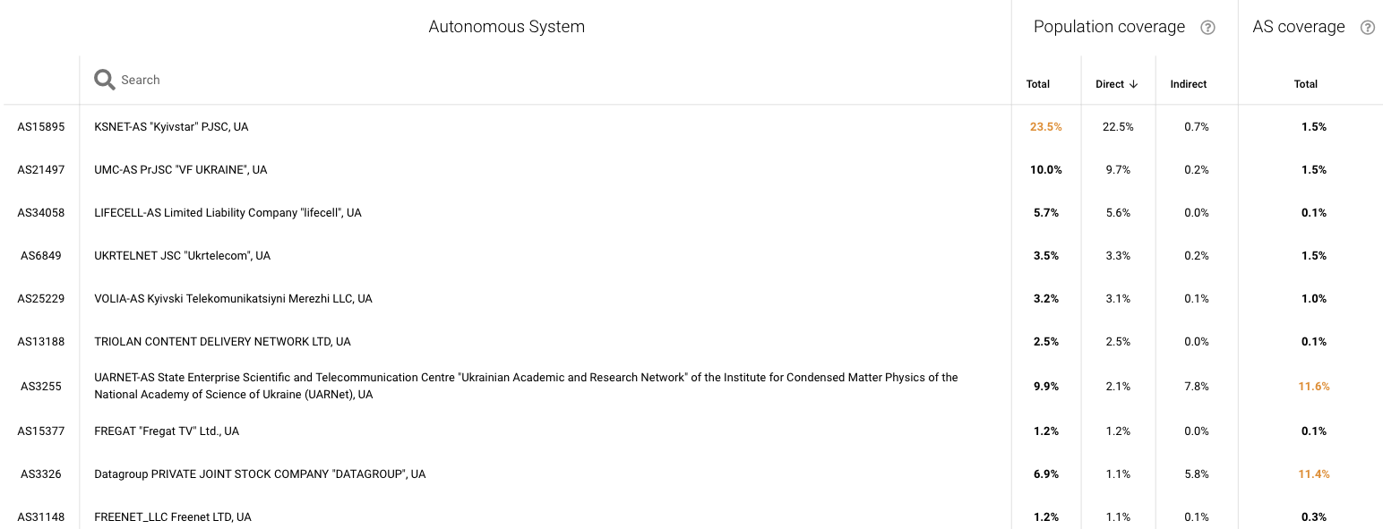
Ukraine – ASN Dependency (IIJ Internet Health Report)
https://ihr.iijlab.net/ihr/en-us/countries/UA?af=4&last=3&date=2023-08-24&rov_tb=routes
Notes:
While Kyivstar is the dominant ISP in the country, multiple other providers provision more than three-quarters of the remaining traffic. This has been especially important given that Kyivstar has experienced increased latency and decreased throughput.
Notably, 71% of networks are implementing best current routing security practices, 99% of which have documented their routing announcements in the IRR and 40% in RPKI.

Slide 29
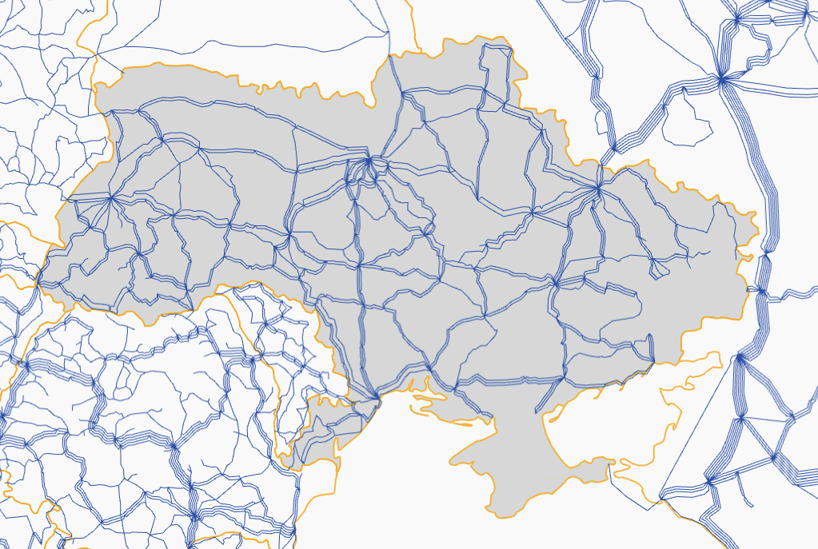
Ukraine – Exit Points
Belarus
Poland
Russia
Slovakia
Hungary
Moldova
Romania
https://bbmaps.itu.int/bbmaps/
Notes:
While we don’t yet show exit points on the IRI, we recognize it is an essential indicator of a country’s Internet resilience. Ukraine has no submarine cables and relies only on terrestrial links with its neighboring countries, which, luckily, have many that are not at war with it. Furthermore, Ukraine’s ISPs have four or more international upstream providers.

Slide 30
Limitations
Notes:
What I’ve shown you here is merely a guide and some of you may have scoffed at some of the scores and sources, and you may have your own data that shows something different. What we’re trying to do with this tool is to make these open data sources more readily available to decision-makers so they can make sense of them in demonstrating the various aspects that make up the health of the Internet.

Slide 31
Limitations
The data is pulled from external public sources, not always up-to-date.
An indicator is not included if data is missing on more than 25% of countries in the Index.
Without in-country measurements, it’s difficult to validate the data.
RIPE Atlas and OONI are doing great work in this area, but more is needed.
Some of the data undergoes processing, normalization, and weighing, we use a methodology that is reproducible.
You can see raw numbers via API. Email us for access pulse@isoc.org
Ultimately, the Index benchmarks countries with one another and helps decision makers recognize gaps and weaknesses to conduct further study into validating these and work towards addressing them.
Notes:
By no means do we say use this as the source of truth. But it does provide a digestible view of what is going on to help you, and especially decision makers, identify weaknesses and then hopefully do your own research to validate if what these measurement systems are seeing is accurate.
To this point, we advocate for greater localized data sourcing and sharing, which provides greater resolution to what is really happening at the edge.
This is also the first version of this Index framework, and we plan to expand it to include new metrics, including how resilient countries' Internet ecosystems are to climate and natural disasters.

Slide 32
We all have a role to play
Notes:
To conclude, understanding what’s happening upstream and beyond your country’s borders is equally important as knowing your network's health.

Slide 33
Take aways
Understanding what’s happening upstream and beyond your shores is equally important as knowing your network’s health.
Having an insightful national measurement system in place improves the resolution of the health of the edge.
Your network's health and the health of the whole of Europe’s Internet are interconnected. We all have a role to play to make sure it is robust and secure.
Notes:
You may want to know that the networks you’re peering with, and the routes you’re taking are resilient, so you won’t be up for any sudden costs to purchase capacity on the chance of any mishap.
Some of you may also be servicing customers in other countries or are considering doing so. Again, knowing the Internet resilience of those countries and the links between them can help you understand the risks and where you might need to invest.
Furthermore, having an insightful national measurement system in place helps validate this sort of data that we and decision-makers are becoming more reliant on to help us address the weaknesses in the ecosystem.

Slide 34
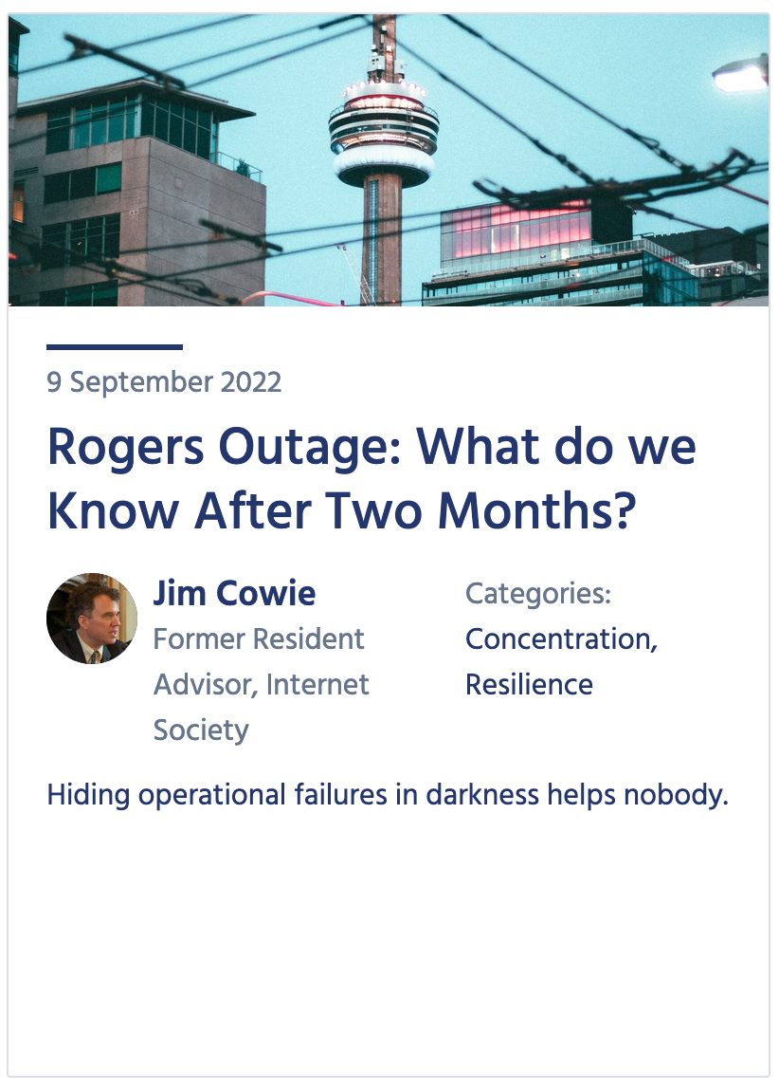
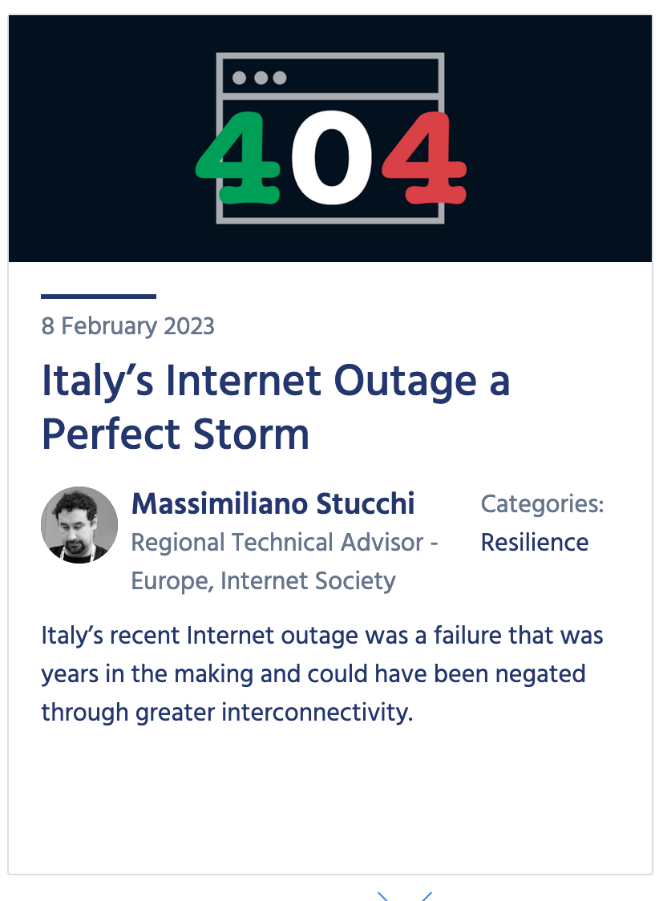
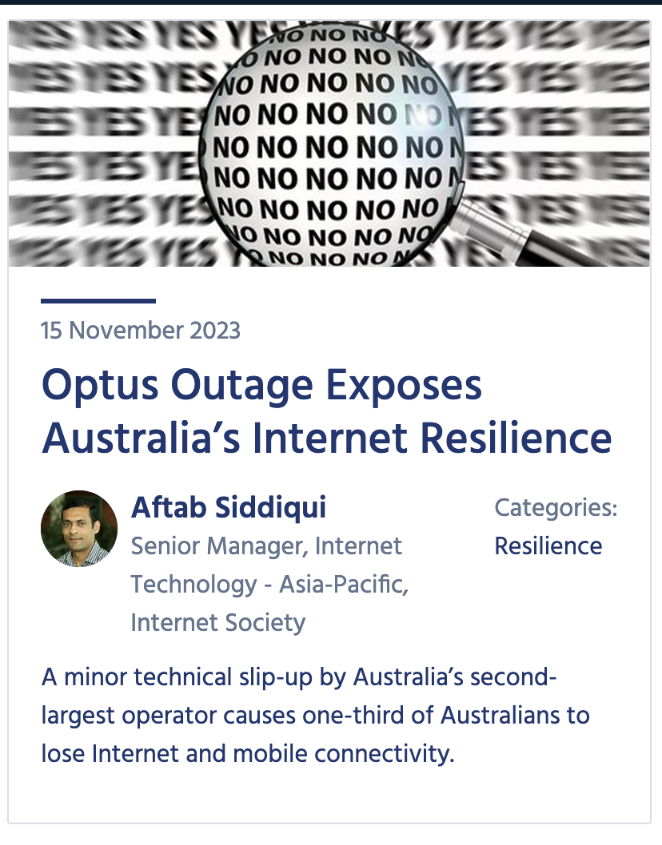
Not if, but when
Who’s next?
Canada, July 2022
Italy, February 2023
Australia, November 2023
Notes:
And while it’s unfortunate that others have mishaps, you can learn from them and should share your own misfortunes and successes so that others can learn from you, too.
As the adage goes, it’s not a case of if but when. But the impact doesn’t necessarily have to follow those I’ve talked about.

Slide 35
Subscribe, Review, Contribute
Subscribe to the Pulse newsletter
Review the Pulse IRI methodology
Contribute to Pulse
pulse@isoc.org
Notes:
Finally, if you’re interested in keeping abreast of our project, please subscribe to our monthly newsletter.
Or email us to discuss opportunities to partner or contribute to our Blog.
I’ve also shared a link to the methodology of the IRI for those interested in the sources and calculations.

Slide 36
Thank you
Robbie Mitchell
mitchell@isoc.org

